Slide 1
Fish and Fisheries in European Seas
Rainer Froese, GEOMAR
YOUMARES 7, Hamburg University
13 September 2016, Hamburg, Germany

Slide 2
Overview
Relevant European legislation
Crash course in fisheries management
Status of European stocks
Three rules to minimize the impact of fishing
Pitfalls of the MSY concept
Conclusions

Slide 3
Marine Strategy Framework Directive (MSFD, 2008)
D3.1 Keep fishing pressure below the maximum sustainable level
D3.2 Keep stock size above the level that can produce maximum sustainable catches, at least above the level of reduced reproduction
D3.3 Ensure age and size structure indicative of a healthy stock

Slide 4
Common Fisheries Policy (CFP, 2013)
All fish stocks have to be rebuilt above the level that can produce maximum sustainable yields (MSY)
Until 2015, fishing pressure has to be reduced to a level that allows the recovery of the stocks
Additional measures such as protected areas are to be established to protect juvenile fish

Slide 5
The new CFP
Article 2.2
The CFP shall apply the precautionary approach to fisheries management, and shall aim to ensure that exploitation of living marine biological resources restores and maintains populations of harvested species above levels which can produce the maximum sustainable yield.

Slide 6
CFP and the Ecosystem Approach
Preamble of CFP
Whereas: ...
(11) The CFP should contribute to the protection of the marine environment, to the sustainable management of all commercially exploited species, and in particular to the achievement of good environmental status by 2020, as set out in Article 1(1) of Directive 2008/56/EC of the European Parliament and of the Council1.
(13) An ecosystem-based approach to fisheries management needs to be implemented, environmental impacts of fishing activities should be limited and unwanted catches should be avoided and reduced as far as possible.

Slide 7
CFP and the Ecosystem Approach
Article 4.1 (9) 'ecosystem-based approach to fisheries management' means an integrated approach to managing fisheries within ecologically meaningful boundaries which seeks to manage the use of natural resources, taking account of fishing and other human activities, while preserving both the biological wealth and the biological processes necessary to safeguard the composition, structure and functioning of the habitats of the ecosystem affected, by taking into account the knowledge and uncertainties regarding biotic, abiotic and human components of ecosystems; Article 4.1 (11) 'low impact fishing' means utilising selective fishing techniques which have a low detrimental impact on marine ecosystems or which may result in low fuel emissions, or both;

Slide 8
Article 8, Establishment of fish stock recovery areas
1. The Union shall, while taking due account of existing conservation areas, endeavour to establish protected areas due to their biological sensitivity, including areas where there is clear evidence of heavy concentrations of fish below minimum conservation reference size and of spawning grounds. In such areas fishing activities may be restricted or prohibited in order to contribute to the conservation of living aquatic resources and marine ecosystems.

Slide 9
CFP and Minimizing Impact of Fishing
Article 2.3 The CFP shall implement the ecosystem-based approach to fisheries management so as to ensure that negative impacts of fishing activities on the marine ecosystem are minimised, and shall endeavour to ensure that aquaculture and fisheries activities avoid the degradation of the marine environment.

Slide 10
Article 4.1 (17) 'minimum conservation reference size' means the size of a living marine aquatic species taking into account maturity, as established by Union law, below which restrictions or incentives apply that aim to avoid capture through fishing activity; such size replaces, where relevant, the minimum landing size;

Slide 11
Quick & Dirty Definitions
MSY is the maximum catch that a stock can support; taking more will shrink the stock and will shrink future catches
B_{msy} is the smallest biomass (stock size) that can support MSY
F is the proportion of fish in the water (on average over the year) that are killed by the fishery
F_{msy} is the maximum F that is compatible with the MSY concept; F_{msy} will lead to MSY and B_{msy}, albeit very slowly
B_{mey} is the biomass with maximum profit for the fishers
B_{pa} is the biomass below which reproduction may be compromised

Slide 12
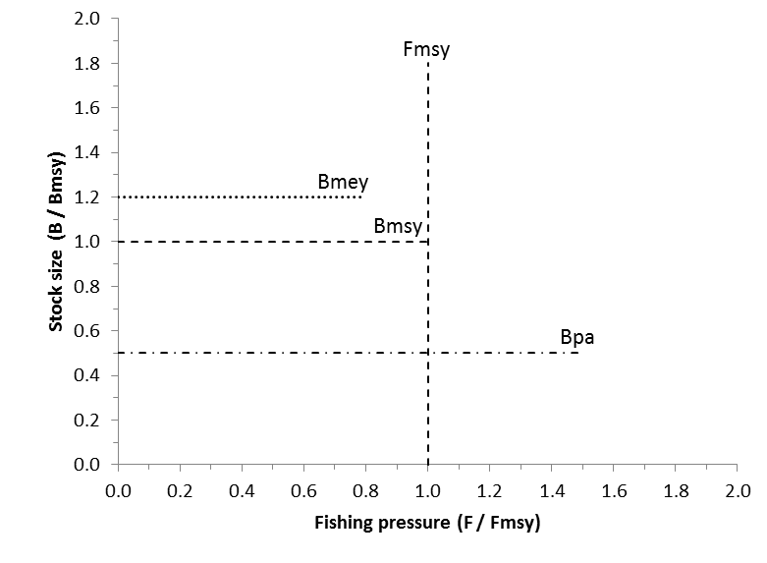
The MSY Framework

Slide 13
The MSY Framework
High biomass
High profit
High catch
Overfishing
CFP 2013
Recovering
Outside safe biological limits

Slide 14
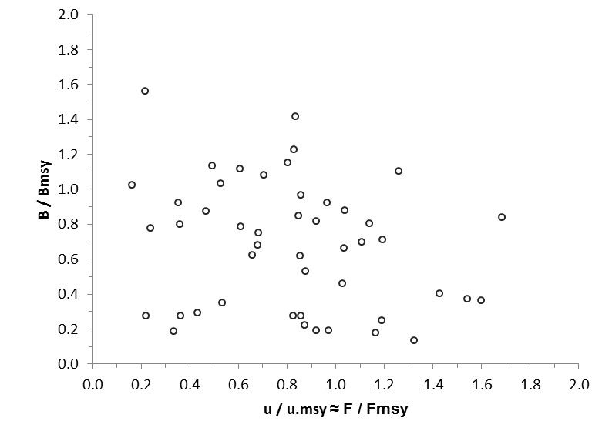
Northeast Atlantic Stocks in 2013
◄ Council Decision on TAC ►
◄ F & Reproduction & Growth ►
Analysis of 47 stocks of the Northeast Atlantic with a Bayesian state-space production model, Froese et al., submitted

Slide 15
Three Simple Rules
Excerpts from a paper in Fish&Fisheries
Three simple rules for EBFM
Take less than nature ( F < M )
Keep populations above half natural size (B > 0.5 B₀)
Minimize impact of catch (L_{mean} = L_{opt})
Such fishing shall result in
Large stocks & large fish & healthy ecosystems
High catches & low cost & good profits
Froese et al. 2016 Minimizing the impact of fishing

Slide 16
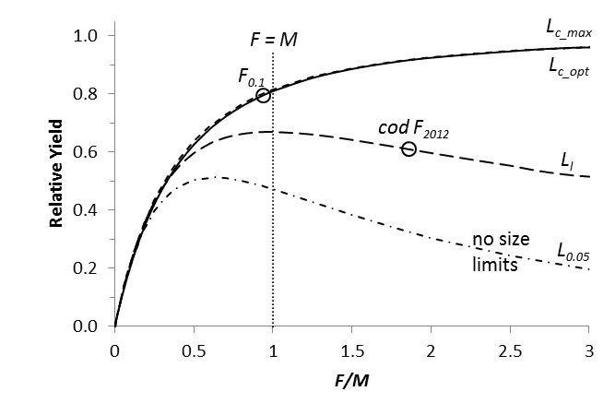
Catch as a Function of Fishing Pressure (F/M)
Yield relative to maximum possible yield per recruit, as a function of the F/M ratio and
different lengths at first capture. The bold curve indicates optimum size selection, the lowest
curve indicates no size selection. Froese et al. 2016

Slide 17
Stock Size Larger than Half of Unexploited
Ecosystem roles of stocks as prey and predator may be endangered if the stock is too small
Highest longterm yield is obtained at about half of unexploited stock size
But highest profits are obtained at about 20% larger stock sizes (default rule in Australia)

Slide 18
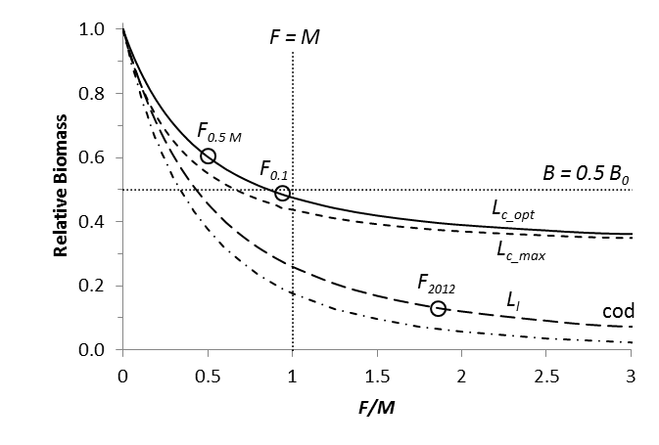
Biomass as a Function of F/M
Biomass relative to unexploited biomass, as a function of the F/M ratio and different lengths
at first capture. The bold curve indicates optimum size selection, the dot-dashed curve
indicates no size selection. Froese et al. 2016

Slide 19
Maximizing Profits of Fishers
Profit of fishers is the difference between the value of the catch and the cost of fishing
Cost of fishing is a function of the abundance of fish
Highest profits are obtained at about 1.2 B_{msy}
1.2 B_{msy} is therefore the target biomass level in Australia

Slide 20
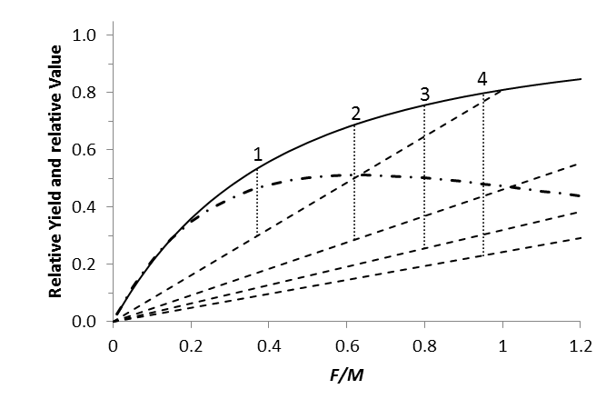
Catch and Profit as a Function of F/M
EC- Fisheries
Relative yield and value as a function of fishing pressure.
F/M < 0.83 results in B > 0.5 B₀. Froese et al. 2016

Slide 21
Size Matters: Let fish Grow and Spawn
L_{opt} is the mean length of parents in the absence of exploitation
For a given catch, fewer fish have to be killed if mean length in catch equals L_{opt}
For a given fishing pressure, highest catch is obtained if mean length in catch equals L_{opt}

Slide 22
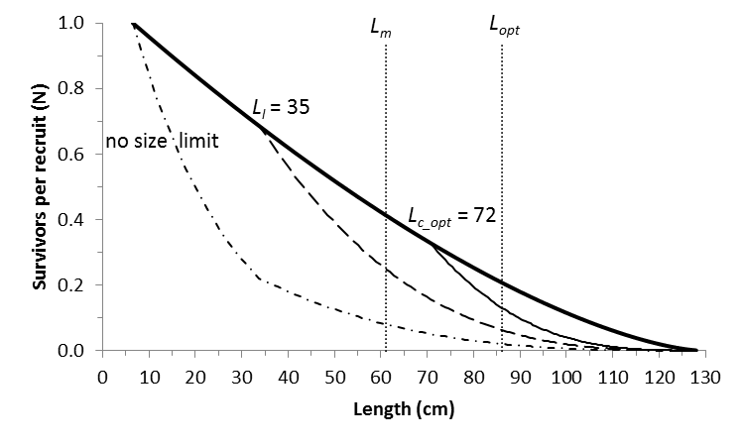
Impact of Fishing on Size Structure
The bold curve indicates no fishing. The three other curves indicate fishing with F=M,
but with fishing starting at different lengths. Life history data of North Sea cod. Long-term
catches are highest for L_{c_opt}

Slide 23
MSY Pitfalls & Failures
Using MSY or F_{msy} for all stocks
Forage fish such as anchovy, sprat, herring or sardines are the crucial link between lower and upper trophic levels in the food web
Forage fish transport energy from copepods to cods
Forage fish must therefore be fished less, e.g. with 0.5 MSY or 0.5 F_{msy}
Forage fish typically have the lowest ex-vessel price and are mostly used for animal feed; it makes more economic sense to direct fisheries towards human consumption

Slide 24
Main Pitfall:
The Ministers of Agriculture (Council), in charge of fisheries, are blocking the implementation of the CFP
Overfishing continued in many stocks in 2015 and 2016 and is likely to also continue in 2017

Slide 25
Summary
The CFP sets the correct goal of rebuilding stocks above levels that can produce MSY
Above B_{msy} is the area where high catches are obtained from large stocks at low cost of fishing
Above B_{msy} can only be achieved if F < F_{msy}
Forage fish must be fished less to maintain crucial ecosystem functions
To minimize the impact of fishing, minimum conservation reference size must be set such that fish can grow and reproduce before capture
The system has to be forced to implement its own laws

Slide 26
Thank You

