Slide 1
Three Simple Rules for Ecosystem-Based Fisheries Management
Rainer Froese
GEOMAR, Kiel, Germany
Presentation at the ICCAT workshop in Madrid, Spain, 9-11 June 2015
SCRS/P/2015/019

Slide 2
Overview
Excerpts from a paper submitted to FaF
Three simple rules for EBFM
Take less than nature ( F < M )
Keep populations above half natural size (B > 0.5 B₀)
Minimize impact of catch (L_{mean} = L_{opt})
Such fishing shall result in
Large stocks & large fish & healthy ecosystems
High catches & low cost & good profits
Implementation issues are discussed

Slide 3
Rule 1: F < M
Adult M is a good proxy for F_{msy}
F = 0.8 M is a good rule of thumb for regular fish
F = 0.5 M is a good rule of thumb for forage fish and data-limited stocks
With typical cost of fishing, F = 0.5 – 0.8 M gives close to highest possible profits

Slide 4
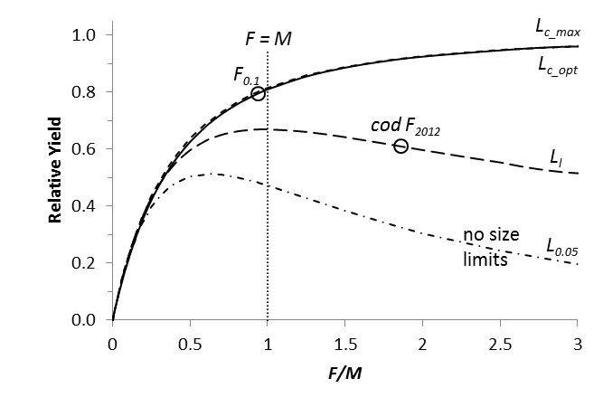
Catch as a function of F/M
Yield relative to maximum possible yield, as a function of the F/M ratio and different lengths
at first capture. The bold curve indicates optimum size selection, the lowest curve indicates
no size selection. Froese et al. submitted

Slide 5
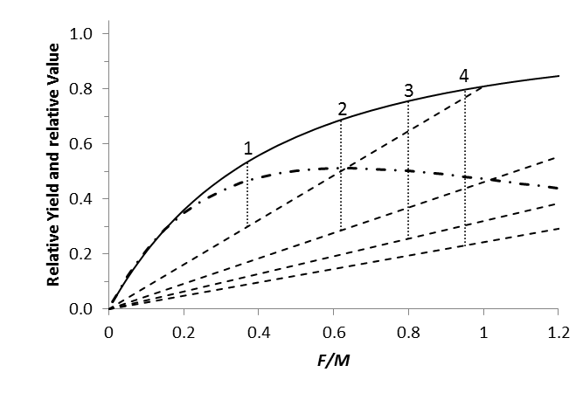
Catch and Profit as a Function of F/M
EC- Fisheries
Relative yield and value as a function of fishing pressure F/M. The vertical dotted lines
indicate the maximum profit for different cost of fishing (dashed lines). The bold curve
Indicates optimum size selection, the dot-dashed curve indicates no selection. Froese et al. sub.

Slide 6
Rule 2: B > 0.5 B₀
Ecosystem roles of stocks as prey and predator may be endangered below 0.5 B₀
Production models predict MSY at stock sizes between 0.37 (Fox) and 0.5 (Schaefer) B₀, but with similar absolute estimates of B_{msy}
MEY is obtained at about 20% larger stock sizes (default rule in Australia)

Slide 7
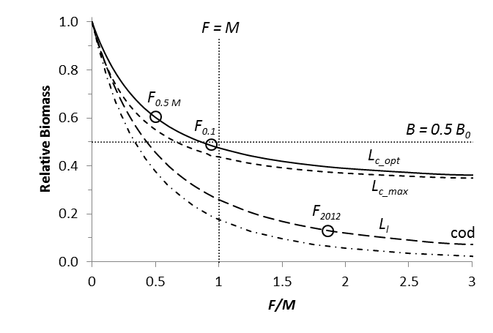
Biomass as a Function of F/M
Biomass relative to unexploited biomass, as a function of the F/M ratio and different lengths
at first capture. The bold curve indicates optimum size selection, the dot-dashed curve
indicates no size selection. Froese et al. submitted

Slide 8
Catch and Profit as a Function of F/M
EC- Fisheries
Relative yield and value as a function of fishing pressure.
F/M < 0.83 results in B > 0.5 B₀. Froese et al. submitted

Slide 9
Rule 3: L_{mean} = L_{opt}
L_{opt} is the mean length of fish at the peak in unexploited cohort biomass
For a given catch, fewer fish have to be killed if mean length in catch equals L_{opt}
For a given F, highest catch is obtained if mean length in catch equals L_{opt}
For unselective fishing above a certain length L_{c}, L_{c} = L_{c_opt} results in mean length = L_{opt}

Slide 10
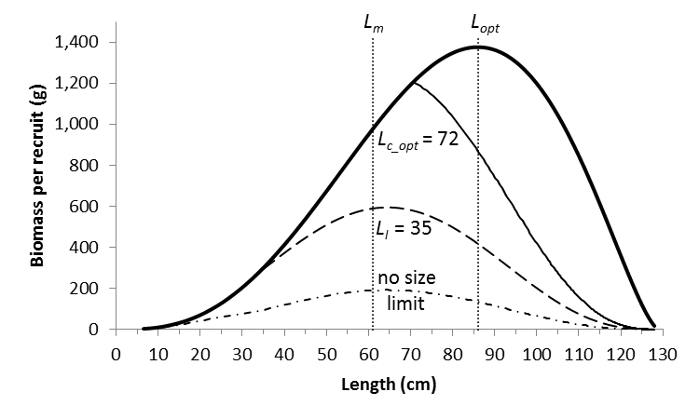
Impact of Fishing on Cohort Biomass
The bold curve indicates no fishing. The three other curves indicate fishing with F=M,
but with fishing starting at different lengths. Life history data of North Sea cod.

Slide 11
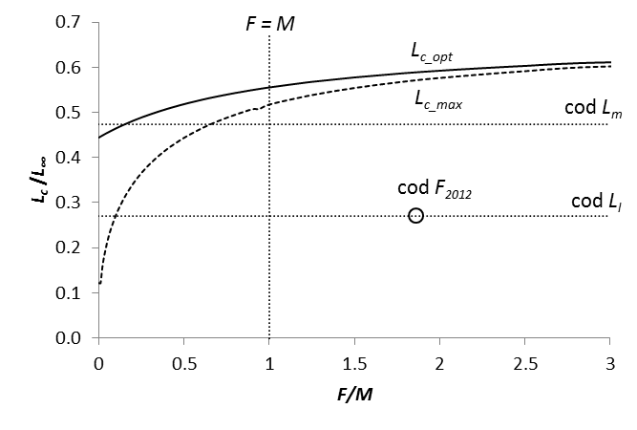
Lengths at First Capture as a Function of F/M
The dashed curve (L_{c_max}) results in the maximum yield per recruit and the solid
curve (L_{c_opt}) results in a mean length of L_{opt} in the catch.

Slide 12
Catch as a function of F/M
L_{c_max} and L_{c_opt} result in practically the same relative yield.

Slide 13
Biomass as a Function of F/M
L_{c_opt} results in higher biomass than L_{c_max.}

Slide 14
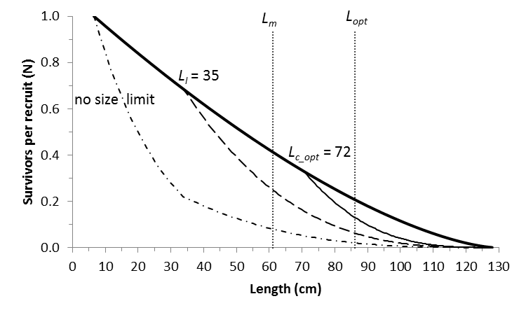
Impact of Fishing on Size Structure
The bold curve indicates no fishing. The three other curves indicate fishing with F=M,
but with fishing starting at different lengths. Life history data of North Sea cod. Long-term
catches are highest for L_{c_opt}

Slide 15
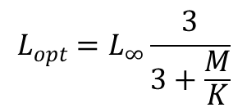
28 Equations…
$$L_{mean}=L_{∞}\left\{1−\frac{F/M+1}{F/M+1+\frac{1}{M/K}}\left(1−\frac{L_{c}}{L_{∞}}\right)\right\}$$
$$L_{opt}=L_{∞}\frac{3}{3+\frac{M}{K}}$$
Setting L_{mean} = L_{opt} and solving for L_{c} gives L_{c_opt}
$$L_{c_opt}=L_{∞}\frac{2+3 F/M}{(1+F/M)(3+M/K)}$$
A number of “forgotten” equations were simplified with ratios (Froese et al. submitted)
$$\frac{Y^{′}}{R}= \frac{F/M}{1+F/M} {(1−L_{c}/L_{∞})}^{M/K} \left(1−\frac{3\left(1−L_{c}/L_{∞}\right)}{1+ \frac{1}{M/{K(1}+F/M)}}+\frac{3{\left(1−L_{c}/L_{∞}\right)}^{2}}{1+ \frac{2}{M/{K(1}+F/M)}} −\frac{{\left(1−L_{c}/L_{∞}\right)}^{3}}{1+ \frac{3}{M/{K(1}+F/M)}} \right)$$

Slide 16
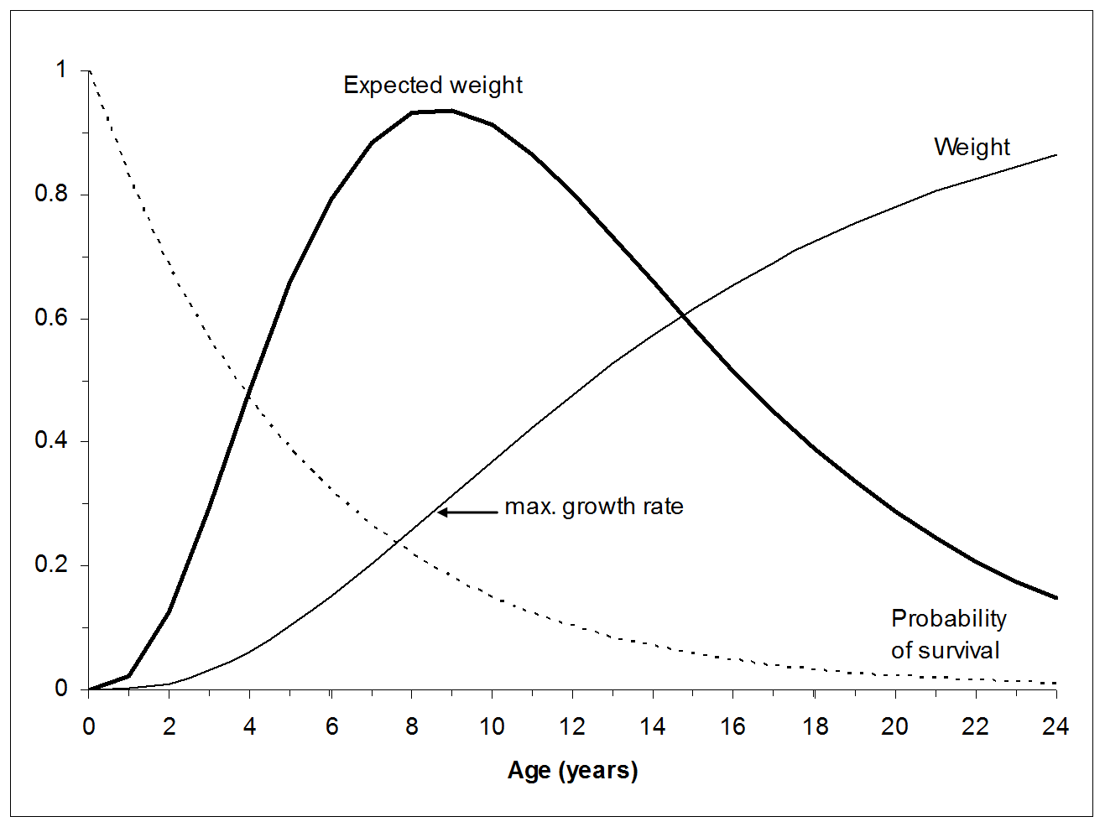
Implementation Issues: M/K
M/K < 1.5
Peak right and higher,
but generation time longer
M/K > 1.5
Peak left
and smaller
M/K 1.5

Slide 17
Implementation Issues: M/K
High M/K moves peak in cohort biomass to small size=low fecundity and short generation time
Low M/K moves peak to large size=high fecundity and long generation time
M/K = 1.5 lets peak in cohort biomass coincide with peak in growth, thus minimizing the cost of reproduction
Impact of M/K on yield prediction is moderate

Slide 18
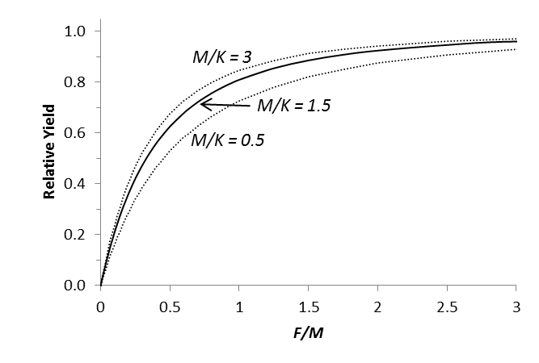
Impact of M/K on Yield
Extreme M/K ratios are 0.5 and 3.0. M/K impact on yield predictions is moderate.

Slide 19
If M/K = 1.5 …
$L_{opt}=0.67 L_{∞}$ -> 2/3 $L_{max}$
$$\frac{L_{c_opt}}{L_{∞}}=\frac{4+6 F/M}{9+9 F/M}$$
$\frac{L_{c_opt}}{L_{∞}}=0.5$2 – 0.55
If F/M = 0.5 – 1.0 then
Many equations and data requirements simplify considerably if M/K = 1.5

Slide 20
Data-Rich Implementation
In fully assessed stocks
F/M is known, F/F_{msy} is already used for management, F/M ≈ F/F_{msy}
B/B_{lim} or B/B_{msy} or B/B₀ are known; B_{msy} ≈ 3 B_{lim}
Mean length in catch and growth parameters are known, so L_{opt} and L_{c_opt} can be estimated
Setting and monitoring management targets e.g. F/M = 0.8, B/B_{msy} = 1.2, L_{mean} = L_{opt} should be no problem

Slide 21
Data-Limited Implementation
If reliable catch data are available, try e.g. CMSY to get u/u_{msy} and B/B_{msy} and proceed as above
Else
Use L_{opt} = 2/3 L_{max}
Use L_{c_opt} = 1/2 L_{max}
Use M = 1.5 K
Use suitable restrictions to ensure that less than 100 * M percent of large fish are taken
Use L_{mean} / L_{opt} ratio to monitor stock status
If L_{mean} = L_{opt} , F >> M can not crash the stock

Slide 22
Biomass as a Function of F/M
With L_{c} = L_{c_opt} and thus L_{mean} = L_{opt} , even very high F/M does not crash the stock.
Conversely, no size limit (dash-dotted curve) crashes the stock if F > M.

Slide 23
Reality Check
http://www.asmfc.org/uploads/file/529e5ceb2013StripedBassBenchmarkStockAssessment_57SAWReport.pdf
Striped bass (Morone saxatilis) catch-at age 1980-2012. In 1990, a minimum size limit of 71 cm
(~ ½ L_{max}) was introduced and F was restricted to F <= M = 0.25. Age-groups 6-13 recovered.
Recent catches are about 3 times higher than before 1990. 57th SAW Assessment Report.

Slide 24
Conclusions
Single-stock assessments are not “isolated” but represent current best knowledge about an exploited population, linked to its ecosystem by recruitment, growth and mortality
Effective EBFM can be simple: Don’t take more than nature, maintain sufficient stock sizes, let them grow and reproduce before capture

