Slide 1
Principles of life in the Newton/Einstein Universe
Rainer Froese
GEOMAR
GEOMAR EV Lunch Seminar 12th April 2021

Slide 2
Diversity or Monotony?
While most pepole are amazed by the diversity of life,
some are amazed by the lack thereof:
Very simple rules with ‘life-history constants’ determine allometry, somatic growth, population growth, maturation, fecundity, longevity, mortality, and many other traits

Slide 3
The physical World sets the Frame in which Evolution operates
Key physical constraints are:
Concentrations of metabolic gases (e.g. O₂, CO₂)
Temperature
Pressure
Gravity

Slide 4
Key Geometric Constraints
Different scaling between length (L=V ^{1/3}), area (A=V ^{2/3}) and mass or volume (V ^{1/1})
Life depends on the constant exchange of gas, nutrients and heat
These exchanges service a volume but have to pass through dedicated areas
While an organism, organ or appendage grows, length and area grow less than body mass: if a cube grows e.g. from 1 g, 1 cm and 6 cm² to 1000 * 1 g = 1 kg, the new area is only 100 * 1 cm² = 100 cm² and the new length is only 10 * 1 = 10 cm.

Slide 5
Key Geometric Constraints
The overall decrease in metabolic rate with increase in body mass, typically scaling with 0.75, is caused by a combination of constraints such as relative shrinking in relevant surface areas, increase in distances, relative shrinking in diameters of transportation tubes, etc.
The diameter of bones grows less than body weight (as Gallileo already pointed out)
For a certain adult body plan to be optimized for a certain physical environment (gravity, pressure, temperature, gas concentration,..), relevant design components that grow slower than body mass have to be larger in juveniles than in adults (larger eyes, heads, ...)
Alternatively, body proportions and thus body shape have to change constantly during growth

Slide 6
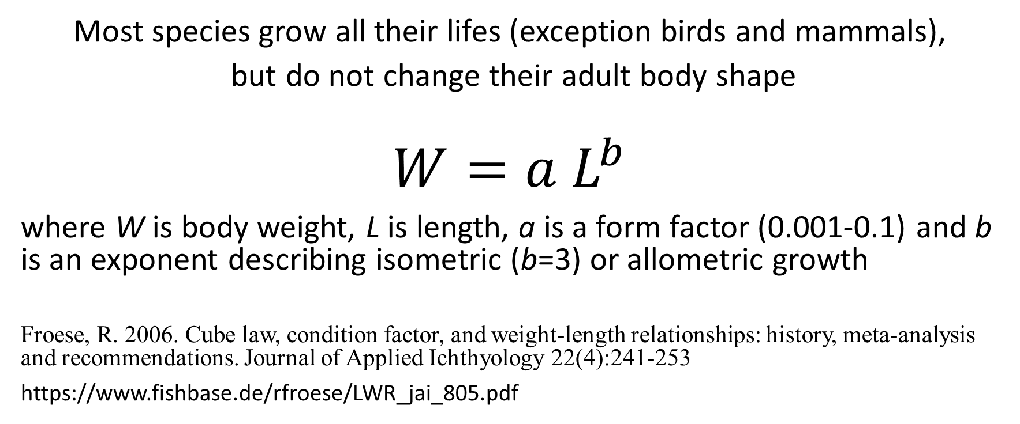
Allometry
Most species grow all their lifes (exception birds and mammals),
but do not change their adult body shape
$$W=a L^{b}$$
where W is body weight, L is length, a is a form factor (0.001-0.1) and b is an exponent describing isometric (b=3) or allometric growth
Froese, R. 2006. Cube law, condition factor, and weight-length relationships: history, meta-analysis and recommendations. Journal of Applied Ichthyology 22(4):241-253
https://www.fishbase.de/rfroese/LWR_jai_805.pdf

Slide 9
Growth in Body Weight for
Trees, Bivalves, Squids, Shrimps, Fish, and Newts

Slide 10
von Bertalanffy Growth
Von Bertalanffy’s (1934) Growth Function (VBGF)
dW/dt = H * W_{t} ^{2/3} – B * W_{t}
where W = body weight, H W^{2/3}= total available energy (metabolism),
B W = energy needed for processes other than growth, t = age,
dW/dt = growth rate at age t = energy available for growth at age t
Solving the differential equation results in
W_{t} = W_{inf} (1 – e^{-K * t})³
L_{t} = L_{inf} (1 - e^{-K * t})
where W_{inf} and L_{inf} are asymptotic weight and length, and K describes how fast these are approached (the exponential decrease of the distance to L_{inf})

Slide 11
Maturation is predictable
While maximum fitness would be obtained by Darwinian Devils that start reproducing at birth and live forever, lifespan and max size are determined and determine maturation
Froese, R. and C. Binohlan 2000. Empirical relationships to estimate asymptotic length, length at first maturity and length at maximum yield per recruit in fishes, with a simple method to evaluate length frequency data. J. Fish Biol. 56:758-773.
https://www.fishbase.de/rfroese/EmpRelJFB.doc

Slide 12
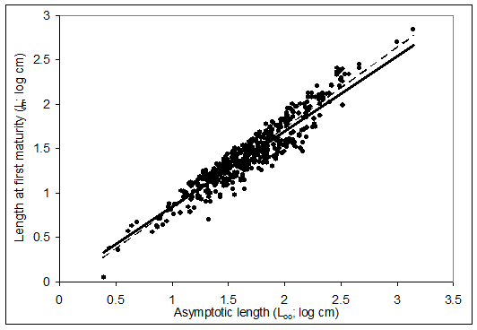
Fig 1. Relationship between length at first maturity and asymptotic length for all records representing 265 species of fish. Regression lines are for females (----) and males (-).

Slide 13
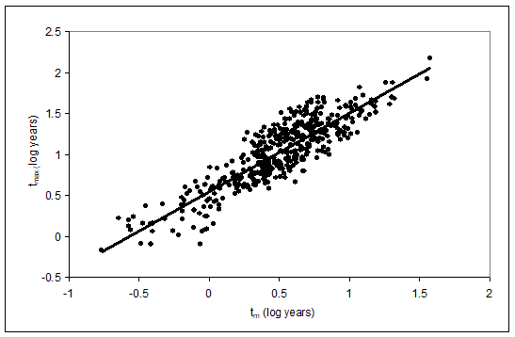
Fig. 4. Relationship between life-span (t_{max}) and length at first maturity (t_{m}).

Slide 14
Maturation Strategies
Evolution has ‘economized’ onset and duration of reproduction
Froese, R. and D. Pauly. 2013. Fish Stocks. Volume 3, p.477-487 In Simon Levin (ed.). Encyclopedia of biodiversity. Academic Press, 5504 p.
https://www.fishbase.de/rfroese/FishStocksNew_2.doc

Slide 15
Schematic representation of reproductive strategies in relation to probability of survival (red curve) and increase in body weight (green curve). The blue curve indicates the expected reproductive output. Strategy A represents single-spawners, such as salmon or eels. Strategy B represents multiple-spawners with parental investment, such as live-bearers, nesters or guarders. Strategy C represents highly-fecund nonguarders such as cods, sardines or tunas. The dotted horizontal lines indicate the necessary duration of the reproductive phase.

Slide 16
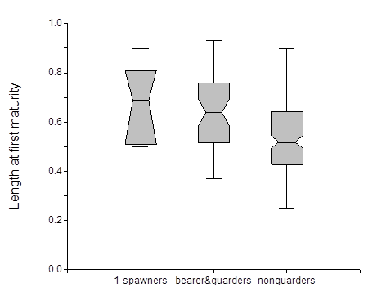
Figure 5. Length at first maturity relative to asymptotic length for species that spawn only once in their life time (1-spawners, 5 studies), bearers or guarders (49 studies), and nonguarders (178 studies). The horizontal lines within the boxes present the median and the notched area the 95% confidence limits. The boxes contain 50% of the data and the extended lines indicate the spread of the data. The difference between bearers & guarders and nonguarders is significant. Data from FishBase 06/2011

Slide 17
No Relation between High Fecundity and Population Growth
Only 1-10 replacement adults are produced per adult
Froese, R. and S. Luna. 2004. No Relationship between Fecundity and Annual Reproductive Rate in Bony Fish. Acta Ichthyologica et Piscatoria 34(1):11-20
https://www.fishbase.de/rfroese/NoFecundRel.pdf

Slide 19
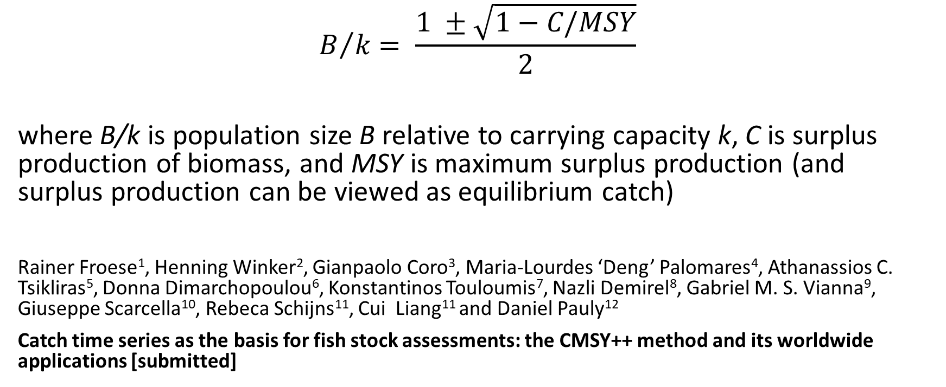
Principles of population growth
$$B/k= \frac{1 ±\sqrt{1−C/MSY}}{2}$$
where B/k is population size B relative to carrying capacity k, C is surplus production of biomass, and MSY is maximum surplus production (and surplus production can be viewed as equilibrium catch)
Rainer Froese¹, Henning Winker², Gianpaolo Coro³, Maria-Lourdes ‘Deng’ Palomares⁴, Athanassios C. Tsikliras⁵, Donna Dimarchopoulou⁶, Konstantinos Touloumis⁷, Nazli Demirel⁸, Gabriel M. S. Vianna⁹, Giuseppe Scarcella¹⁰, Rebeca Schijns¹¹, Cui Liang¹¹ and Daniel Pauly¹²
Catch time series as the basis for fish stock assessments: the CMSY++ method and its worldwide applications [submitted]

Slide 20
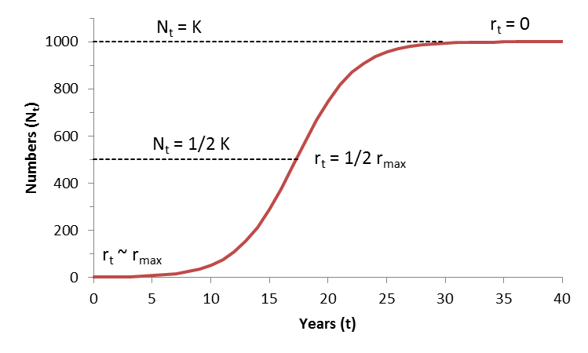
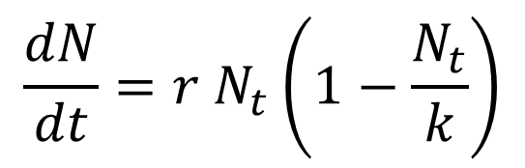
Logistic Curve Properties
$$\frac{dN}{dt}=r N_{t}\left(1−\frac{N_{t}}{k}\right)$$
BioDivPopGrowthMSY.xls

Slide 21
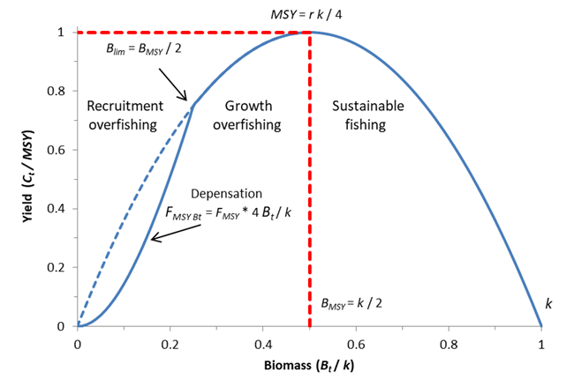
Figure 2. Schematic representation of the surplus production model used by CMSY, with indication of depensation, where FMSY is reduced linearly with decline in biomass

Slide 22
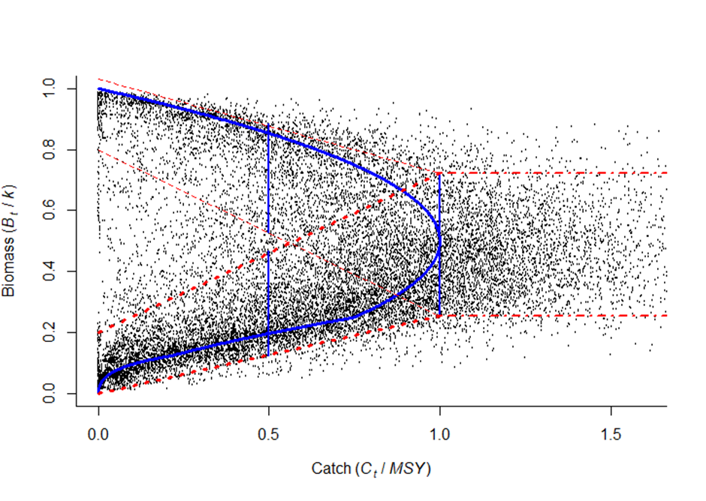
Figure 4. Scatterplot of relative biomass (Bt/k) over relative catch (Ct/MSY), with 18,341 points for 400 stocks. The blue curve is the equilibrium prediction from Equation (4). The vertical blue lines indicate the range that contains 90% of the (Bt/k) points for the respective catch (Ct/MSY). The red dashed lines indicate approximate 95% confidence ranges for prior Bt/k predicted by Equation (5). For catches above MSY, the same prior distribution is assumed.

Slide 23
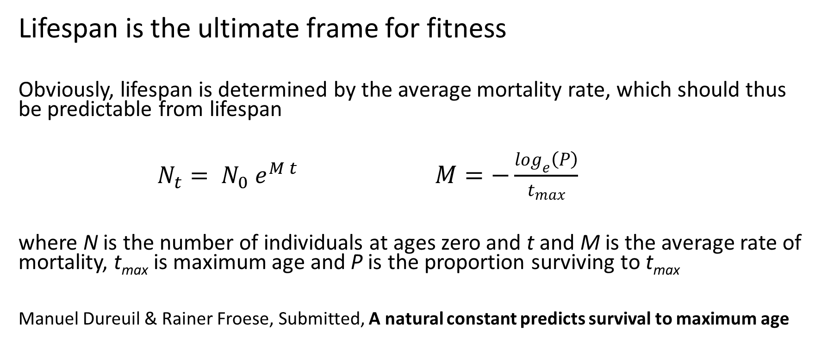
Death Rules..
Lifespan is the ultimate frame for fitness
Obviously, lifespan is determined by the average mortality rate, which should thus be predictable from lifespan
$N_{t}= N_{0} e^{M t}$ $M=−\frac{\log_{e}\left(P\right)}{t_{max}}$
where N is the number of individuals at ages zero and t and M is the average rate of mortality, t_{max} is maximum age and P is the proportion surviving to t_{max}
Manuel Dureuil & Rainer Froese, Submitted, A natural constant predicts survival to maximum age

Slide 24
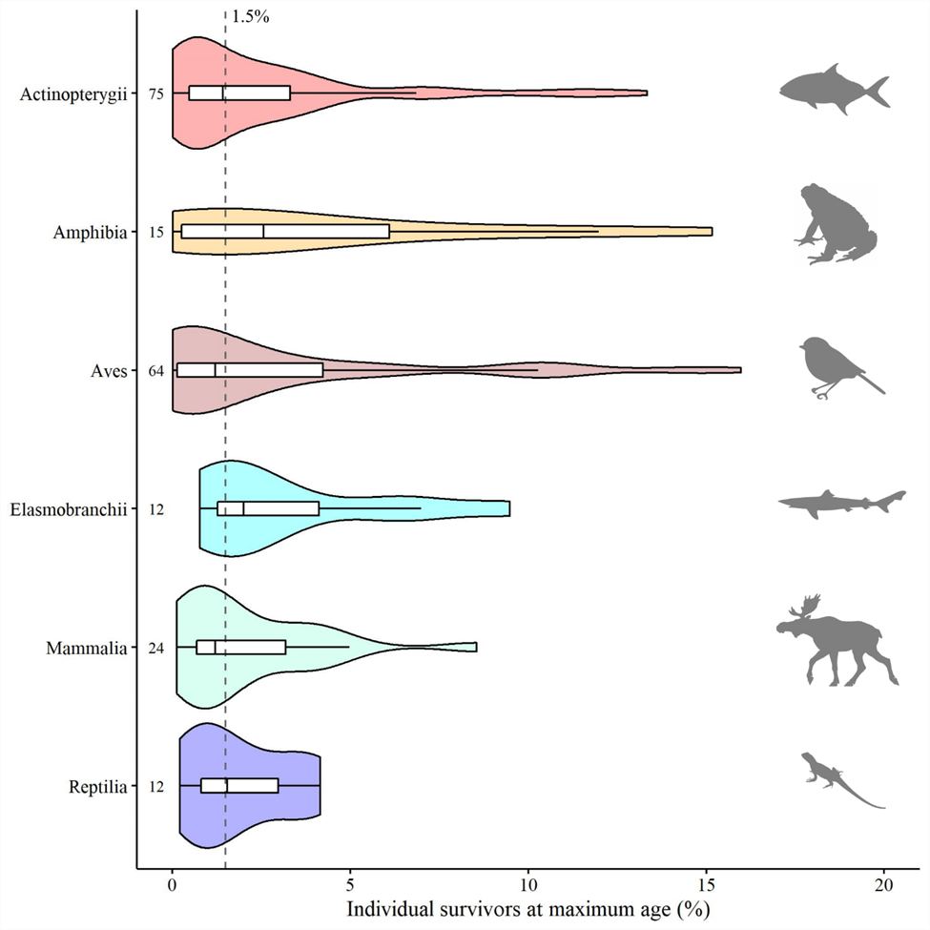
Figure 1 | Survival to maximum age in natural populations of vertebrates. The median survival to average maximum age in a cohort is shown per vertebrate class as a vertical solid line within each boxplot, the 25th and 75th percentiles are the lower and upper bound of the boxes, respectively. Violin plots indicate the density distribution of the data points, the numbers refer to the sample size (number of species) per vertebrate class. The dashed vertical line indicates the median survivorship from birth to average maximum age across all vertebrate classes, at 1.5%

Slide 25
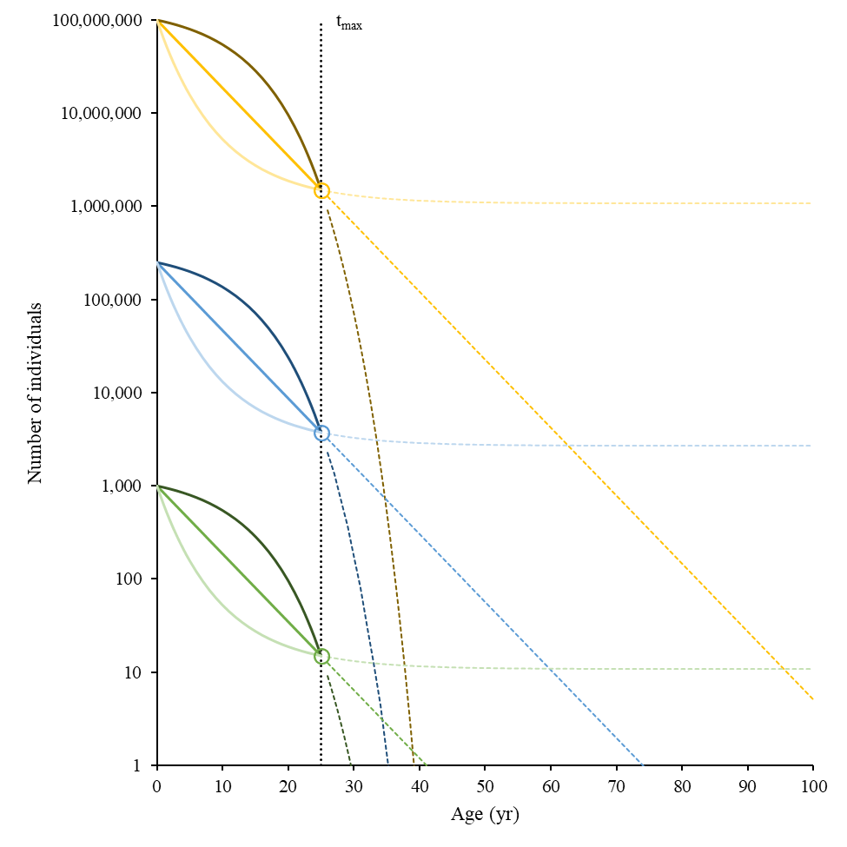
Figure 2 | The number of survivors to a certain age under different survivorship patterns and initial cohort (or sample) sizes. Individual survivors to a maximum age tmax of 25 years (black dotted vertical line) representing 1.5% of the initial numbers (P = 0.015, open circles). Shown are scenarios for constant mortality, mortality increasing with age (dark colours) and mortality decreasing with age (light colours). The coloured dotted lines show the expected trajectory of these scenarios from 1.5% survivorship until the theoretical maximum age reached by 1 individual.

Slide 26
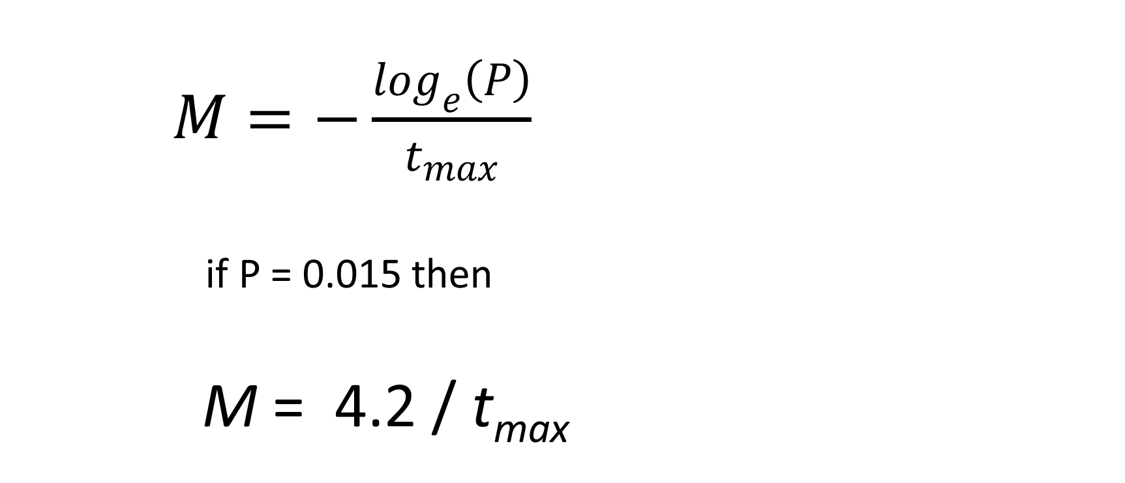
The Answer to the Ultimate Question of Life, the Universe, and Everything is 4.2
$M=−\frac{\log_{e}\left(P\right)}{t_{max}}$
if P = 0.015 then
M = 4.2 / t_{max}

Slide 27
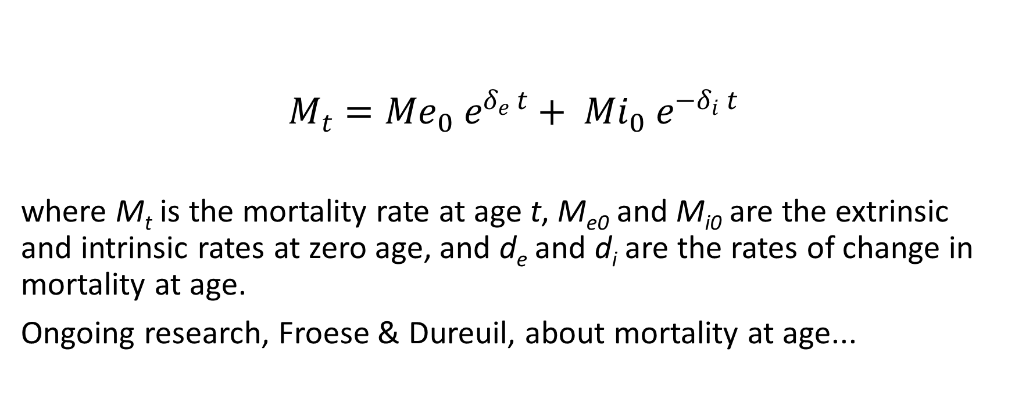
What Goes Down
Must Come Up
$$M_{t}={Me}_{0} e^{δ_{e} t}+ {Mi}_{0} e^{−δ_{i} t}$$
where M_{t} is the mortality rate at age t, M_{e0} and M_{i0} are the extrinsic and intrinsic rates at zero age, and d_{e} and d_{i} are the rates of change in mortality at age.
Ongoing research, Froese & Dureuil, about mortality at age...

Slide 28
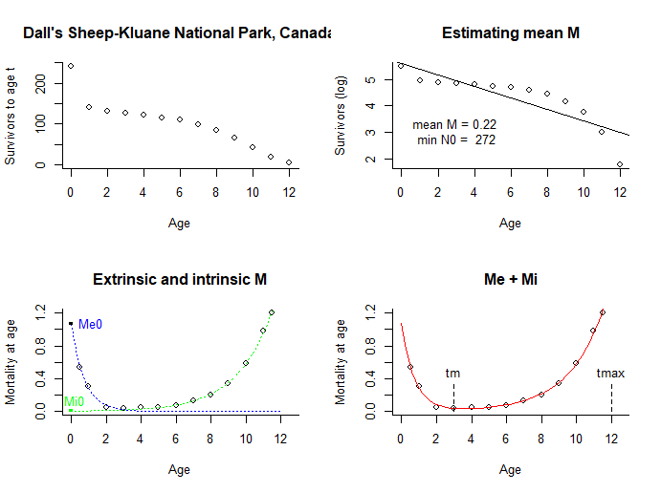

Slide 29
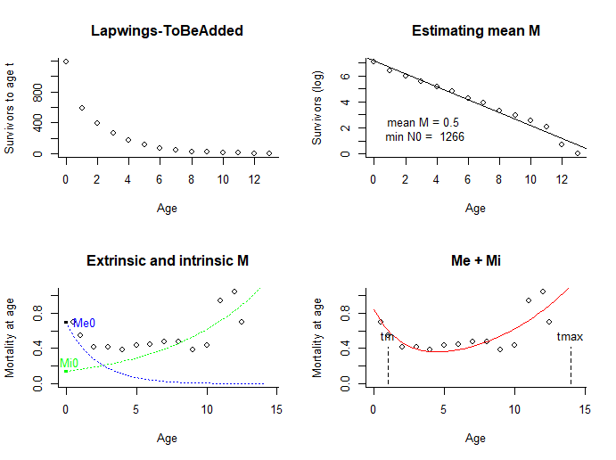

Slide 30
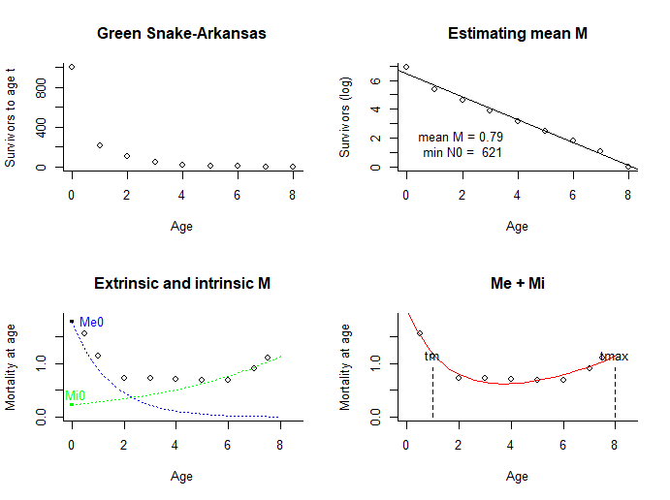

Slide 31
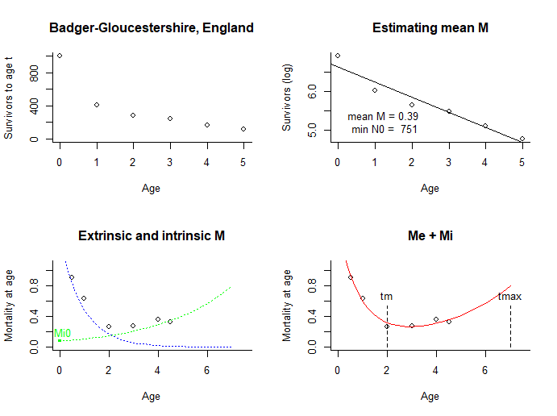

Slide 32
Thank You

