Slide 1
Two Promising Methods for Assessment of Data-Poor Stocks
Rainer Froese, GEOMAR, Germany
Daniel Pauly, FC-UBC, Canada
9 November 2014, San Francisco, USA

Slide 2
The Challenge
Globally, about ¾ of exploited fish stocks are not “fully assessed”, i.e., stock status is unknown
This is also true for developed areas, such as Europe or USA
Two new approaches are presented which provide reasonable proxies for stock status

Slide 3
The Catch-MSY Method
This method gives robust estimates of the maximum sustainable yield (MSY)
It also gives (biased) estimates of productivity and stock size
Despite the known bias, these stock status estimates were better than other methods (outcome of simulations by FAO workshop)

Slide 4
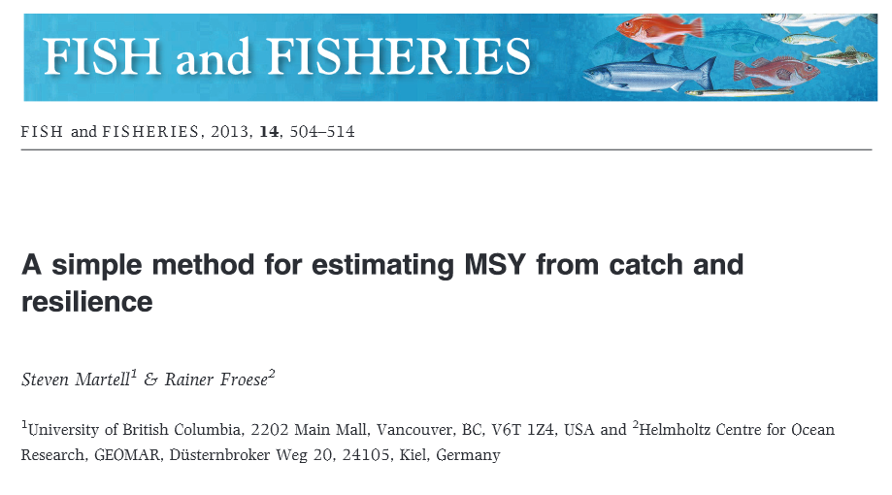
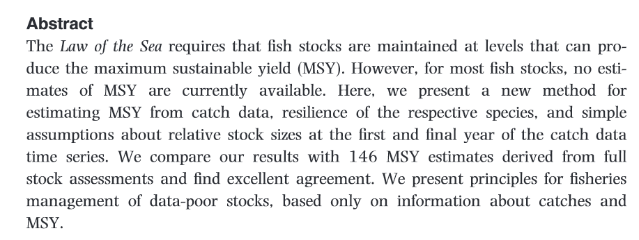

Slide 5
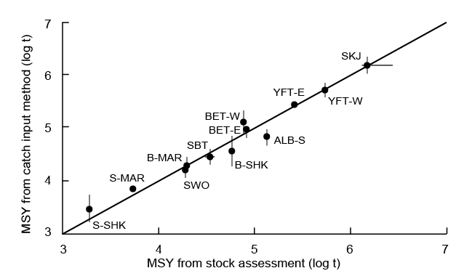
Daniel just added one slide: one my students used this method…
Notes:
Pacific tuna and shark stocks whose MSY was estimates using complex and data-hungry stock assessments (X-axis) and using the catch-MSY methods (from FishBase); from Schiller and Pauly (in prep.)

Slide 6
First New Method: CMSY
CMSY is a further development of Catch-MSY
CMSY overcomes the bias and gives reasonable estimates of F_{msy} and B_{msy}
Simulation testing and evaluation of CMSY has been done, submission planned for December
Recent ICES workshop (WKLIFE IV) applied CMSY successfully to several data-limited stocks

Slide 7
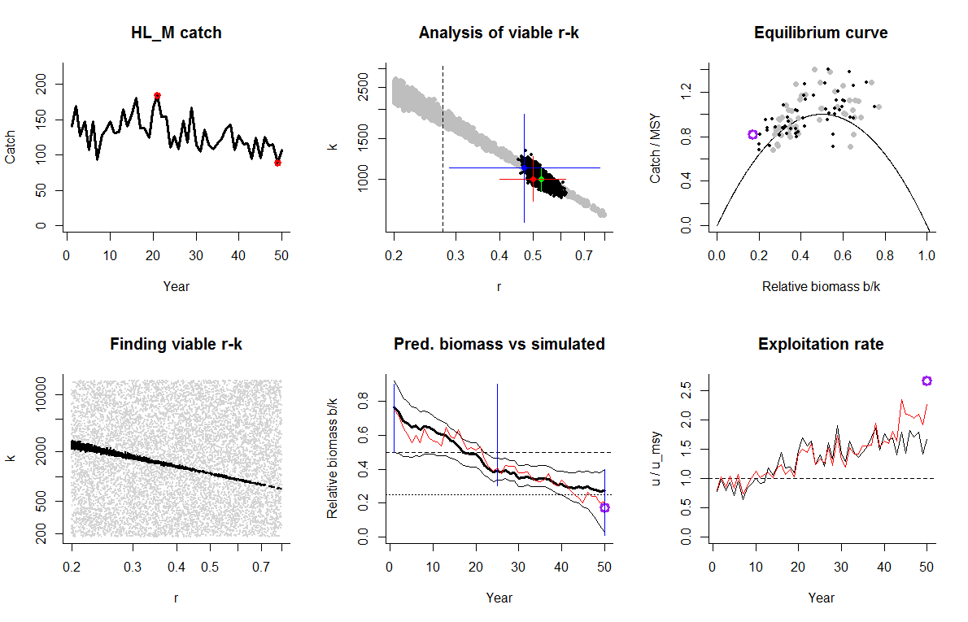
CMSY Simulation testing I
Simulated high to low biomass, for a species with medium resilience
Notes:
The upper left panel shows the time series of simulated catches of a species with medium resilience. These catches resulted in a high-to-low “true” simulated biomass (red line in lower mid panel). Lower left panel shows range of productivity values (r on X-axis) and maximum stock sizes (k on Y-axis) that were tested for compatibility with the catches. Only r-k pairs resulting in biomass trajectories that did not overshoot carrying capacity nor crash the stock were considered viable and are represented by black dots. The upper middle panel shows the viable r-k pairs in grey. The red point represents the true r-k pair used in the simulations. The green dot shows the r-k pair resulting from fitting a full Schaefer model to catch and(!) biomass data. The blue dot shows the r-k pair resulting from fitting CMSY only to the catch data. The estimates are not significantly different. The bold black curve in the lower middle panel shows the biomass predicted by CMSY, in excellent agreement with the true biomass. The upper right panel shows the Schaefer equilibrium parabola. Points on the parabola mean that biomass will remain unchanged if catches remain unchanged. Points above the parabola mean that the stock will shrink. Points below allow it to grow. Black dots are from the full Schaefer, grey dots are from CMSY, the purple dot is observed last catch over precautionary (25th percentile) biomass predicted by CMSY. The lower right graph shows the exploitation history (catch / biomass) relative to the maximum sustainable value (dashed horizontal line). The red curve is the true history from the simulations, the black curve is the history predicted by CMSY, the purple dot is a precautionary prediction (catch over 25th percentile of biomass).

Slide 8
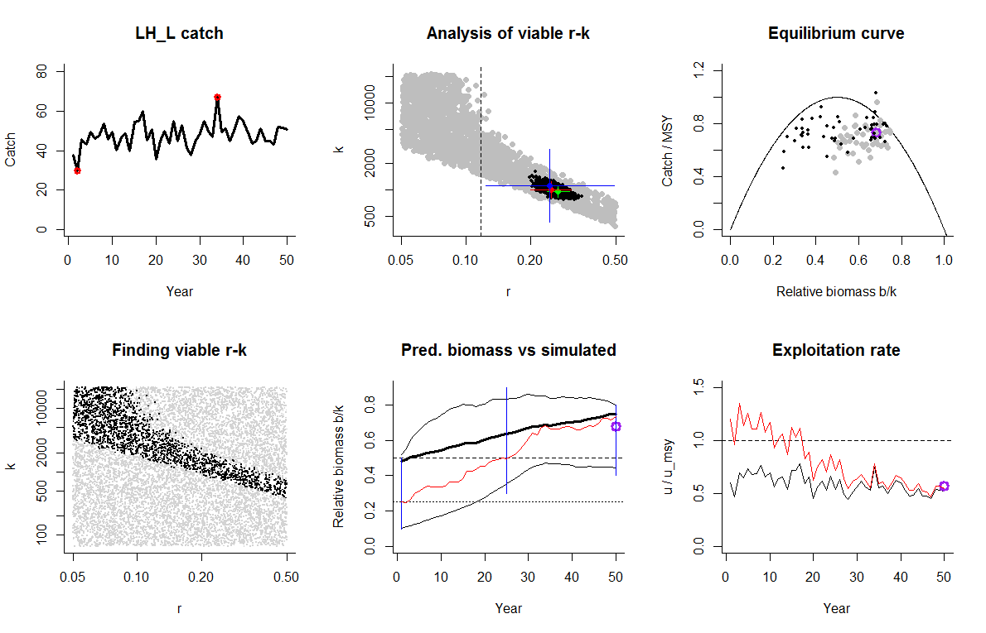
CMSY Simulation testing II
Simulated low to high biomass, for a species with low resilience
Notes:
Example of a simulated recovering stock with low resilience. Other data-poor methods (e.g. DCAC) can only deal with depletion, not with recovery, but CMSY handles the scenario reasonably well. Note that all points under the equilibrium curve are not indicative of a bad fit but of a recovering stock.

Slide 9
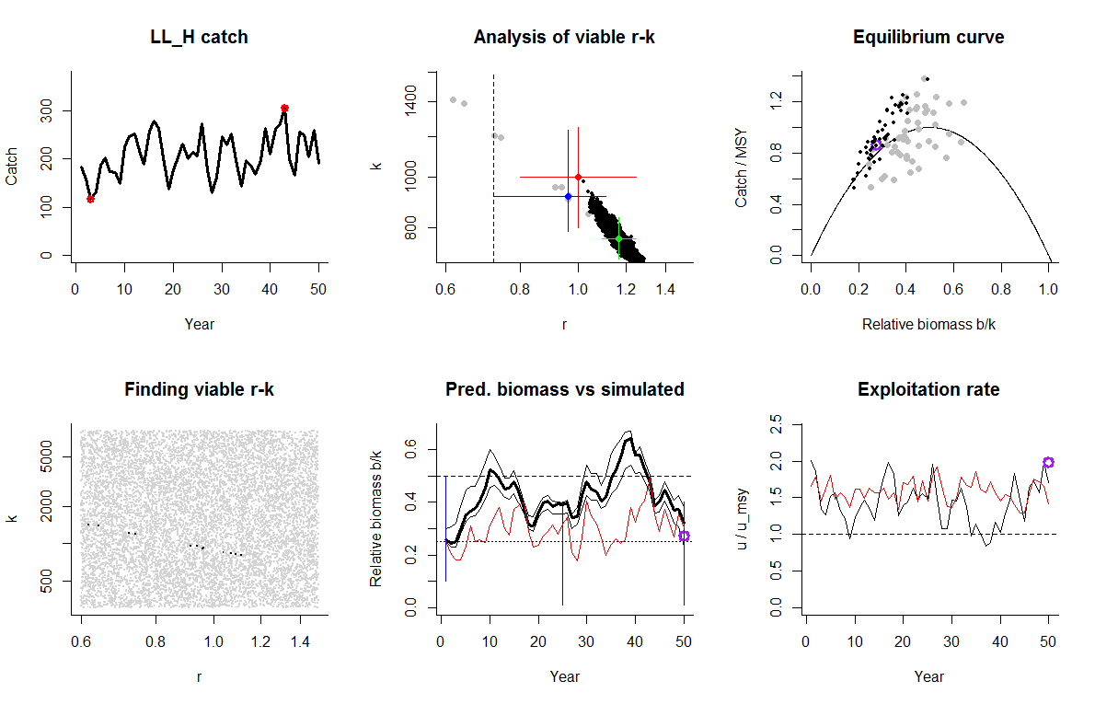
CMSY Simulation testing III
Simulated constant low biomass, for a species with high resilience
Notes:
Example of continued overfishing and low stock sizes around 20% of unexploited biomass. Other methods have difficulties if no depletion trend is visible in the data, but CMSY handles it reasonably well.

Slide 10
Preliminary Simulation Results
CMSY was tested against 24 simulated stocks where true r, k, MSY and biomass were known
CMSY included the true r-k within its 95% confidence limit in all cases
The final true biomass was in included in the 95 percentile range of CMSY in 23(96%) of the cases

Slide 11
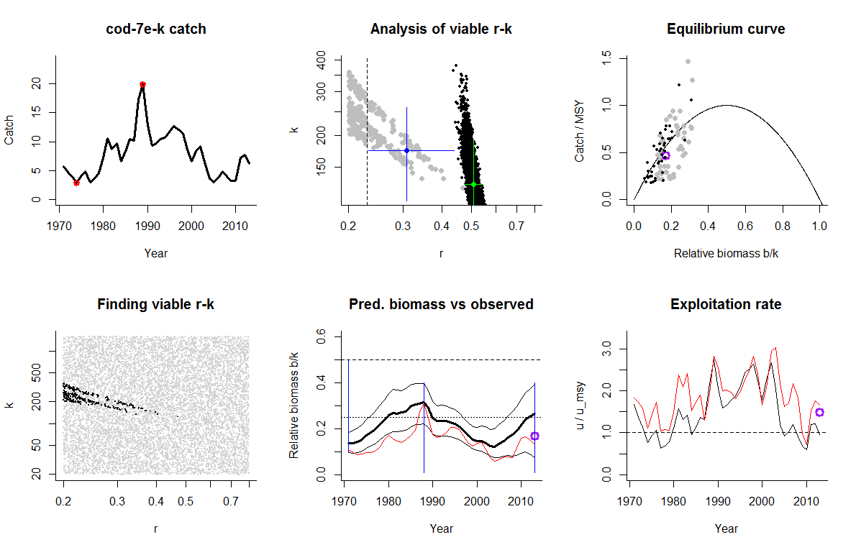
CMSY Evaluation I
Evaluation testing against full assessment data for Celtic Sea cod
Notes:
Here CMSY is tested against the results of full stock assessment for the severely overfished cod in the Celtic Sea. Predictions for biomass and exploitation agree very well with the results from full assessment.

Slide 12
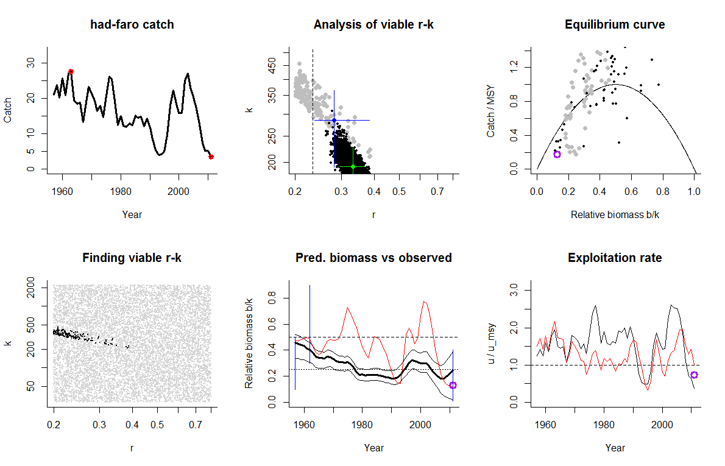
CMSY Evaluation II
Evaluation testing against full assessment data for Faroe Haddock
Notes:
This is an example for a declining stock.

Slide 13
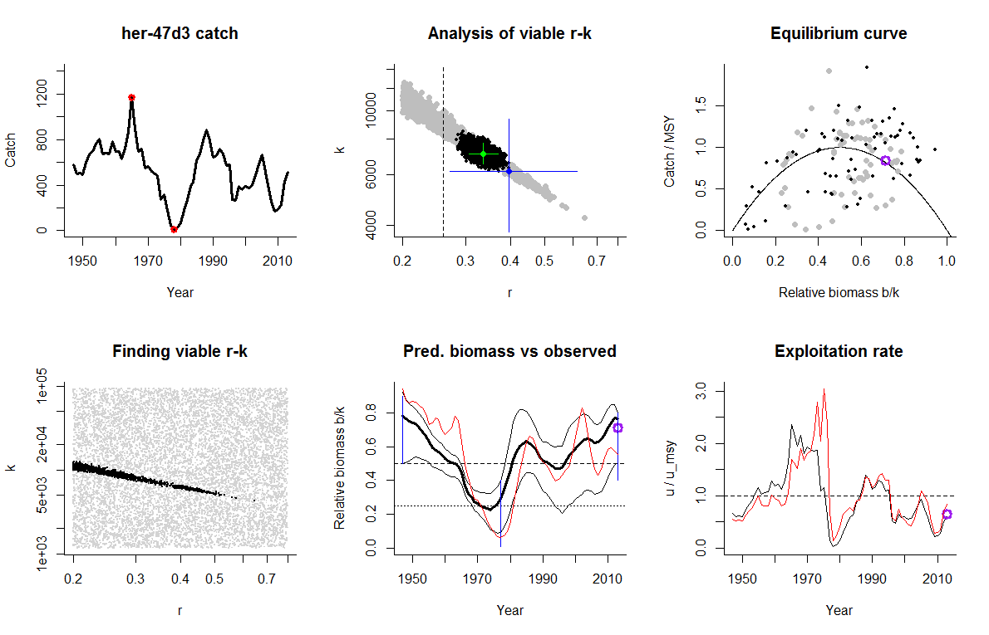
CMSY Evaluation III
Evaluation testing against full assessment data for North Sea herring
Notes:
This is an example for a stock that crashed in the 1970s and recovered thereafter. Note that the assumption of constant average productivity overestimates biomass in the 70s, when the stock size was so low that recruitment was reduced.

Slide 14
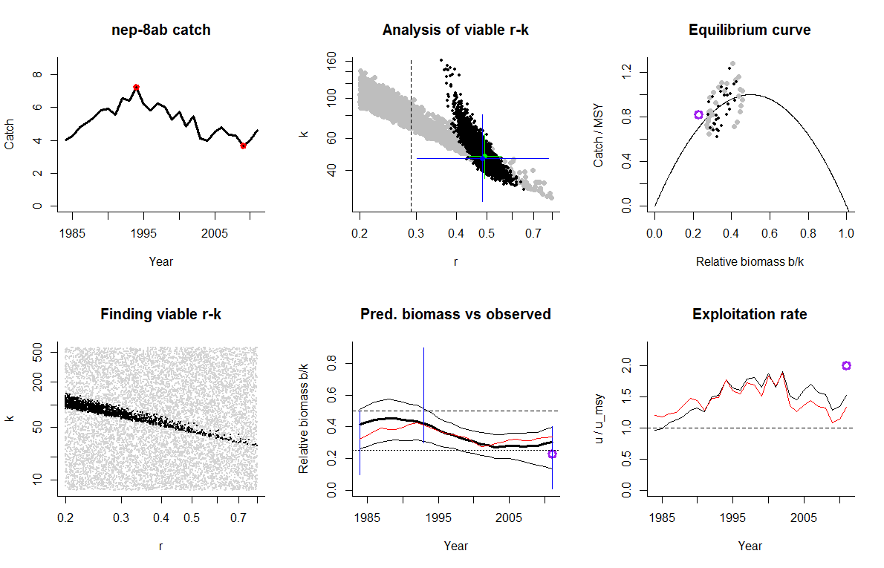
CMSY Evaluation IV
Evaluation testing against full assessment data for Norway lobster in the Bay of Biscay
Notes:
This is an example for application of CMSY to a non-fish stock, here Norway lobster.

Slide 15
Preliminary Results of the Evaluation
CMSY was tested on 114 fully assessed global stocks
95% Confidence limits of CMSY and the full Schaefer overlapped in 97% of the stocks
r and k of the full Schaefer were included in the CMSY estimates in 93% and 92% of the cases, respectively

Slide 16
CMSY Summary
Requires: catch or landings, resilience (e.g. from FishBase), broad stock status (good or bad)
Predicts: MSY, B_{msy}, F_{msy}, current biomass & exploitation. Note that relative predictions such as
B/B_{msy} are more robust than absolute values
Limitations: needs at least 10 years of data; assumes average productivity and is too optimistic if that assumption is not true, e.g. at very low stock sizes

Slide 17
Second New Method: hsCPUE
hockey-stick analysis of Catch-Per-Unit-of-Effort
CPUE data are split into juveniles and adults
Abundance of juveniles is plotted over that of their parents
A hockey-stick fit shows the point below which recruitment declines
Current stock status can be assessed relative to the hockey stick

Slide 18
Stock-Recruitment Plot with
Fisheries Reference Points
Notes:
Acronyms shown are those used in Europe. SSBlim is the break-point of a segmented regression fit to the S-R data. SSBpa is the upper confidence limit of SSBlim. SSBpa ~ 20% of unexploited biomass. Consequently, 2 * SSBpa can be used of a proxy for 40% of unexploited biomass, which is a proxy for Bmsy.

Slide 19
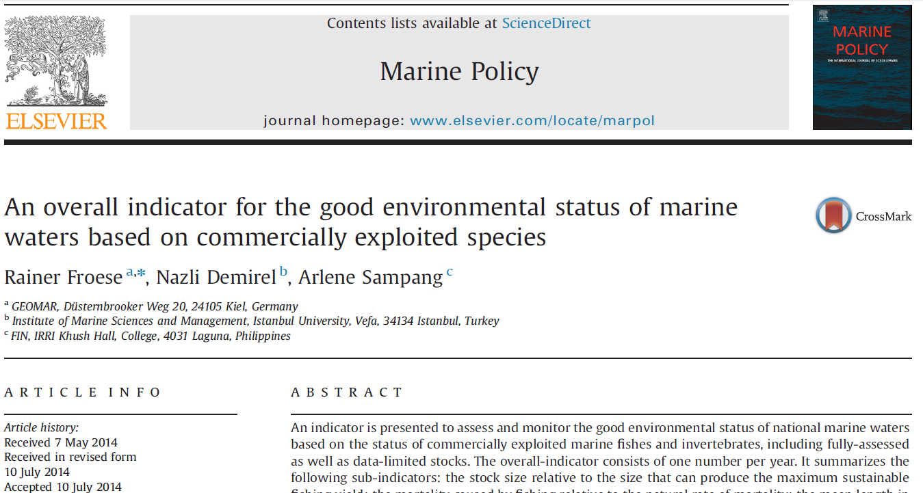
Proof of Concept
hsCPUE was applied to 12 data-limited stocks

Slide 20
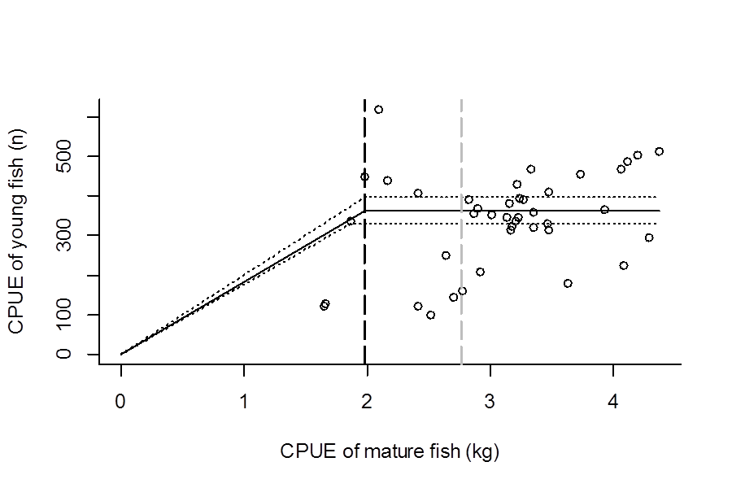
hsCPUE fit to data-poor North Sea dab

Slide 21
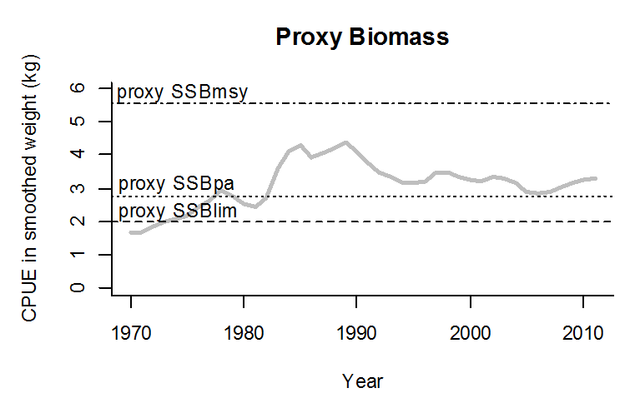
Adult CPUE of North Sea dab shown against hsCPUE reference points

Slide 22
hsCPUE Summary
Requires: size-structured CPUE (best from surveys
Predicts: stock size relative to reference points
Limitations: needs at least 10 years of data, including a range of stock sizes
Notes:
Note that this is one of the few methods that allows stock status evaluation without knowledge of catch or landings.

Slide 23
Thank You

