Slide 1
Managing Fisheries with a Ruler
Rainer Froese, GEOMAR
Q-Quatics Training Course, Los Baños, 28 November 2018

Slide 2
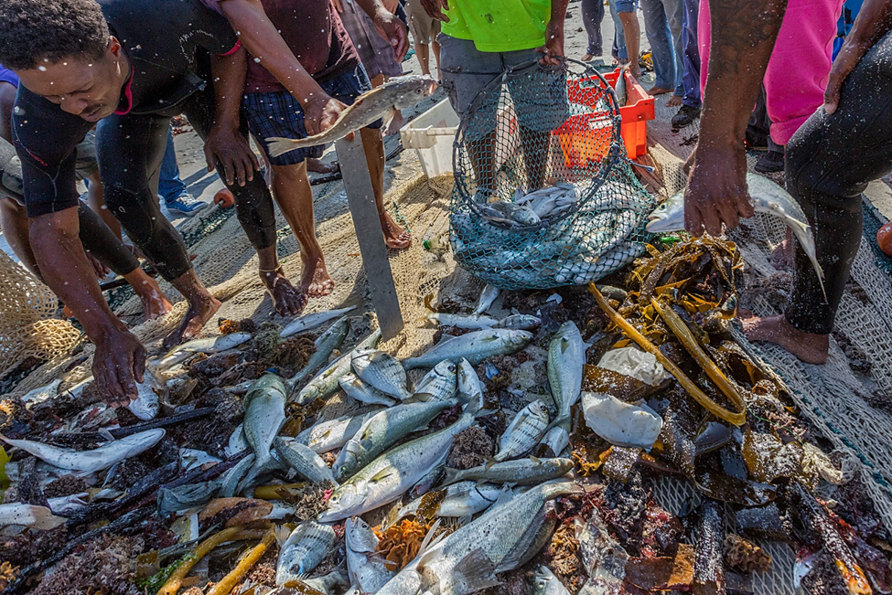
Notes:
Fishers sorting and measuring the catch of a beach-seine in False Bay, South Africa. Undersized fish are collected in a hoop-net for immediate release. Of 170 permits for such operations in the 1970s, only 4 remain today. Methods such as LBB can help in estimating the stock status of the four main species and in determining minimum landing sizes that reduce the impact of fishing on these stocks (Photographer: Robert Tarr).

Slide 3
Too many stocks, too few data
New legislation in Canada, US and Asia requires management of all exploited stocks
New and old simple approches are needed to get reasonable assessments with less time and data
New data-light but computation-heavy methods come to the rescue:
LBB: Length-based Bayesian Biomass Estimator
Froese, R., Winker, H., Coro, G., Demirel, N., Tsikliras, A.C., Dimarchopoulou, D., Scarcella, G., Probst, W.N., Dureuil, M. and D. Pauly. 2018. A new approach for estimating stock status from length frequency data. ICES Journal of Marine Science 2018, doi:10.1093/icesjms/fsy078)

Slide 4
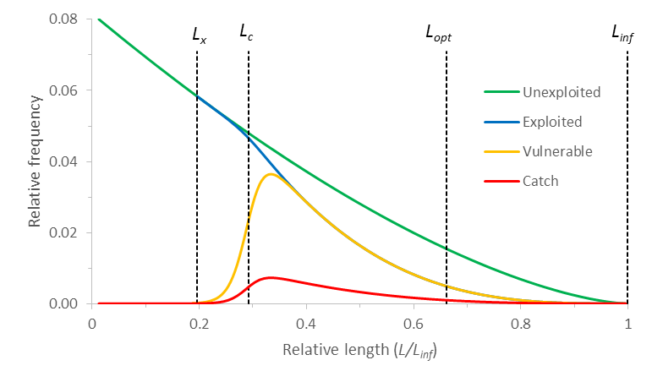
Conceptual Framework
?
Sim_23.xlsx
Notes:
Conceptual framework for the analysis of length frequency data from the commercial fishery, here modeled with life history traits of western Baltic cod (Gadus morhua). The green curve shows the decline in cohort numbers without fishing. The blue curve shows the decline with fishing, the yellow curve shows the fish vulnerable to the gear, and the red curve is the catch in numbers resulting from a certain fishing effort. The vertical dashed lines indicate the length (L_{x}) where fish become vulnerable to the gear, the length (L_{c}) where 50% of the individuals are retained by the gear, the length (L_{opt}) where the unexploited cohort would have maximum biomass, and the asymptotic length (L_{inf})

Slide 5
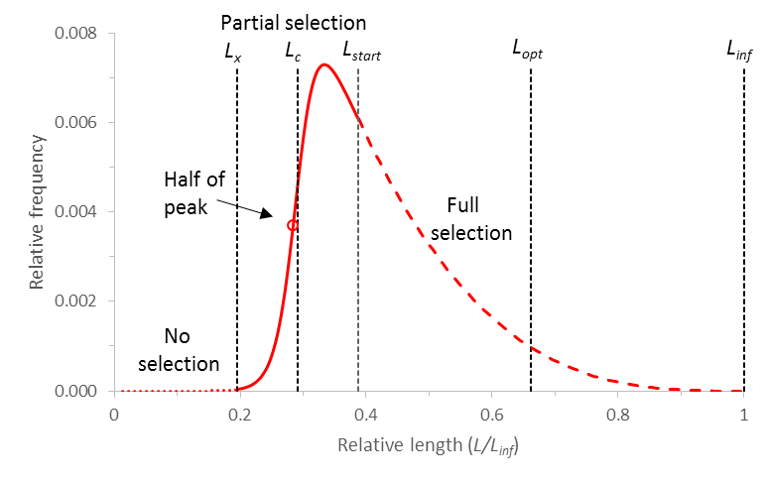
The Visible Length-Frequencies
Sim_23.xlsx
Notes:
Schematic representation of the length-frequency distribution in commercial catch, with indication of the sections that are subject to no gear selection (dotted red curve), partial gear selection (solid red curve), and full gear selection (dashed red curve). Note the difference between the length at half of the peak of the catch curve and the slightly larger true L_{c} used in the model [Sim_19.xlsx].

Slide 6

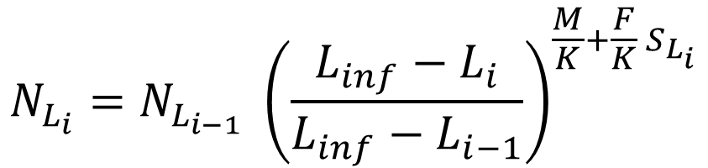
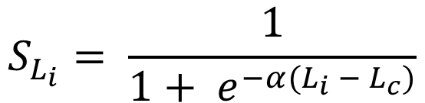
The LBB Equations
Gear-selectivity:
$$S_{L_{i}}= \frac{1}{1+ e^{−α(L_{i} − L_{c})}}$$
$$N_{L_{i}}=N_{L_{i−1}} {\left(\frac{L_{inf}−L_{i}}{L_{inf}−L_{i−1}}\right)}^{\frac{M}{K}+\frac{F}{K} S_{L_{i}}}$$
Survivors:
Vulnerable/
relative catch:
$C_{L_{i}}=N_{L_{i}}$ $S_{L_{i}}$
Using a Bayesian approach with priors derived from previous or aggregated LFs,
all parameters are estimated simultaneously.

Slide 7
Mortality Estimates Are Not Recent
Mortality estimates of LBB are of limited use for management, because they are not recent but the average of the exploited length (L_{x} to L_{inf}) and corresponding age range.

Slide 8
Standard Yield per Recruit Equation
Average growth and mortality parameters are
the required input for yield per recruit equations.
A combination of these standard equations then gives
the current biomass relative to unexploited biomass (B/B₀)

Slide 9
Optimum Length at First Capture L_{c_opt}
The length where cohort biomass is maximum in an unexploited population is given by Holt (1958) as:
This is also the length where cohort fecundity is about maximum and thus this is the natural average length of spawners.
Froese et al. (2016) present an equation for the length at first capture that will maximize catch and biomass for a given F and will result in L_{opt} being the mean length in the exploited population:

Slide 10
Proxy for B_{msy}
A proxy for the biomass that can produce the maximum sustainable yield can be calculated from standard equations by assuming that L_{c} = L_{c_opt} and F/M = 1.0
The relative biomass and the length at first capture estimated by LBB can then be used directly for management of data-poor stocks:
If relative stock size B/B₀ is smaller than B_{msy}/B₀, reduce catches
If length at first capture L_{c} is smaller than L_{c_opt}, start fishing at larger sizes.

Slide 11
Performance of LBB
LBB results for relative biomass or stock status have been validated against simulations and against real stocks
LBB predictions were not significantly different from the “true“ B/B₀ values of the simulations
LBB predictions for stock status were similar to those obtained from full stock assessments

Slide 12
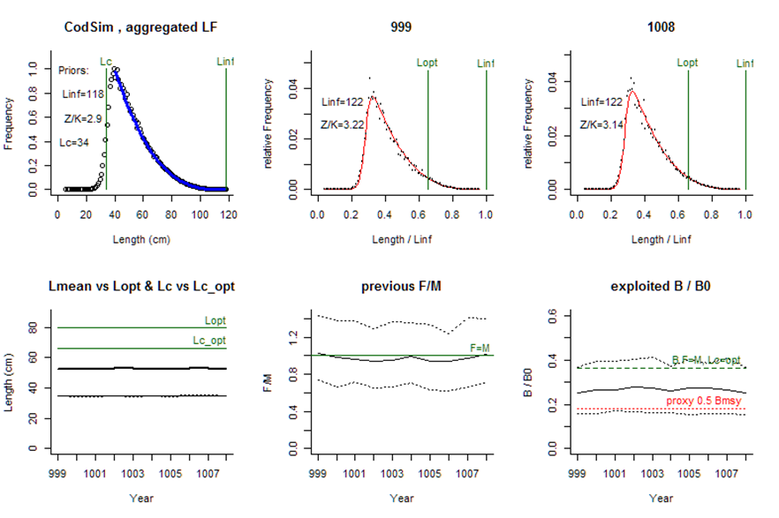
Example Simulated Data for Cod
True Values:
Linf=120
Lc=35
Z/K=3.08
M/K=1.54
F/K=1.54
F/M=1
B/B0=0.261

Slide 13
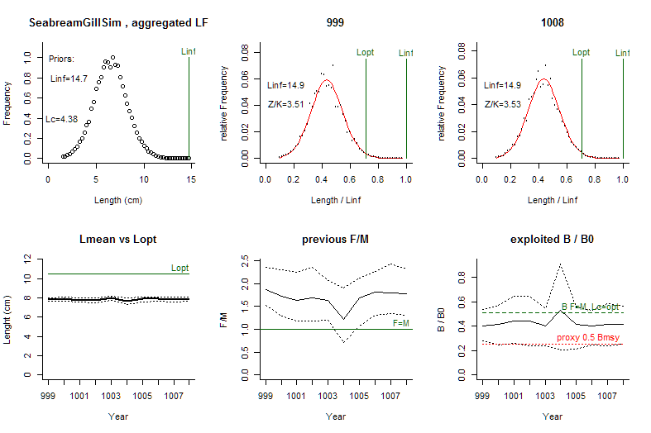
Example Simulated Gill-Net Selection
True Values:
Linf=15
Lmean=8
Z/K=3.75
M/K=1.25
F/K=2.5
F/M=2
B/B0=0.372

Slide 14
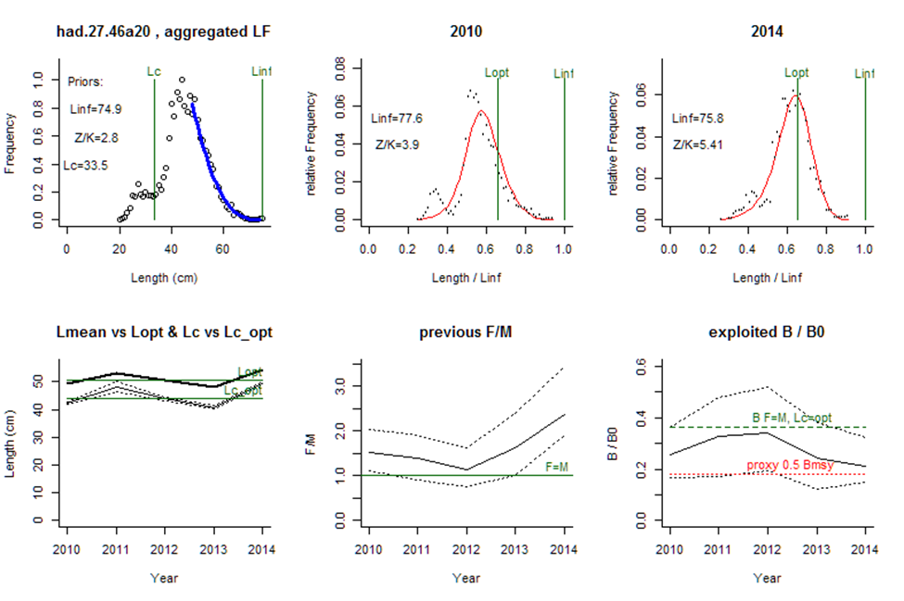
Example for Haddock in the North Sea
LBB gives:
F/M=2.9
B/B0=0.15
B/Bmsy=0.38
ICES:
F/Fmsy=1.6
SSB/Bmsy=0.69
(Bmsy~2*Bpa)
Notes:
An example of graphical output produced by LBB, here for North Sea haddock, for the years 2010 to 2014. The upper left panel shows the accumulated LF data used to estimate priors L_{c}, L_{inf}. and Z/K. The upper middle and right panels show the LF data for the first and last year in the time series. The red curve shows the fit of Equation 8, which provides estimates Z/K, M/K, F/K, L_{c}, and L_{inf}. From L_{inf} and M/K, L_{opt} is calculated and shown as reference. The lower left panel shows L_{mean} (bold black curve) relative to L_{opt}, and L_{c} (black curve) with approximate 95% confidence limits (dotted curves) relative to L_{c_opt}.. The lower middle panel shows relative fishing pressure F/M (black curve), with approximate 95% confidence limits (dotted curves), with indication of the reference level where F = M (green horizontal line). The lower right panel shows relative biomass B/B₀ (black curve) with approximate 95% confidence limits (dotted black curves) with indication of a proxy for B_{msy} (green dashed line) and a proxy for B_{pa} (red dotted line).

Slide 15
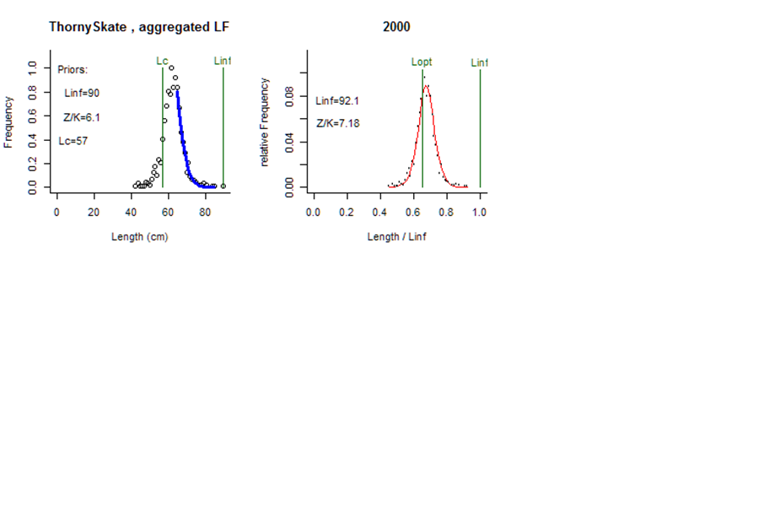
Example Thorny Skate NWA
LBB gives:
F/M=3.5
B/B0=0.15
Qualitative assessment suggests
high exploitation and low biomass.
(DFO 2003, 2017a)

Slide 16
Conclusion
LBB gives preliminary estimates of stock status based on length frequency data from the fishery
LBB results provide objective B/B₀ priors for other assessment methods

Slide 17
Thank You
Rainer Froese
rfroese@geomar.de
www.fishbase.de/rfroese/

