Slide 1
The Good, the Bad, the Worrisome A Critical Look at the New Common Fisheries Policy of the EC
Rainer Froese
rfroese@geomar.de
Presentation at the 2013 Pew Fellows Meeting
17-21 October, Malahide, Ireland

Slide 2
Background
Member States of the EC have deferred fisheries management to the European Community (Commission, Parliament, Council)
The Common Fisheries Policy of the past decades aimed to keep fish stocks just above the border to collapse
Many stocks (e.g. North Sea cod) collapsed under fishing pressure 3 times F_{msy}

Slide 3
The Good (I)
The new CFP, to be implemented from 2014 onward, finally recognizes the legally binding fisheries reference points set by UNCLOS (1982) and UNFSA (1995)
CFP: "..objective of [] restoring and maintaining [] fish stocks above biomass levels capable of producing maximum sustainable yield“

Slide 4
The Good (II)
“.. ensure that negative impacts of fishing activities on the marine ecosystem are minimized ..“
“gradually eliminate discards [..] by avoiding and reducing [..] unwanted catches and gradually ensuring that all catches are landed“
“.. make the best use of unwanted catches, without creating a market for such catches that are below the minimum conservation reference size“

Slide 5
The Good (III)
“.. be coherent with the Union environmental legislation, in particular the objective of achieving a good environmental status by 2020..“

Slide 6
The Good (IV)
“ecosystem-based fisheries management means [..] to manage fisheries within ecologically meaningful boundaries [..] while preserving both the biological wealth and the biological processes necessary to safeguard the composition, structure and functioning of the habitats of the ecosystem..”

Slide 7
The Bad (I)
Fishing opportunities (the catch allowed in the next year for 100+ stocks) continue to be decided by the Council of agriculture/fisheries ministers, even if multiannual plans exist
Parliament has to be involved in the decision of multi-annual plans, but the details of such involvement are disputed

Slide 8
The Bad (II)
No deadline for restoring stocks above the size that can produce MSY.
“In order to reach this objective of [..] restoring [..] fish stocks [..], the maximum sustainable yield exploitation rate shall be achieved by 2015 where possible and [..] latest by 2020 for all stocks.”

Slide 9
The Bad (III)
“provisions of de minimis exemptions of up to 5% of total annual catches of all species subject to an obligation to land [..]”
Lots of vagueness by using language such as “may”, “should”, “shall”, “gradually”, “progressively”, “where necessary”, “where appropriate”, “where applicable”, “taking into account”, “avoiding disproportionate costs”, …

Slide 10
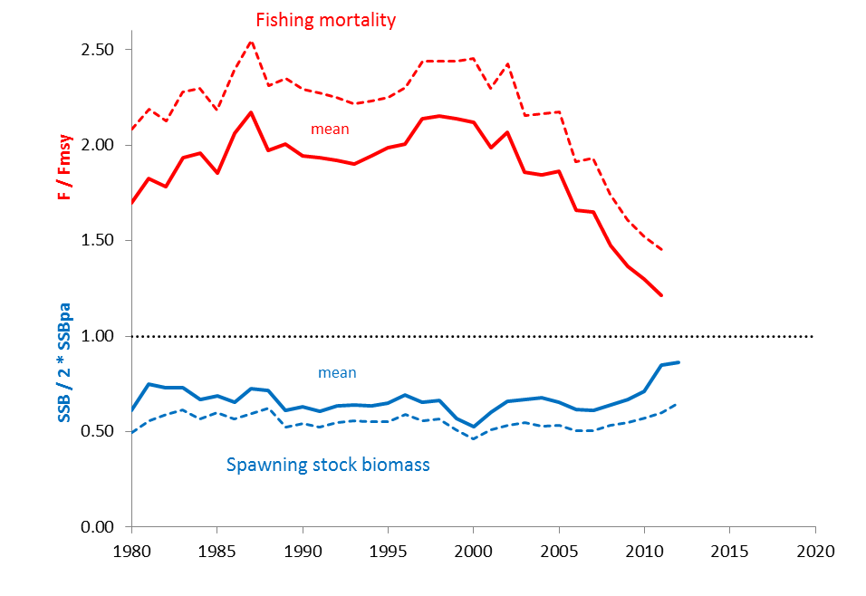
Status of Stocks
Extending the trends
in the last 3 years for the
95% confidence limits…
Based on the ICES Stock Summary database 10/2013 with data for 45 stocks [relF_relB.xlsx]

Slide 11
The Worrisome (I)
CFP decisions are to be “based on best available scientific advice”
But how independent and good is that advice?

Slide 12
The Worrisome (II)
Most fisheries scientist in Europe are directly or indirectly employed by the Ministers of Agriculture (the same who decide about fisheries management in Brussels)
The policy-setting Council of ICES (the advisory body to the EC) consists of national representatives who are determined by the Ministers of Agriculture (the same…)

Slide 13
The Worrisome (III)
Fisheries science holds that mortality caused by sustainable fishing (F_{msy}) should be less than natural mortality (M) caused by e.g. predation, diseases, natural hazards or old age
However, in 29 of 38 stocks (76%) with available data, the ICES estimate of F_{msy} exceeded M, on average by 62%

Slide 14
Status of Stocks
True F/F_{msy} may be higher because
of unrealistically high F_{msy}
in 76% of the stocks
Based on the ICES Stock Summary database 10/2013 with data for 45 stocks

Slide 15
The Worrisome (III)
ICES provides estimates of the border of safe biological limits (SSB_{pa})
However, in 14 of 43 stocks (33%) with available data, the ICES estimate fell below the median estimate of three independent methods

Slide 16
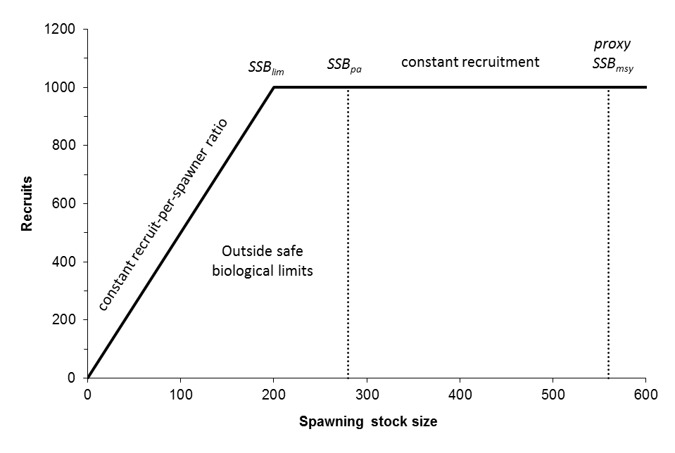
Stock-Recruitment Relationship
Conceptual drawing of the hockey stick relationship between spawning stock size and recruitment. SSB_{lim} marks the border
below which recruitment declines, SSB_{pa} marks a precautionary distance to SSB_{lim}, and 2 * SSB_{pa} can be used as a proxy for
SSB_{msy}, the stock size that can produce the maximum sustainable catch. [ContHS.xlsx].

Slide 17
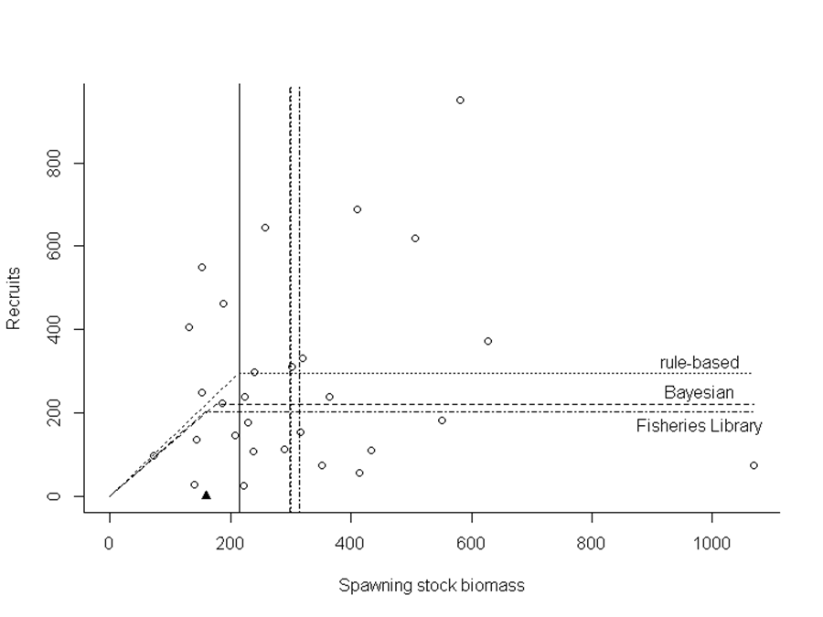
Underestimation of Safe Biological Limits
SSB_{pa}
ICES three independent methods
Analysis of stock-recruitment data for North Sea Doggerbank Sandeel (san-ns1), with three different methods. [S-R_HS_5_san-ns1.r]

Slide 18
Status of Stocks
True SSB/SSB_{pa} may be lower because of unrealistically low SSB_{pa}
in 33% of the stocks
Based on the ICES Stock Summary database 10/2013 with data for 45 stocks

Slide 19
The Worrisome (IV)
The CFP asks for an ecosystem-based approach to fisheries management
ICES has started providing “Multispecies considerations”, e.g. for the Baltic. In there, ICES recommends maximization of catch from the ecosystem. The resulting “multispecies advice” for F_{msy} exceeds single species advice for all species.
See: http://www.ices.dk/sites/pub/Publication%20Reports/Advice/2013/2013/Baltic%20Multispecies%20Advice.pdf

Slide 20
Thank You Questions?
Rainer Froese
rfroese@geomar.de

