Slide 1
Things that You Did Not Know about Fish
Rainer Froese
Fisheries Research Institute, Nea Peramos, Kavala, Greece
25 May 2023

Slide 2

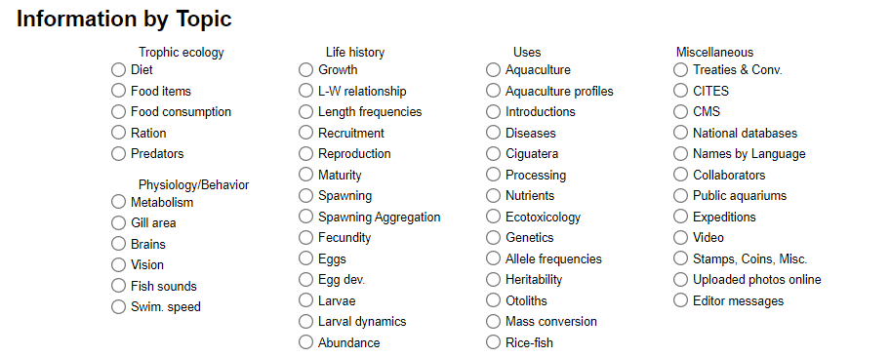

Slide 3
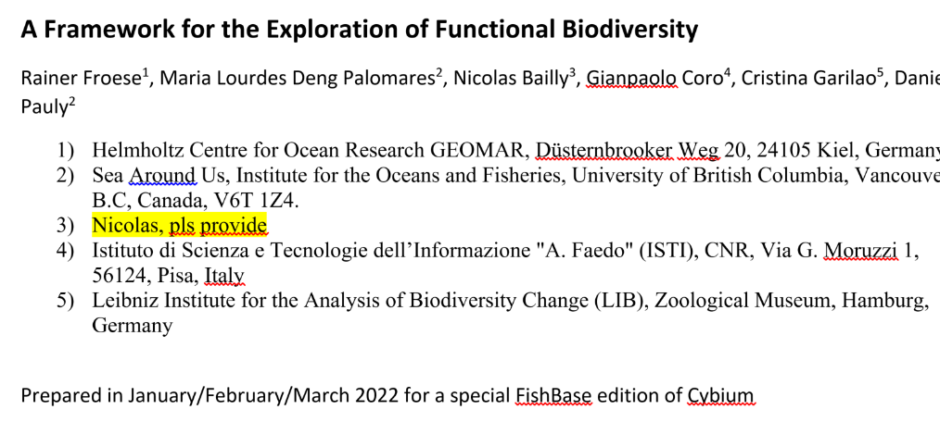
Fish Collection, Beaty Biodiversity Museum, University of British Columbia, Vancouver, B.C.,
Cybium 2023: 1 – 16, https://doi.org/10.26028/cybium/2023-003

Slide 4
Introduction
The number of conceivable life-history patterns is essentially infinite, if we judge by the possible combinations of the many known traits.
This study focuses on main traits which are highly correlated with many other traits and thus can serve as proxy indicators for life history strategies.
As a practical consideration, these traits had to be available for a high number of species across all Classes of fishes.
The three main traits considered in this study are body size, productivity, and trophic level, and their combination is referred to as SPT-space from here onward.

Slide 5
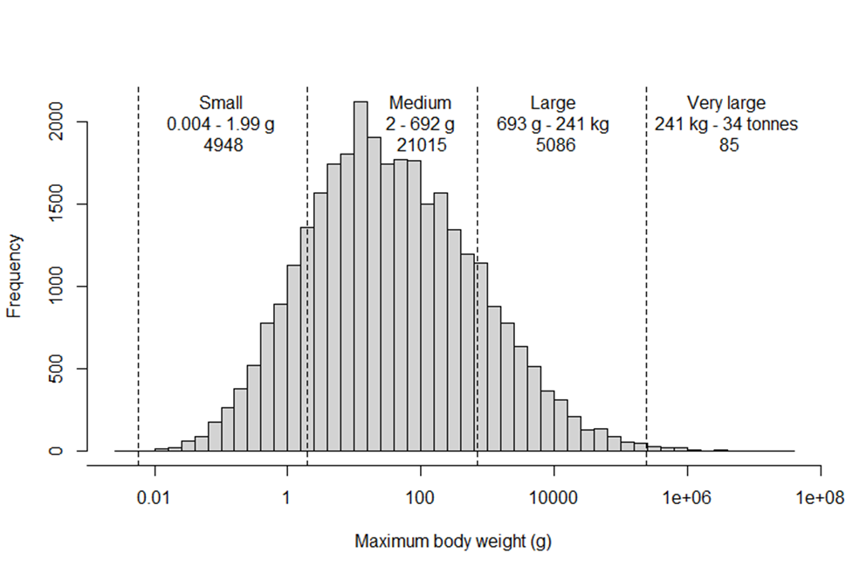
Maximum Body Weight
Histogram of maximum body weights of 31,134 species of fishes. The dashed vertical lines indicate -3, -1, 1 and 3 standard deviations in log space and are used as borders between the displayed size categories, with indicated weight ranges and number of species. Geometric mean body weight is 37.2 g.

Slide 6
Productivity = Resilience = Inverse of Vulnerability
Proposed correlations between ordinal categories of productivity and other life-history traits,
where r is the intrinsic rate of population increase, K is a parameter of the von Bertalanffy
growth function, Fecundity is the typical annual number of eggs or offspring produced
by a female, t_{m} is the age where 50% of females reach maturity, and t_{max} is the reported life span.
Note that the correlation with the lowest category of productivity matters.

Slide 7
Trophic level
Plants and detritus have trophic level 1
by definition. Animals have the mean trophic level
of their food, plus 1.
The Table shows a convenient ordinal assignment of
trophic levels to trophic groups.

Slide 8
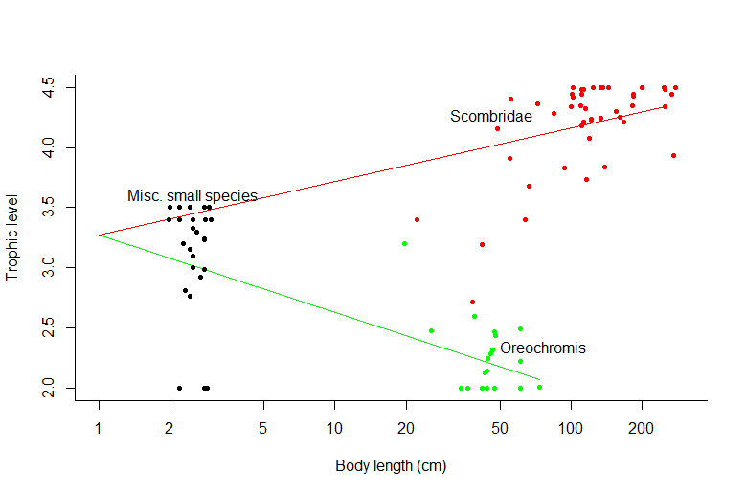
Ontogeny and Evolution(?) of Trophic Levels
Larvae as well as small
species of fish feed on
small zooplankton,
not on phytoplankton, even
if adults (or larger relatives) are top predators or herbivores

Slide 9
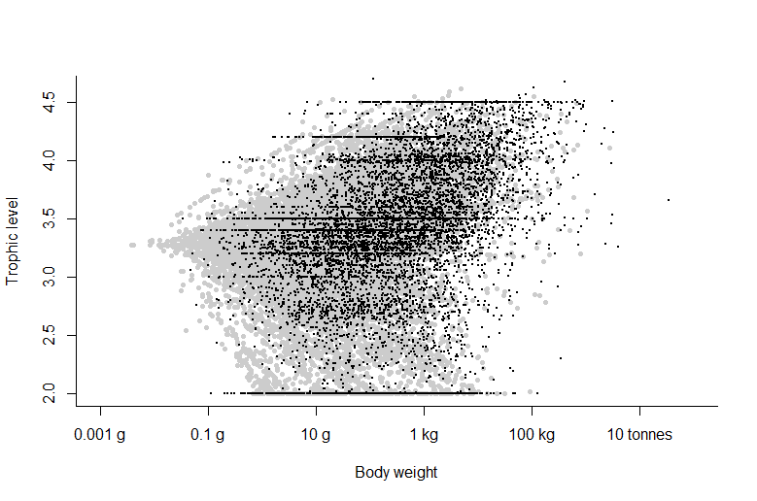
Observed (black) over
predicted (grey)
trophic levels
as a function of body weights, for 31,134 species of fishes

Slide 10
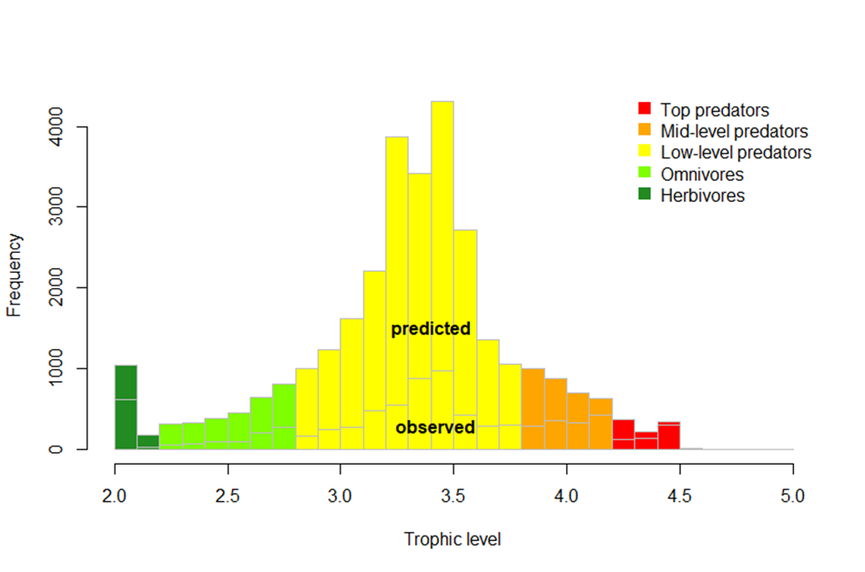
Frequency distribution of trophic levels among extant species of fishes. Most fishes are low-level predators feeding on zoo-plankton or detritus-feeders such as worms

Slide 11
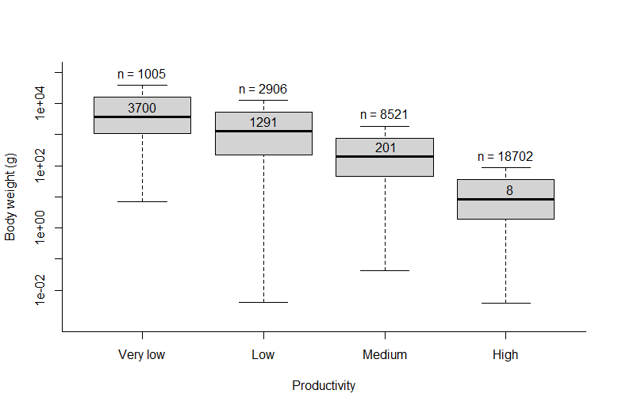
Productivity and body weight
are inversely related
Metabolism scales at about 0.75 with body mass across species from bacteria to whales

Slide 12
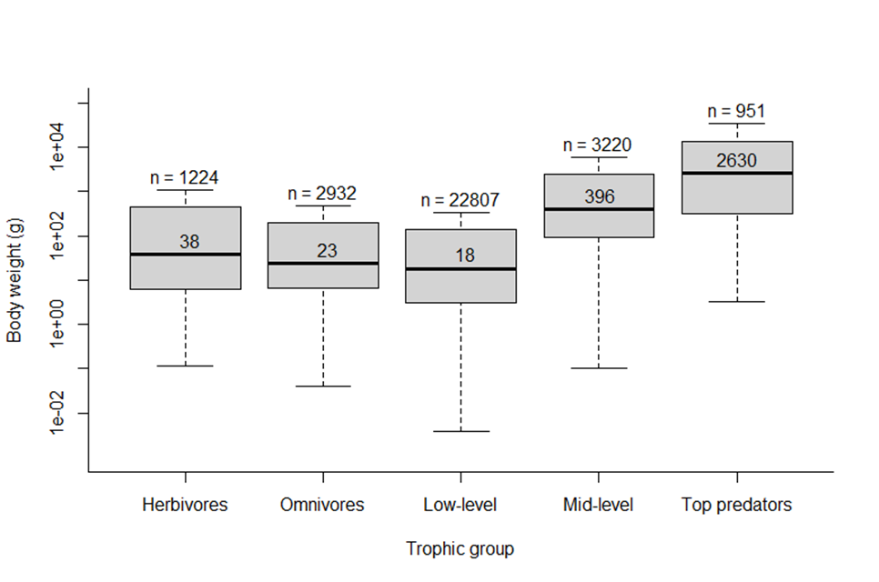
Body weight distributions
by trophic group
for 31,134 species of fishes,
with indication of number
of species (n) and median
body weight in grams.
Note that Herbivores group
includes detrivores.

Slide 13
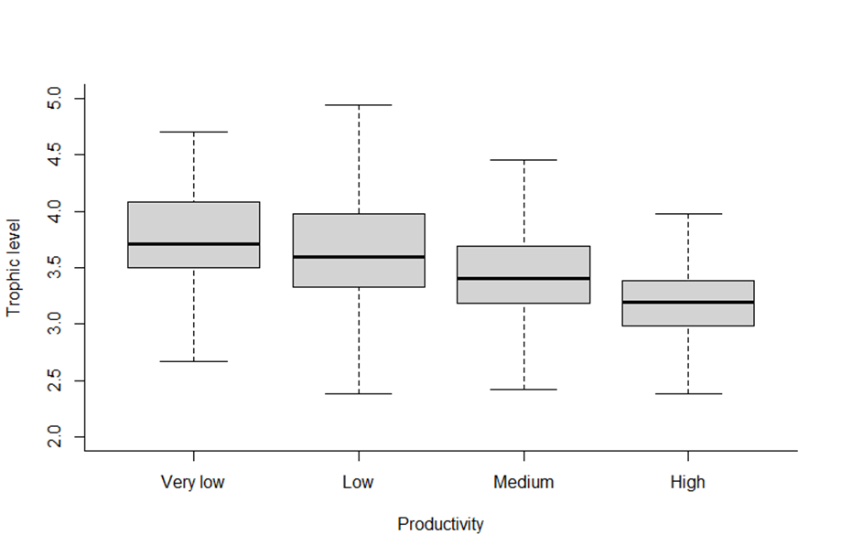
Box plot of trophic levels
by productivity group
for 31,134 species of
fishes

Slide 14
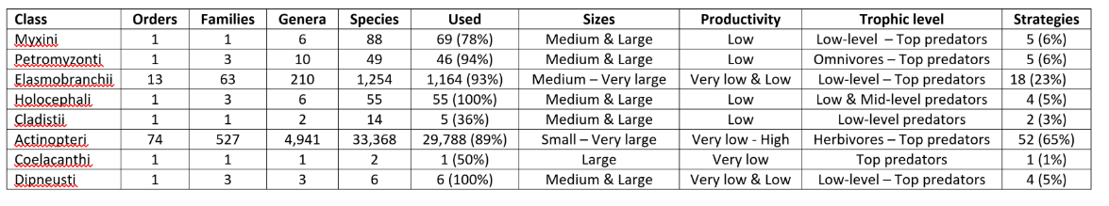
Distribution of Traits across Phylogeny

Slide 15
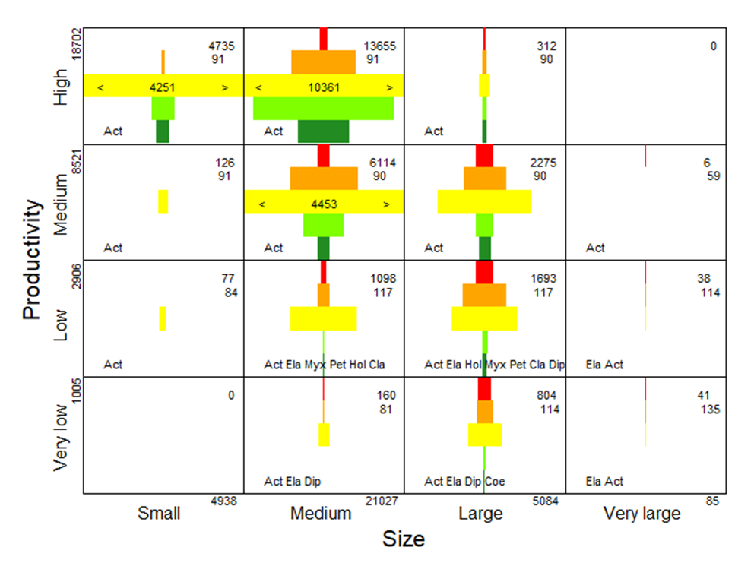
Functional biodiversity
plot for 31,134 species
of fishes. The colors
indicate the trophic
groups. Cell width
represents 2000 species. The numbers in the upper-right corners indicate the number of species assigned to a cell and the median evolutionary age of the Orders the species belong to. Text at the bottom of the cells gives first 3 letters of represented Classes. Blue arrow indicates evolutionary axis.

Slide 16
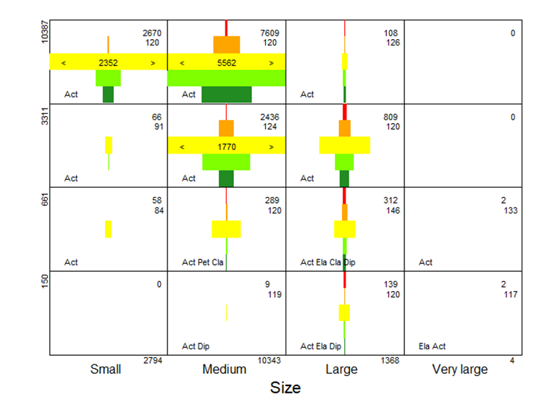
Live history strategies of 14,509
freshwater species of fishes.
Cell-width represents 1000 species. Note lack of very large fish, fewer top-predators, more herbivores, more small and medium sized species with high productivity. Median evolutionary age of Orders is 120 million years.

Slide 17
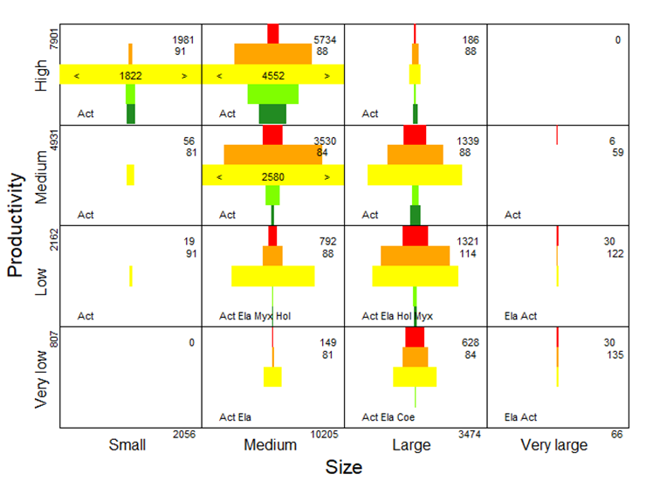
Live history strategies of 15,801 marine species of fishes.
Cell-width represents 1000 species. Median evolutionary age of Orders is 88 million years.

Slide 18
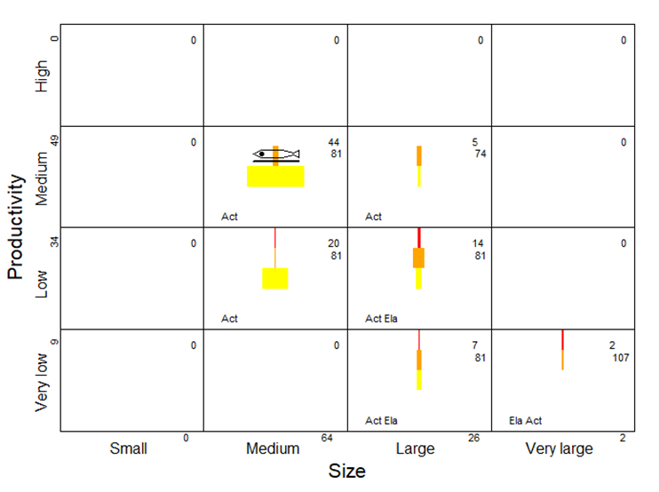
Live history strategies of 92
marine Arctic species of fishes.
Cell-width represents 100 species. Note lack of high productivity, small species, herbivores, fewer top-predators, more herbivores, more small and medium sized species with high productivity. Median evolutionary age of Orders is 81 million years. Pictogram is the Saddled eel-pout, one of very few medium-sized mid-level predators.

Slide 19
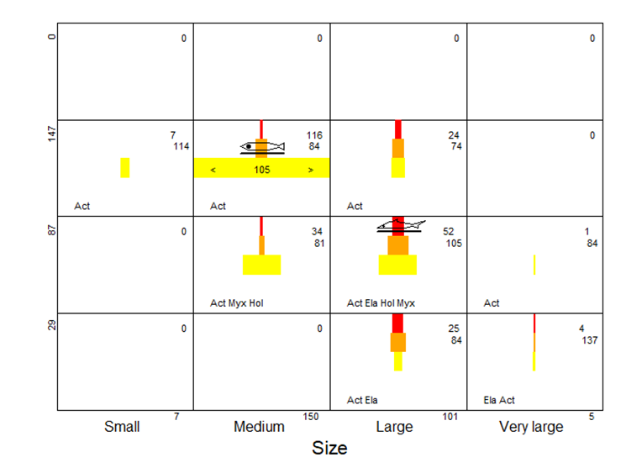
Live history strategies of 263
marine Arctic species of fishes
predicted for 2100.
Cell-width represents 100 species. Note that species numbers are predicted to triple,
top-predators are predicted to increase 5-fold, including benthic sharks which may feed on the endemic eel-pout.

Slide 20
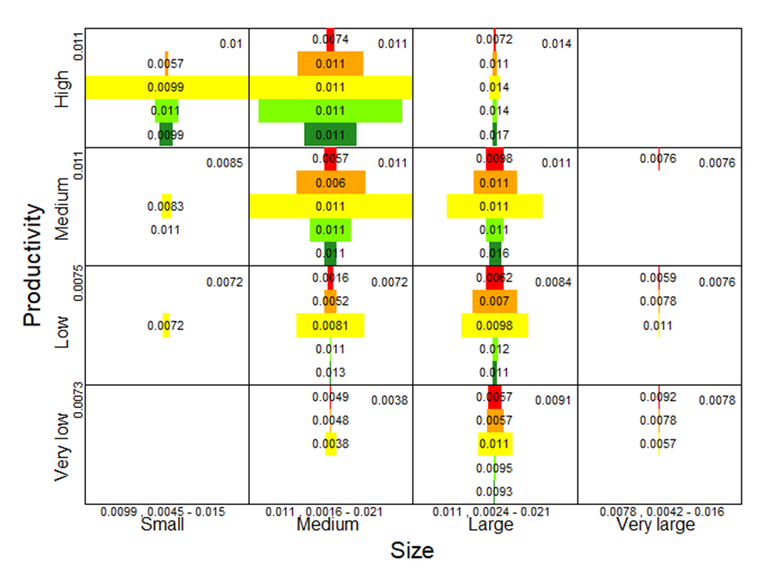
Body shape indicator
as example of an additional trait displayed in the size-productivity.trophic framework. 0.011 indicates fusiform bodyshape, less than 0.008 indicates elongated body shape. Very large fish and top predators tend to be elongated.

Slide 21
Thank You

