Slide 1
FIN Progress Report for ECOKNOWS
Rainer Froese, Rudy Reyes
Rennes, France, 3 February 2014
Skype Presentation

Slide 2
Bayesian Stock-Recruitment Tool
This relates to the objectives of WP6 and WP3
Together with a colleague from iMarine, we have developed a Bayesian hockey-stick and used it to estimate fisheries reference points
The draft manuscript and the R-Code with data are available on the WIKI
In the following graphs, bends are B_{lim} and vertical lines are B_{pa}, Bayesian estimate is red

Slide 3
Priors for the Hockey-Stick
Generic knowledge about S-R relationships was used as prior, i.e.,
that recruitment at large stock sizes fluctuates around a geometric mean
that left of Blim recruitment would fall below the geometric mean.
Simplified, if R were standardized by division through the mean, then the prior for the shaft is 1, and the prior for Blim is the biomass below which all R < 1.

Slide 4
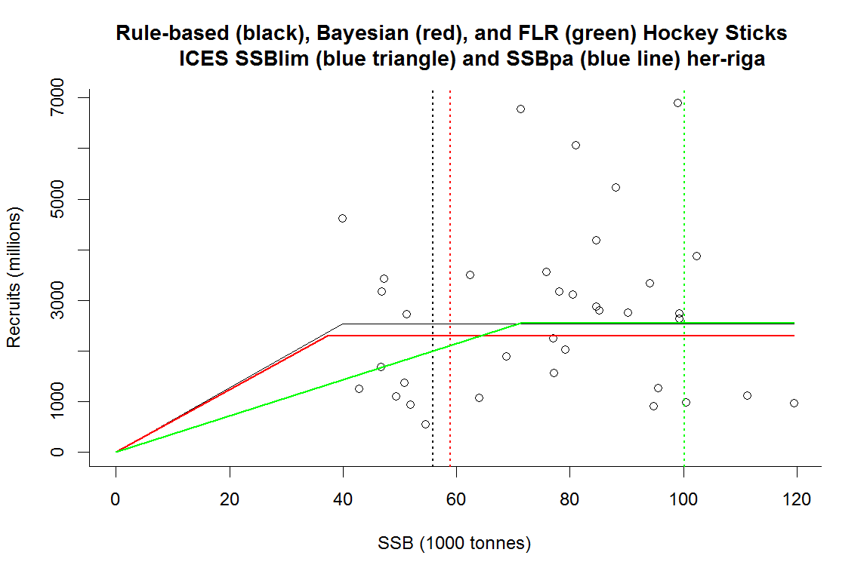
Herring in the Gulf of Riga
Note that the Fisheries Library HS probably overestimates Blim and Bpa.

Slide 5
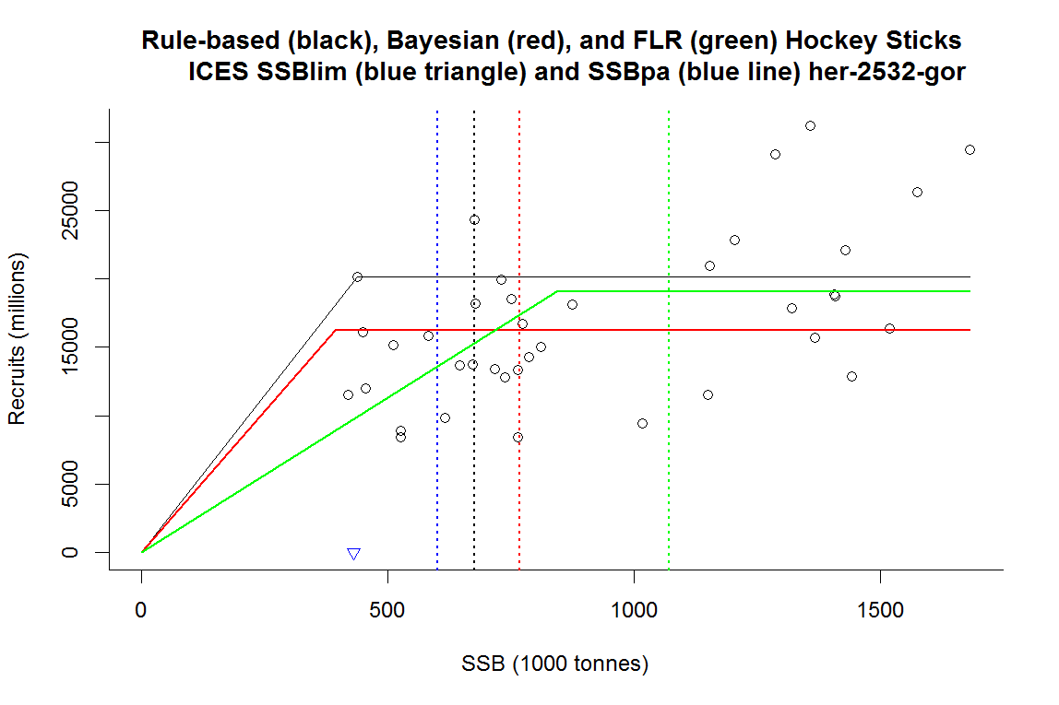
Herring in the Central Baltic
Again, the Fisheries Library HS seems to overestimate Blim and Bpa

Slide 6
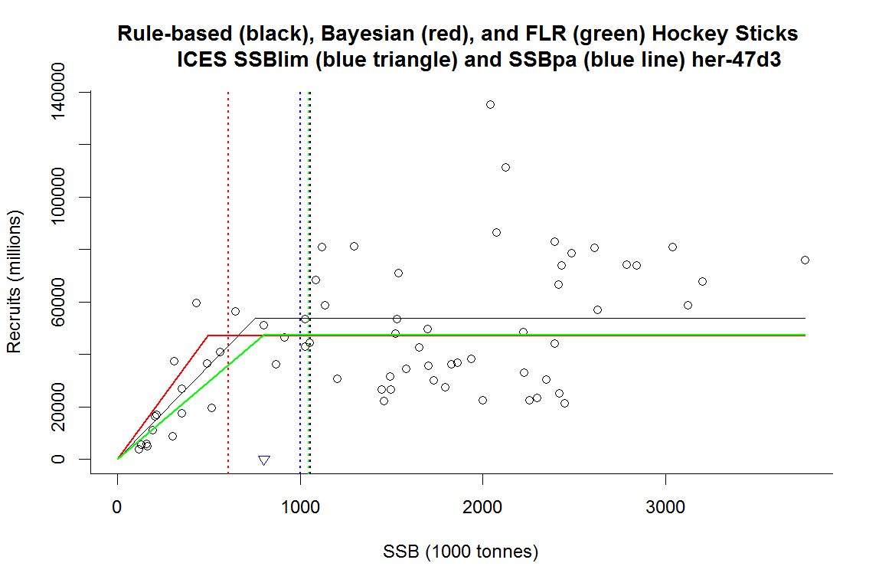
North Sea Herring
Here, the Bayesian HS seem to underestimate Blim and Bpa.

Slide 7
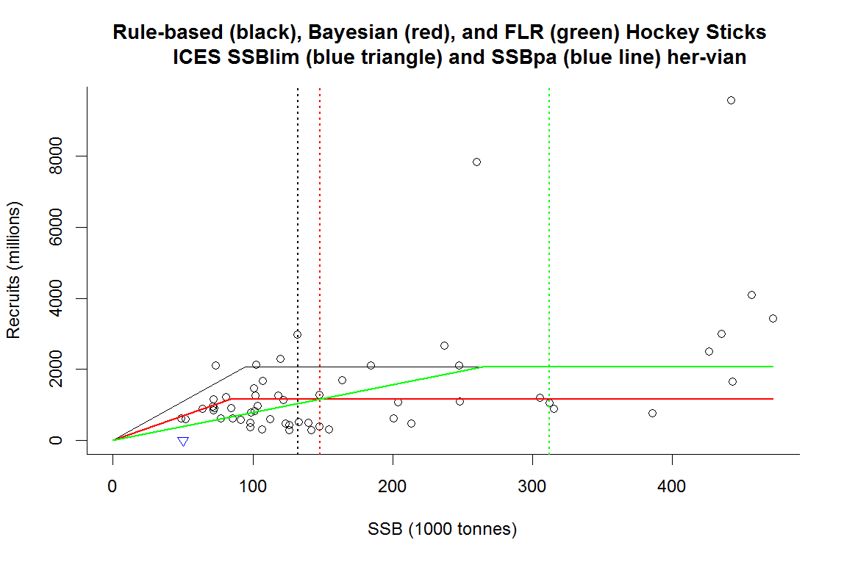
Herring in the Celtic Seas
Again, the Fisheries Library HS overestimates Blim and Bpa

Slide 8
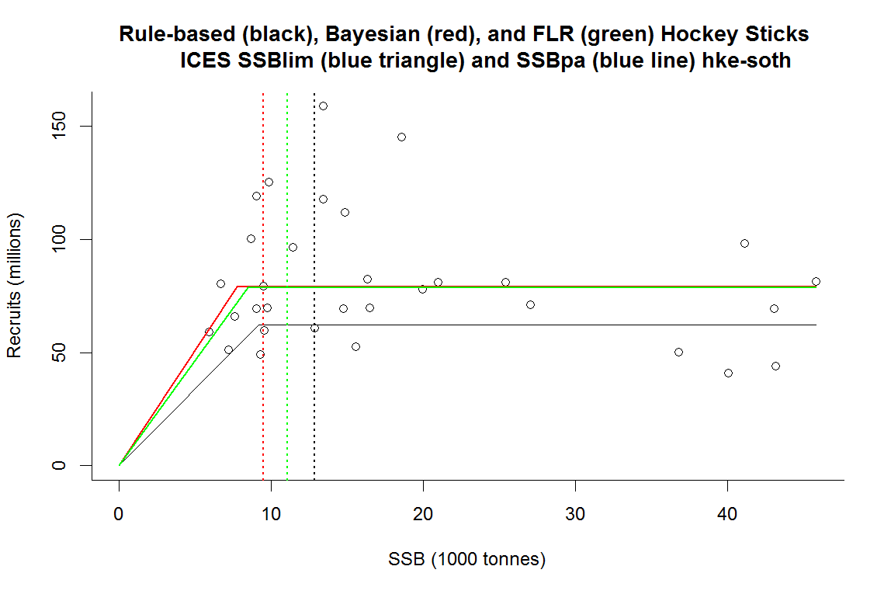
Hake Southern Stock
All HS are in good agreement.

Slide 9
Results of Bayesian Hockey-Stick
FishStock | ICES Blim | ICES Bpa | Bayesian Blim | Bayesian Bpa | FishLib Blim | FishLib Bpa
her-47d3 | 800,000 | 1,000,000 | 491,006 | 604,940 | 800,322 | 1,046,862
her-2532-gor | 430,000 | 600,000 | 392,754 | 766,896 | 842,136 | 1,072,139
her-riga |  | 60,000 | 37,261 | 58,854 | 71,304 | 100,216
her-vian | 50,000 |  | 83,893 | 148,107 | 264,253 | 312,179
hke-soth |  |  | 7,736 | 9,463 | 8,440 | 11,070
More hockey-sticks can be fitted if you send S-R data to rfroese@geomar.de .
Please also indicate the age at recruitment.

Slide 10
CMSY Monte Carlo Tool
The Catch-MSY method (Martell & Froese 2013) presented at earlier meetings has been developed further to estimate biomass and fisheries reference points
CMSY can be considered an implicit Bayesian approach because the priors are uniform
Instead of MCMC random walk, a simple 4-step zoom-in is used
Turning CMSY into an explicit Bayesian method needs co-author to write the model
The following slides show application to case study species

Slide 11
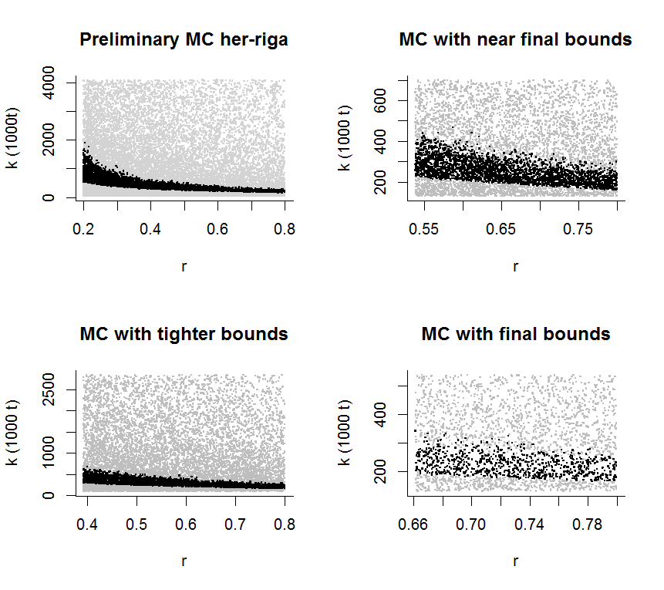
Herring in the Gulf of Riga I
4-step zoom-in on area used to estimate geometric mean r, k and MSY

Slide 12
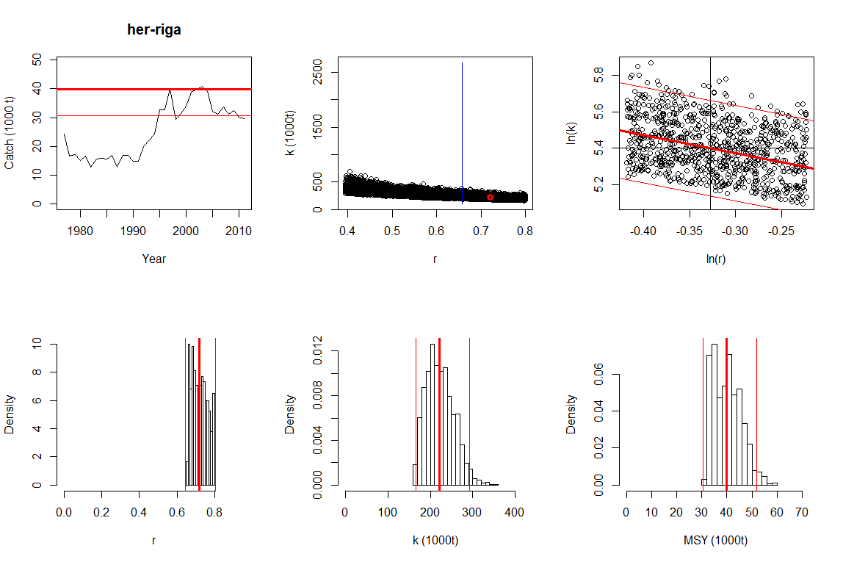
Herring in the Gulf of Riga II
Fisheries reference points MSY (bold red line in upper left graph), F_{msy} = 0.5 r and B_{msy} = 0.5 k

Slide 13
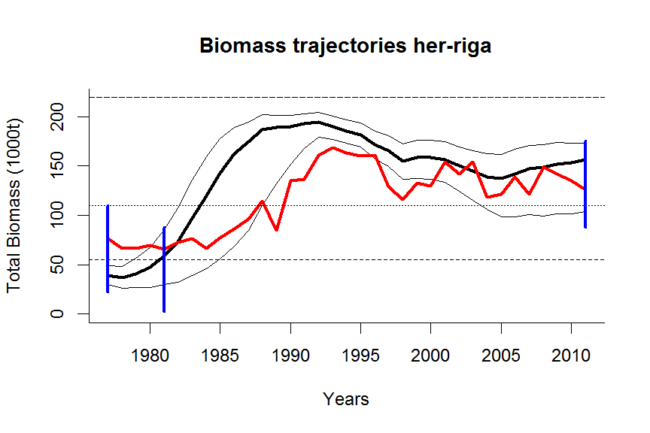
Herring in the Gulf of Riga III
Blue lines are prior biomass windows, medium resilience is prior for r. Red line is observed
Biomass, black line predicted biomass, with 5th and 95th percentile. Required data are catch.

Slide 14
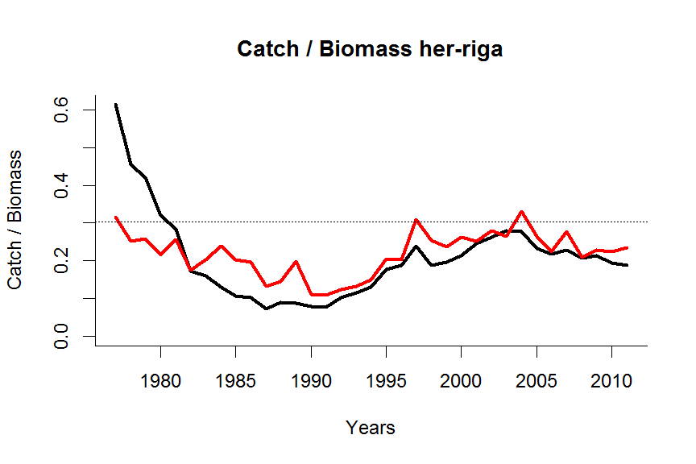
Herring in the Gulf of Riga IV
Catch/biomass ratio u as proxy for F. Dotted line is u_{msy}. Black line is predicted, red line
is observed.

Slide 15
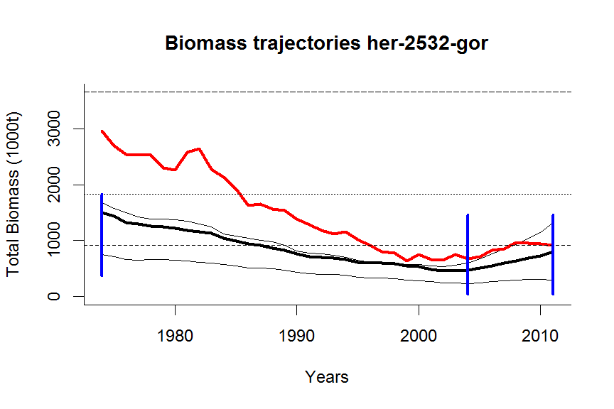
Herring in the Central Baltic
Better fit possible by replacing defaults with “informative priors”.

Slide 16
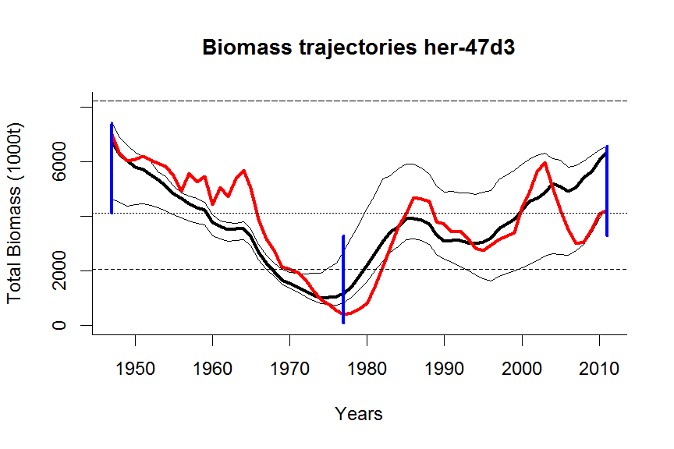
North Sea Herring

Slide 17
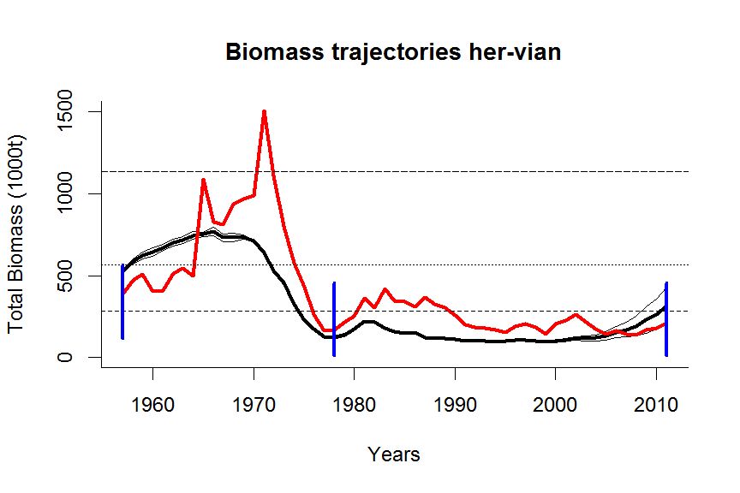
Herring in the Celtic Seas

Slide 18
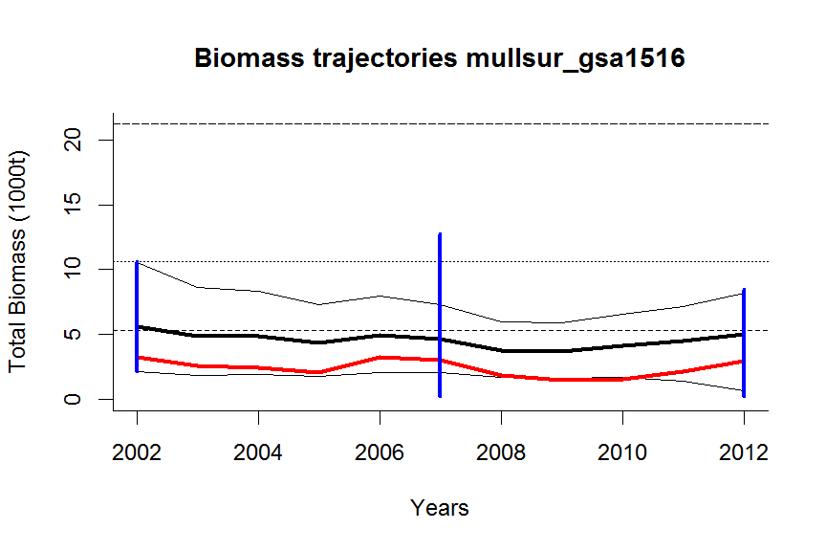
Mullus surmuletus in the Mediterranean

Slide 19
Results of CMSY
FishStock | F_{msy} | HDI | B_{msy} | HDI | MSY | HDI
her-riga | 0.36 | 0.32 - 0.40 | 110,500 | 83,361 - 146,476 | 39,818 | 30,609 - 51,799
her-2532-gor | 0.26 | 0.20 - 0.32 | 957,474 | 777,870 - 1,178,547 | 246,538 | 229,348 - 265,018
her-47d3 | 0.17 | 0.15 - 0.19 | 4,109,175 | 3,658,562 - 4,615,289 | 682,660 | 634,529 - 734,442
her-vian | 0.16 | 0.14 - 0.19 | 567,905 | 492,028 - 655,483 | 91,803 | 89,169 - 94,515
mullsur_gsa1516 | 0.24 | 0.23 – 0.25 | 10,616 | 4,540 – 24,823 | 2,566 | 1,101 – 5,984
More CMSY analyses can be done if you send catch data to rfroese@geomar.de .
It would help if in addition you indicate most likely relative biomass range 0-1 k
at the beginning and at the end of the time series.

Slide 20
To Do
Finalize and publish S-R paper
Finalize and publish CMSY paper
Resume work on Bayesian growth in FishBase, use to update resilience in FishBase
Start work on Bayesian maturity in FishBase
Start work on Bayesian mortality in FishBase
Summarize above in new, continuous, Bayesian estimate of resilience (=risk) in FishBase

