Slide 1
Bewertungskriterien für Umweltschutz in der Hochseefischerei
Rainer Froese
GEOMAR, Kiel
Fachgespräch zur Entwicklung von Umweltkriterien im Tiefseebergbau
Hamburg, 29. Januar 2019

Slide 2
Overview
Understanding the deep-sea ecosystem services and resilience
Understanding the environmental impact of deep-sea mining
What are Vulnerable Marine Ecosystems (VMEs)
What are expected impacts and monitoring requirements
What can be learned from environmental regulations applicable to deep-sea fishing?
Discussion

Slide 3
Understanding the deep-sea ecosystem (Do we?)
Extreme environmental conditions: Very high pressure, cold, dark, very slow currents, limited food, limited oxygen, high future CO₂ loads
No primary production (no plants). Except for food chains based on chemosynthetic bacteria (e.g. at thermal vents), all life forms depend on organic matter (fecal pellets to whale-falls) sinking down from the surface layer
High longevity (> 100 years in several organisms), late maturity, long generation times, very low reproductive rates
Very low adaptability and resilience

Slide 4
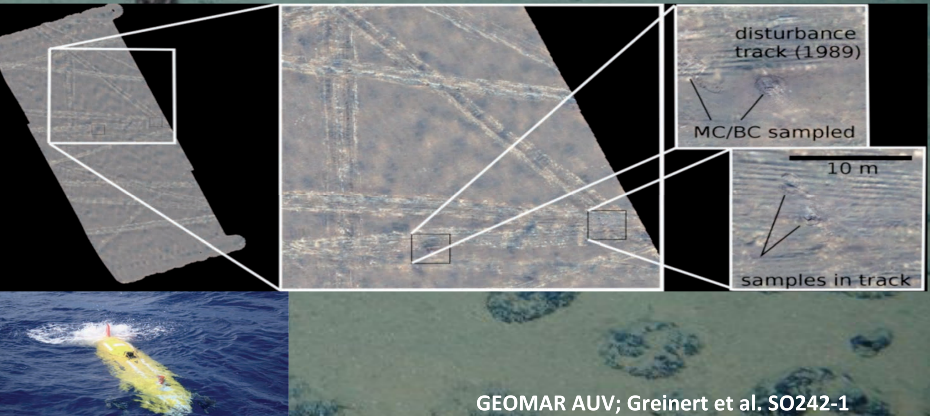
26 years later…

Slide 5
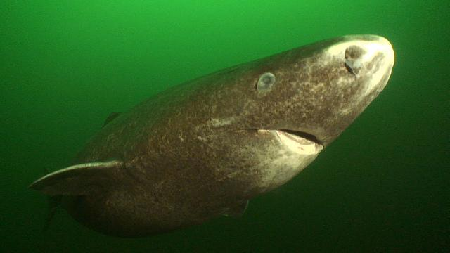
The Greenland shark may live up to 500 years

Slide 6
Deep-sea ecosystem service
Waste management: specialized organisms for the treatment and safe depositing of all organic material that constantly rains down from the upper layers, from whales to fecal pellets.
What can possibly go wrong with that? Without a well-function deep-sea ecosystem, the stuff that sinks to the bottom decays, sometimes forming huge microbial mats producing hydrogen sulfide and methane. If too much gas is formed, the mats may ‚explode‘ and release toxic gas with subsequent fish kills and other hazards, and release of huge amounts of heat-trapping methane into the atmosphere

Slide 7
Environmental impact of deep-sea mining
Three types of mining are currently foreseen:
„Massive sulphide mining“ removes inactive hydrothermal vents
„Sea mount skinning“ for cobalt-rich crusts
Collecting (= pumping up) of polymetallic nodules

Slide 9
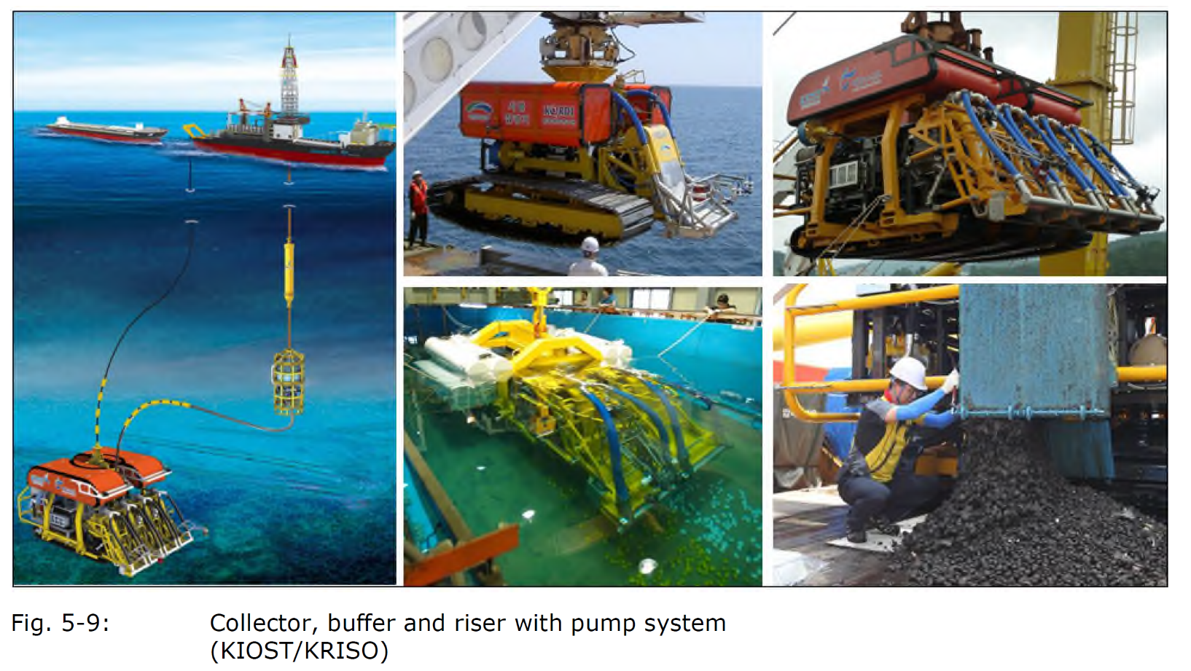

Slide 10
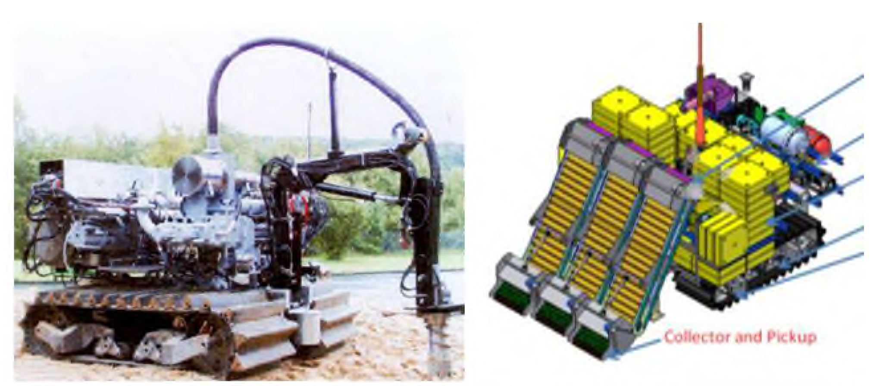

Slide 11
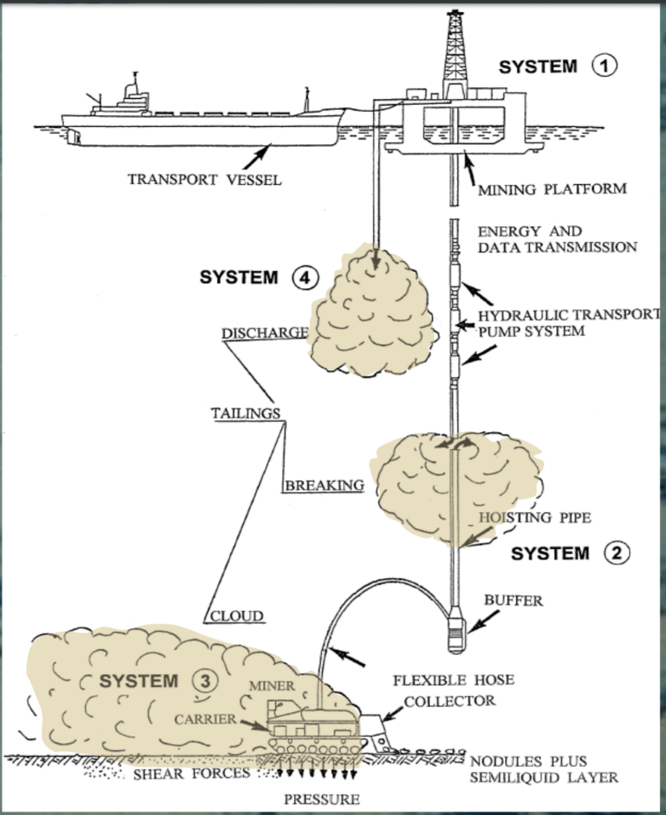

Slide 12
Vulnerable Marine Ecosystems (VME) in the deep-sea
Cold-water corals and hydroids
Sponge-dominated communities
Dense emergent fauna
Seep and vent communities

Slide 13
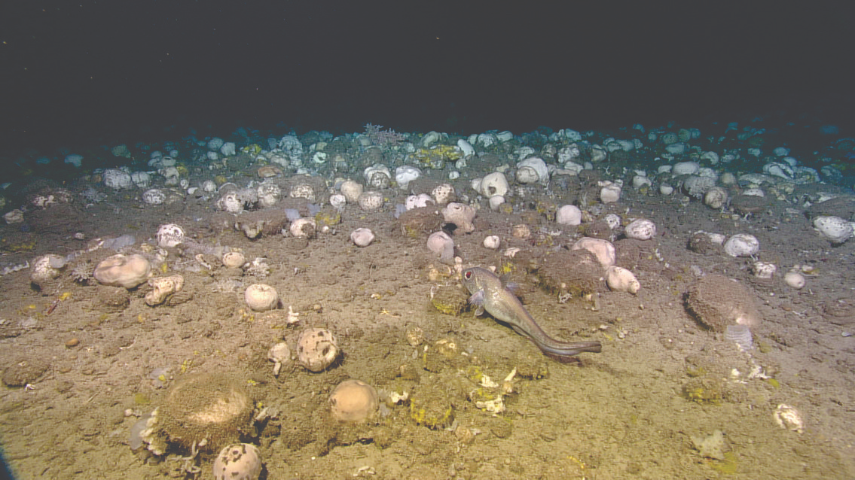
Geodia sponges are considered an indicator species for VMEs

Slide 14
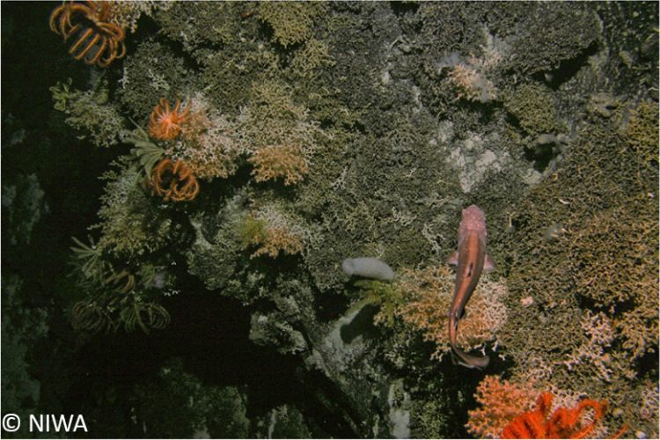
Louisville Seamount showing corals and associated fauna including sea stars, feather stars, and fish.

Slide 15
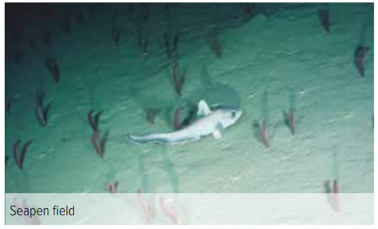
Dense emerging fauna: Seapen field

Slide 16
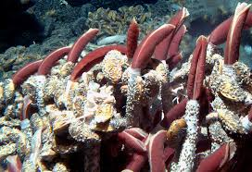
Life at vents and seeps

Slide 17
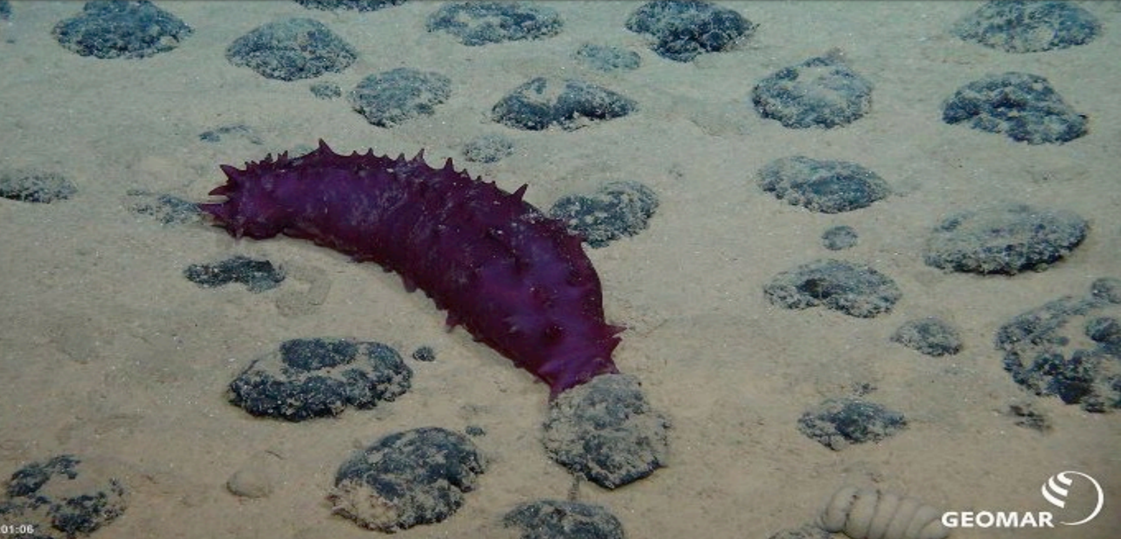
Seacucumber at a nodule field

Slide 18
Impact of collector mining on VMEs
Active work kills sessile and mobile fauna
Removal of hard substrate removes sessile habitat
Liquefying of upper sediment layer affects microorganisms
Turbidity cloud burries organisms and obstructs filter-feeding and gill-breathing
Oxygen may be reduced and toxic elements may be increased
Turbidity cloud from the vessel has similar effects in the water column (plus nutrients)
Noise and light from operations will affect organisms

Slide 19
Monitoring requirements
Number and type of species
Measurement of noise and light effects
Monitoring of sedimentation rates
Concentration of trace metals and nutrients
Changes in oxygen and pH
Changes in pore volume in sediments
(Source: Analysis of exonomic benefits of developing commercial deep sea mining operations, Report of Expert group)

Slide 20
Environmental regulations for deep-sea fishing
Regional Fisheries Management Organizations (RFMOs) are considered as implementation of the binding UNCLOS obligation for cooperation in usage of the high seas
As „UNCLOS implementations“, RFMOs have to „protect and preserve rare or fragile ecosystems as well as the habitat of depleted, threatened or endangered species and other forms of marine life.“ (UNCLOS Article 194(5))
Towards this end, FAO has published Deep-sea Fisheries Guidelines

Slide 21
FAO Deep-sea Fisheries Guidelines (Recommendations)
Reporting of all fishing operations, including through VMS (and presumably AIS)
Conduct impact assessments
Identify, describe and map VMEs and areas likely to contain VMEs
Close areas to fishing where VMEs are likely to occur
Asks parties to define what constitutes an encounter (during fishing) with a VME
After VME encounter, cease fishing, report encounter and move-on
Use gear that minimize impact
(Source: http://www.fao.org/docrep/011/i0816t/i0816t00.HTM, 2009)

Slide 22
Binding regulations of RFMOs relevant for deep-sea fishing
Power to declare no-fishing zones
Power to prescribe design and use of allowed gear
Power to require on-board observer coverage
Power to restrict deep-sea fishing in previously assessed areas with regard to presence of VMEs
Requirement of deep sea fishing protocols
Power to set thresholds for VME presence in catch, such as amount of indicator species
Requirement to „move-on“ if VME thresholds are surpassed
(Source: Review and analysis of int. legal and policy instruments related to deep-sea fisheries and
biodiversity conservation in ABNJ, FAO 2017, http://www.fao.org/3/a-i7009e.pdf)

Slide 23
Thank You, Questions?
Rainer Froese
GEOMAR, Kiel
rfroese@geomar.de

