Slide 1
New Approaches for the Management of Data-Limited Stocks
Rainer Froese
GEOMAR
Rethinking paradigms & approaches in fisheries research
ZMT, Bremen, 20 March 2014

Slide 2
Overview
Some recent research
M as proxy for unknown Fmsy
Size matters: current F_{msy} fishing will not result in MSY and B_{msy}
Size matters: starting fishing at optimum size will result in MSY, B_{msy}, and many large fish
Ecosystem-based fisheries management is simple
How to Manage a Fishery without B, F, M, C ?

Slide 3
Some Recent Fisheries Research See www.fishbase.de/rfroese for PDFs
Martell, S. and R. Froese, 2013. A simple method for estimating MSY from catch and resilience. Fish and Fisheries 14: 504-514, doi:10.1111/j.1467-2979.2012.00485.x
Froese, R. and M. Quaas. 2013. Rio+20 and the reform of the Common Fisheries Policy in Europe. Marine Policy 39:53-55, doi.org/10.1016/j.marpol.2012.10.007
Villasante, S., D. Gascuel and R. Froese. 2012. Rebuilding fish stocks and changing fisheries management, a major challenge for the Common Fisheries Policy reform in Europe. Ocean and Coastal Management 70:1-3,
Froese, R. and M. Quaas. 2012. Mismanagement of the North Sea cod by the European Council. Ocean and Coastal Management 70:54-58, doi:10.1016/j.ocecoaman.2012.04.005
Quaas, M., R. Froese, H. Herwartz, T. Requate, J.O. Schmidt and R. Voss. 2012. Fishing industry borrows from natural capital at high shadow interest rates. Ecological Economics, doi:10.1016/j.ecolecon.2012.08.002
Froese, R. and A. Proelss. 2012. Is a stock overfished if it is depleted by overfishing? A response to the rebuttal of Agnew et al. to Froese and Proelss “Evaluation and legal assessment of certified seafood”. Marine Policy 38:548-550, doi:10.1016/j.marpol.2012.07.001
Froese, R. and A. Proelss. 2012. Evaluation and legal assessment of certified seafood. Marine Policy 36:1284-1289, doi:10.1016/j.marpol.2012.03.017
Froese, R., D. Zeller, K. Kleisner and D. Pauly. 2012. What catch data can tell us about the status of global fisheries. Marine Biology 159: 1283-1292, doi:10.1007/s00227-012-1909-6

Slide 4
More
Kleisner, K., D. Zeller, R. Froese and D. Pauly. 2012. Using global catch data for inferences on the world's marine fisheries. Fish and Fisheries doi: 10.1111/j.1467-2979.2012.00469.x
Norse, E.A., S. Brooke, W.W.L. Cheung, M.R. Clark, I. Ekeland, R. Froese, K.M. Gjerde, R.L. Haedrich, S.S. Heppell, T.Morato, L.E. Morgan, D. Pauly, R. Sumaila and R. Watson. 2012. Sustainability of deep-sea fisheries. Marine Policy 36:307-320,
Pauly, D. and R. Froese. 2012. Comments on FAO's State of Fisheries and Aquaculture, or 'SOFIA 2010'. Marine Policy 36:746-752.
Froese, R. and M. Quaas. 2011. Three options for rebuilding the cod stock in the eastern Baltic Sea. Marine Ecology Progress Series 434:197-2011
Froese, R. 2011. Fishery reform slips through the net. Nature 475:7
Froese, R., T.A. Branch, A. Proelß, M. Quaas, K. Sainsbury and C. Zimmermann. 2011. Generic harvest control rules for European fisheries. Fish and Fisheries 12:340-351
Khalilian, S., R. Froese, A. Proelss, T. Requate. 2010. Designed for Failure: A Critique of the Common Fisheries Policy of the European Union. Marine Policy 34:1178-1182
Froese, R. and A. Proelß. 2010. Rebuilding fish stocks no later than 2015: will Europe meet the deadline? Fish and Fisheries 11:194-202,
Froese, R. 2008. The continuous smooth hockey stick: a newly proposed spawner-recruitment model. Journal of Applied Ichthyology 24: 703-704,
Froese, R., A. Stern-Pirlot, H. Winker and D. Gascuel. 2008. Size Matters: How Single-Species Management Can Contribute To Ecosystem-based Fisheries Management. Fisheries Research 92:231-241
Froese, R. 2004. Keep it simple: three indicators to deal with overfishing. Fish and Fisheries 5:86-91
Froese, R. 2004. Keep it simple: three indicators to deal with overfishing. Fish and Fisheries 5:86-91

Slide 5
M as Proxy for Unknown Fmsy
There is a broad, longstanding agreement in fisheries science that sustainable rates of fishing F shall not exceed natural mortality M
Gulland 1971, Shepherd 1981, Beddington and Cooke 1983, Clark et al. 1985, Beverton 1990, Patterson 1992, Thompson 1993, Walters and Martell 2002, 2004, MacCall 2009, Pikitch et al. 2012, NOAA 2013.
Proposed secure sustainable fishing rates vary from 0.5 to 0.8 F_{msy} or M
Thus, M can be used as a proxy for F_{msy}

Slide 6
M is an upper limit of F
A fishing mortality rate F that equals the natural mortality rate M is an upper limit because it
doubles the mortality rate that the species has evolved to withstand
reduces life expectancy and duration of reproductive phase by half
reduces the number of old, large, fecund fish

Slide 7
Size Matters
As fish grow, there are two important sizes that they should not miss:
The length L_{m90} where most fish have reached maturity
The length L_{opt} where
growth in weight (including gonads) is maximum
expected fecundity is maximum
cohort biomass and fecundity is maximum

Slide 8
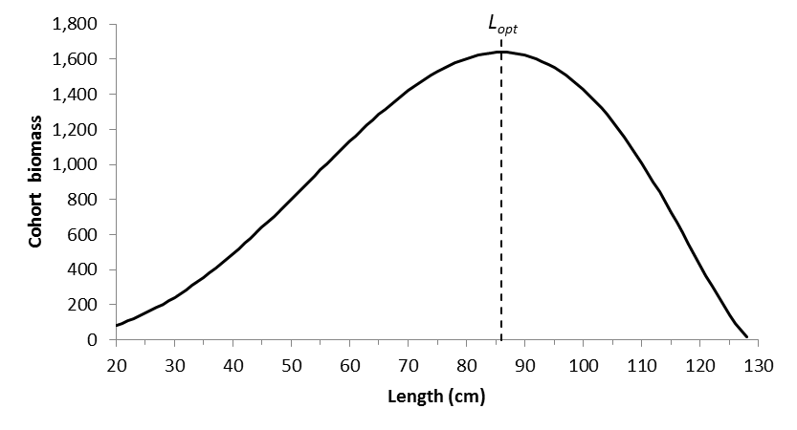
Size matters
L_{m90}
Biomass of a cohort (of North Sea cod) as it grows in length. Maximum fecundity, biomass
and growth in weight is reached at the length L_{opt} = 86 cm. This biomass is the product of
surviving individuals times their body weight. [Lcopt_4.xlsx]

Slide 9
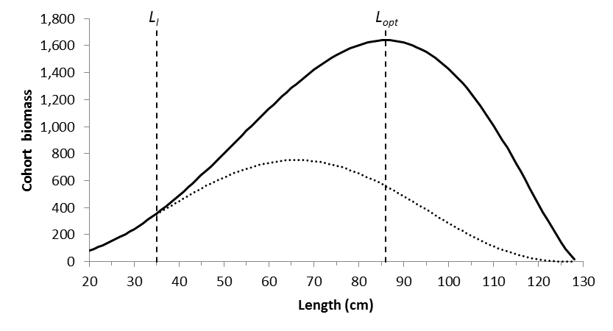
Size matters: fishing with F_{msy} starting at legal minimum length L_{l}
Biomass of a cohort (of North Sea cod) without fishing (solid line) and with fishing
at F = F_{msy} = 0.19 (dotted line), starting at legal minimum length L_{l}. [Lcopt_4.xlsx]

Slide 10
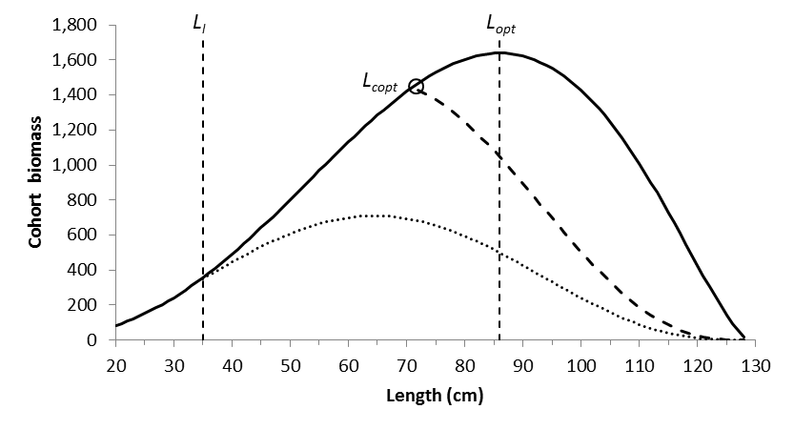
Size matters: fishing with F=M starting at L_{copt}
Biomass of a cohort (of North Sea cod) without fishing (solid line), with F_{msy} fishing
(dotted line), and with fishing at F=M= 0.21 starting at L_{copt} (dashed line), which leads
to a mean length of L_{mean} = L_{opt} in the catch and in the exploited part of the population.

Slide 11
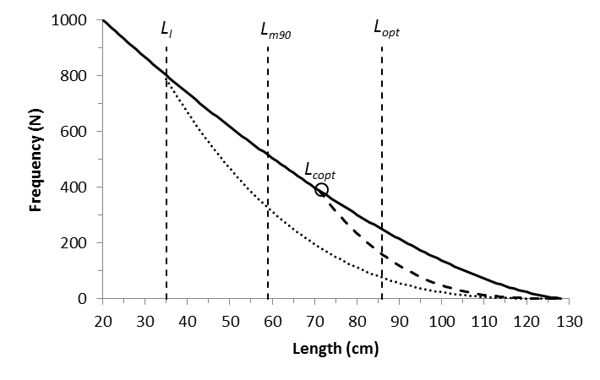
Impact of Fishing on Size Structure
Length frequency distribution without fishing (bold line), with F=F_{msy} fishing after L_{l} ,
and with F=M fishing after L_{copt}. L_{m90} is the length where 90% of the females reach maturity,
and L_{opt} is the “most important length in adult life”. Under L_{copt} fishing, all fish reach maturity
and about 2/3 of the fish reach L_{opt}, compared to no fishing. Under Fmsy fishing, only about
2/3 of the fish reach maturity and only 1/3 reach L_{opt}.

Slide 12
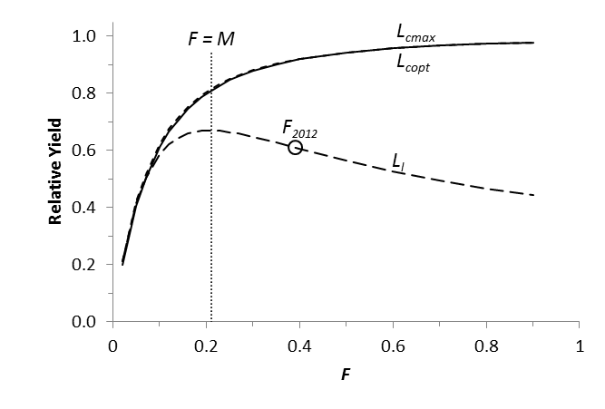
How effective is L_{copt} fishing?
Relative yield (=catch) as a function of F; L_{cmax} and L_{copt} give practically the same catch.
Fishing with F_{msy} = 0.19 starting at L_{l} will not result in the maximum sustainable yield (MSY).
L_{l} is the minimum legal landing length and F₂₀₁₂ is the actual F in 2012 [YpR_1.xlsl]

Slide 13
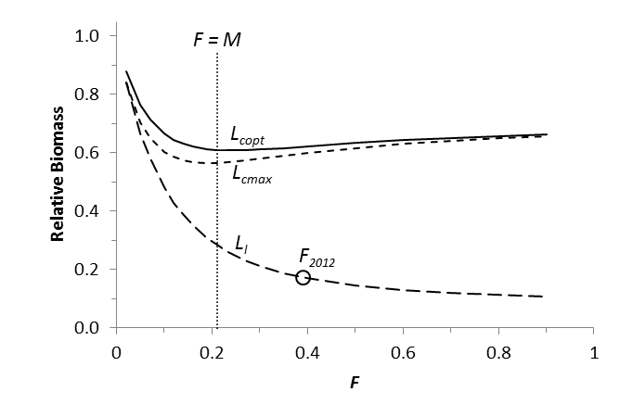
How effective is L_{copt} fishing?
Relative Biomass as a function of F; L_{copt} results in the highest biomass for any F.
Fishing with F = F_{msy} starting at L_{l} will not rebuild stock biomass to MSY-levels .
L_{l} is the minimum legal landing length and F₂₀₁₂ is the actual F in 2012 [YpR_1.xlsl]

Slide 14
Size Matters: Summary
F_{msy}-fishing with current low L_{c} will not result in MSY and will not rebuild stocks to the biomass that can produce MSY
Fishing with F = M and L_{c} = L_{copt} results in higher catches, higher CPUE, lower cost of fishing, more large fish, and low impact on size structure
For ecosystem-based management, chose F = 0.75 M for predatory fish and F = 0.5 M for forage fish

Slide 15

How to Manage a Fishery without B, F, M, C ?
A reasonable proxy for L_{opt} is
$L_{opt}=0.67 L_{max}$
A reasonable proxy for L_{copt} if F=M is
$L_{copt}=0.55 L_{max}$

Slide 16
How to Manage a Fishery without B, F, M, C ?
Determine L_{max} from 3 largest fishes
Get proxies for L_{copt} and L_{opt} from L_{max}
Get representative samples from the catch to determine L_{c} and L_{mean}
Work with fishers to increase their catch and reduce their cost by gradually increasing L_{c} to L_{copt} and L_{mean} to L_{opt}

Slide 17
Summary
Better fisheries management may result from fewer models and more common sense
Thank You

