Slide 1
CMSY: Fisheries Reference Points from Catch and Resilience
Rainer Froese, GEOMAR, Kiel, Germany
Gianpaolo Coro, CNR, Italy
WKLIFE V at IPMA
5-8 October 2015, Lisbon, Portugal

Slide 2
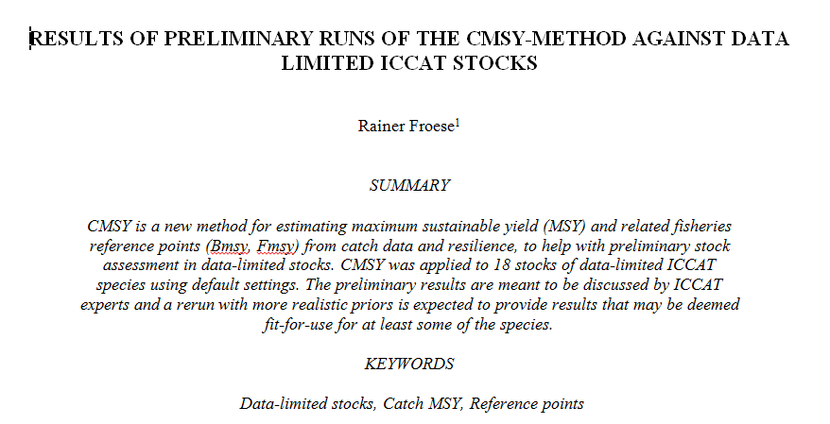
CMSY was recently tried on data-limited ICCAT stocks

Slide 3
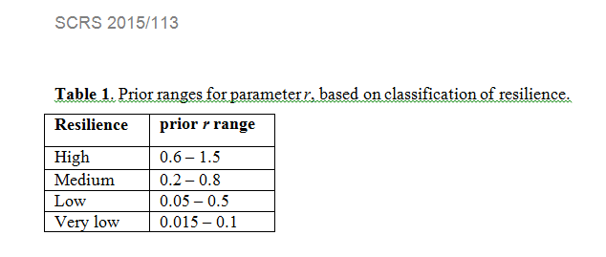
CMSY requires catch and priors for resilience and qualitative abundance
e.g. from FishBase
or from related life history traits
r ≈ 2 M ≈ 2 F_{msy} ≈ 3 K ≈ 3/t_{gen} ≈ 9/t_{max}

Slide 4
Broad Statements about Abundance or Status of the Fishery are Enough

Slide 5
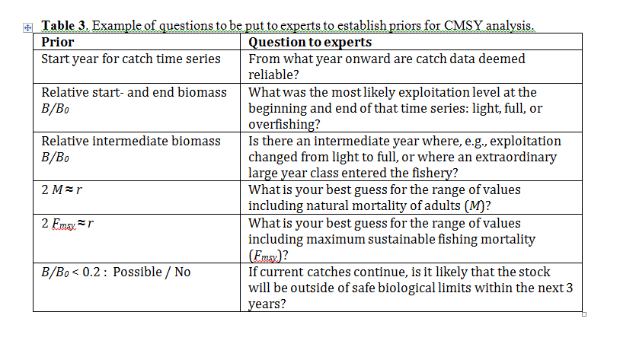
Possible Questions to Experts

Slide 6
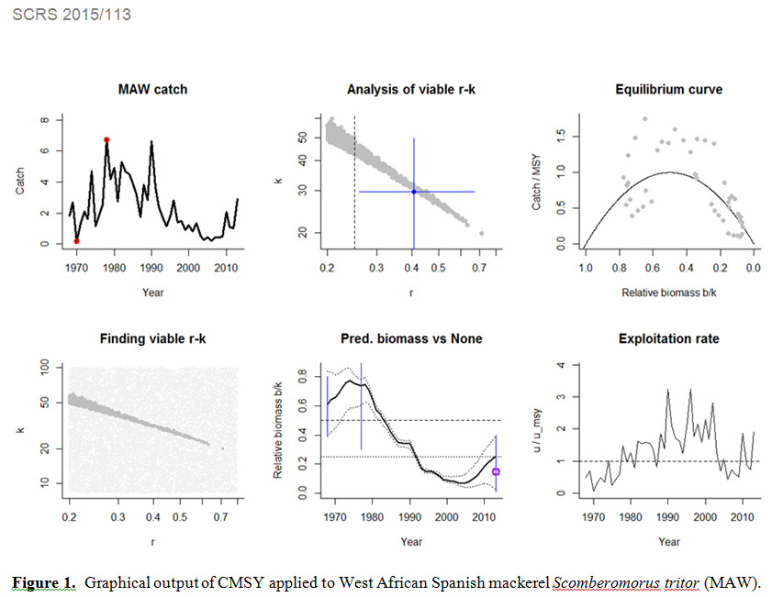
Graphical CMSY Output

Slide 7
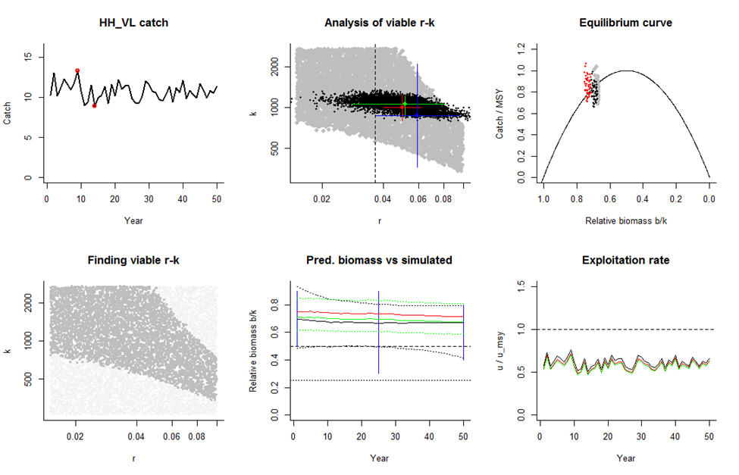
CMSY Analysis of Simulated Data

Slide 8
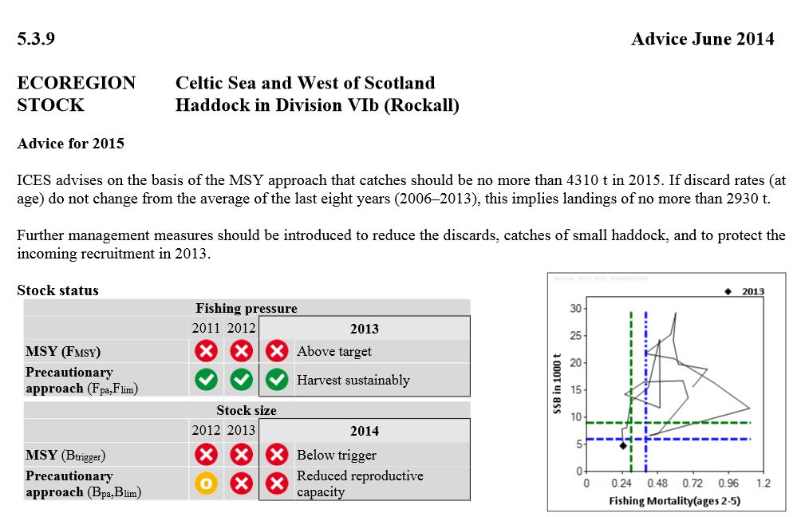

Slide 9
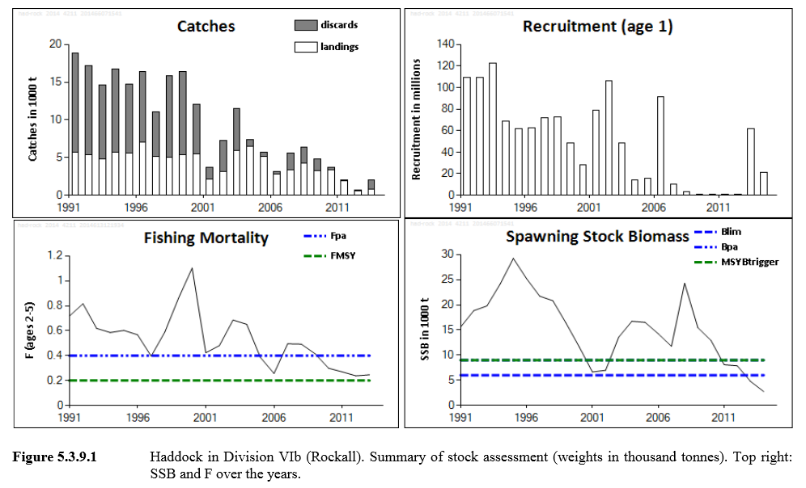

Slide 10
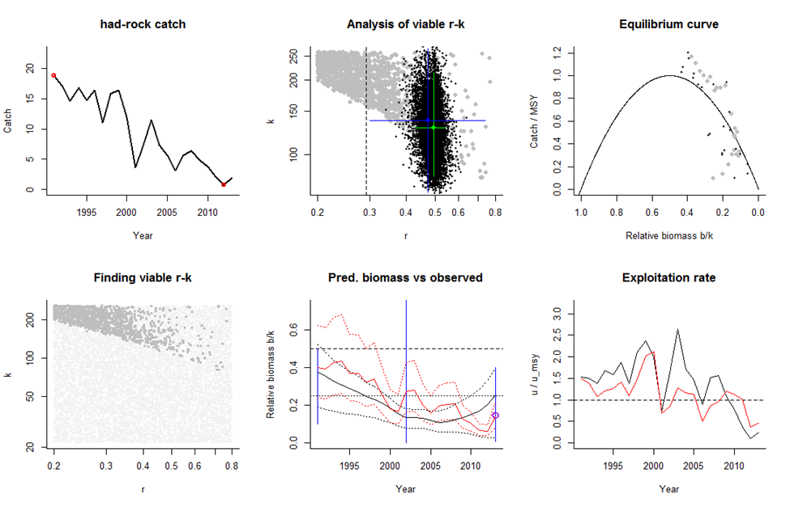
CMSY Analysis of Fully Assessed Stocks

Slide 11
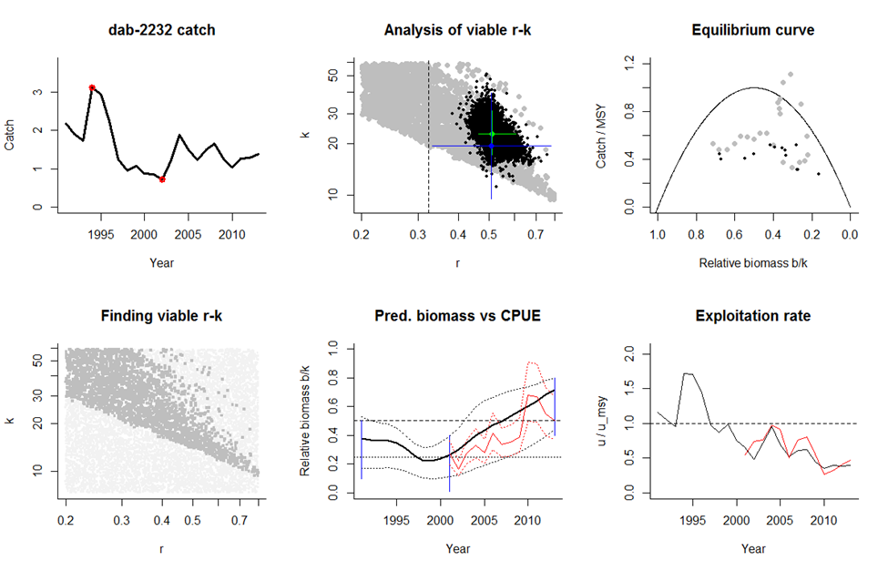
CMSY and BSM with CPUE

Slide 12
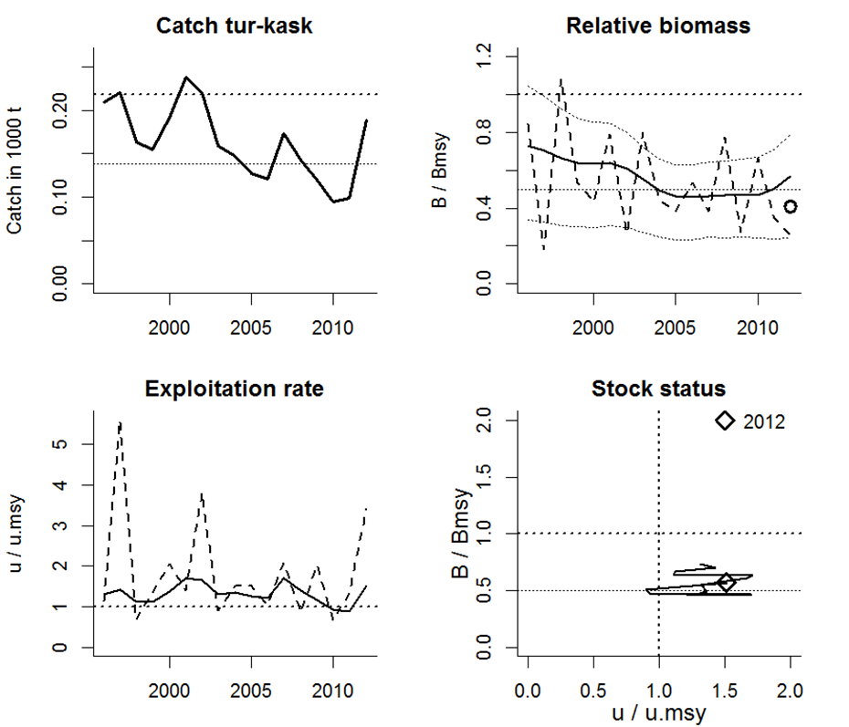
New Management Graph

Slide 13
Goals for this Workshop
Apply CMSY and BSM to several data-limited stocks
Simplify code (from research version to fit-for use-by-others version)
Write simple manual for CMSY and BSM

Slide 14
THANKS

