Slide 1
Data-Limited Stock Assessment Using CMSY/BSM
Rainer Froese, GEOMAR
28 November 2018, Q-Quatics, Los Baños, Philippines

Slide 2
Principles of Surplus Production Modelling

Slide 3
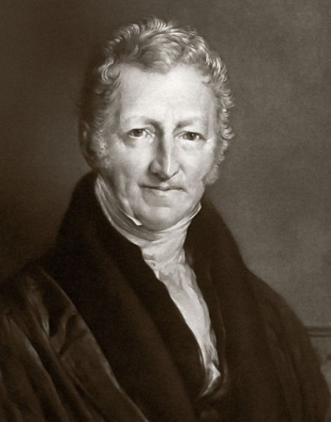
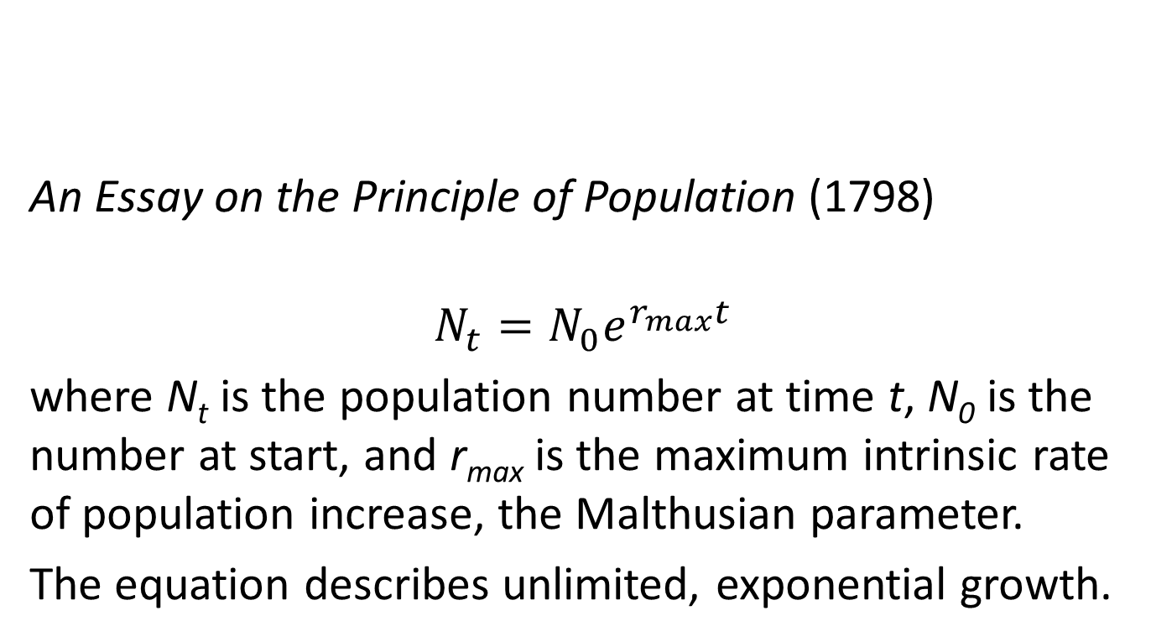
Thomas Robert Malthus
(1766 – 1834, English Economist)

Slide 4
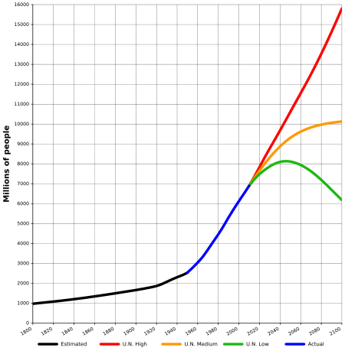

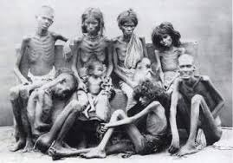
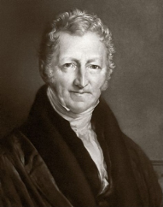
World Population Growth
"The power of population is indefinitely greater than the power in the earth to produce subsistence for man"

Slide 5
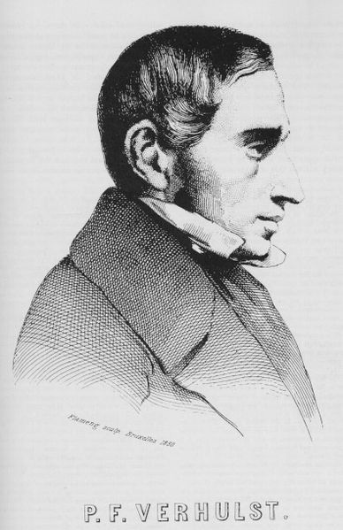
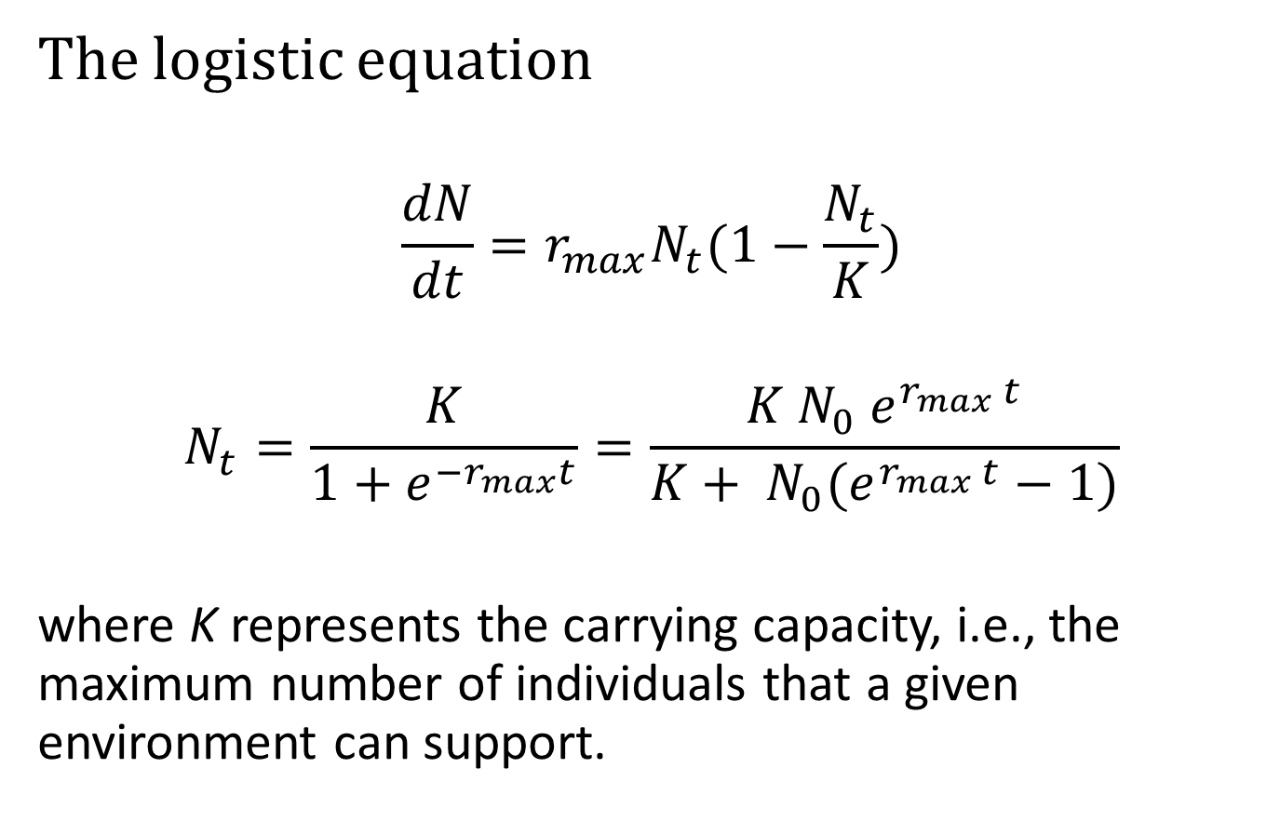
Pierre François Verhulst
(1804 – 1849, Belgian Mathematician)
(1844)
k
k
k
k
k

Slide 6
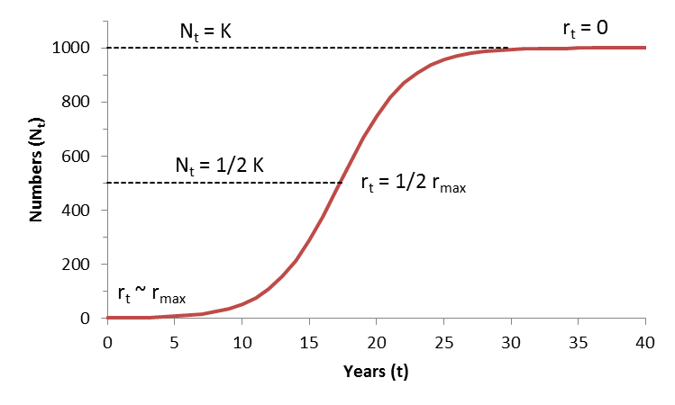
Logistic Curve Properties
k
k
BioDivPopGrowthMSY.xls

Slide 7
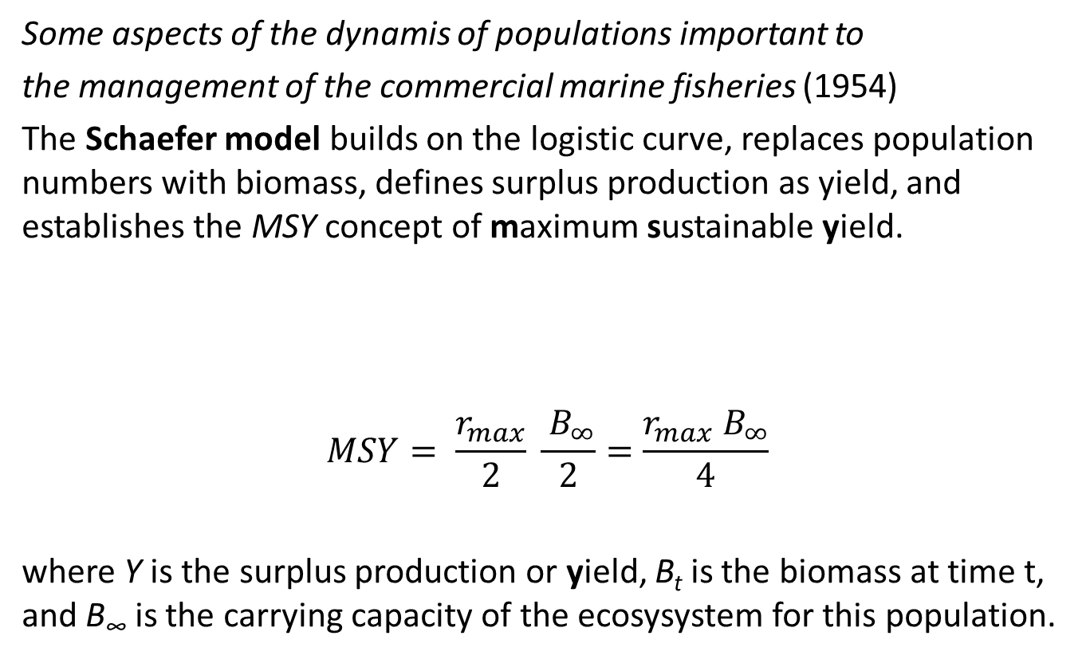
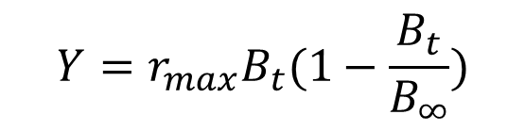
Milner Baily Schaefer
(1912 – 1970, US Fisheries Scientist)

Slide 8
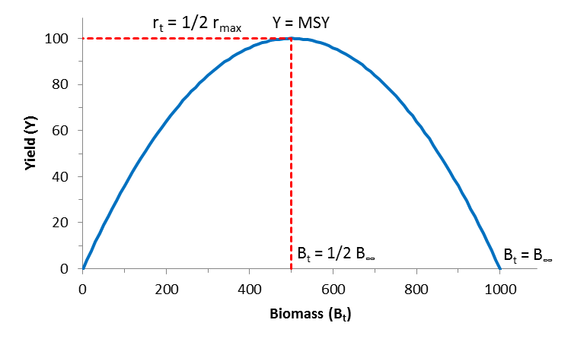
The Schaefer Model
BioDivPopGrowthMSY.xls

Slide 9
The Schaefer Model
Catch per unit of effort (CPUE in e.g. kg/h)
BioDivPopGrowthMSY.xls

Slide 10
The CMSY Method in a Nutshell

Slide 11
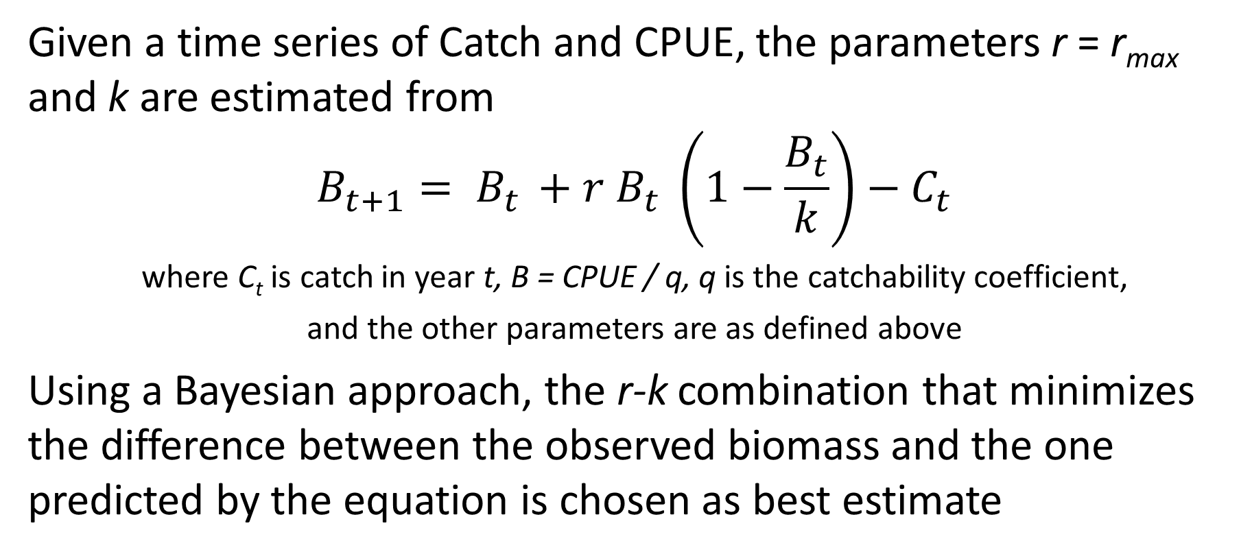
The BSM Method in a Nutshell
Given a time series of Catch and CPUE, the parameters r = r_{max} and k are estimated from
$$B_{t+1}= B_{t }+r B_{t} \left(1−\frac{B_{t}}{k}\right)−C_{t}$$
where C_{t} is catch in year t, B = CPUE / q, q is the catchability coefficient,
and the other parameters are as defined above
Using a Bayesian approach, the r-k combination that minimizes the difference between the observed biomass and the one predicted by the equation is chosen as best estimate

Slide 12
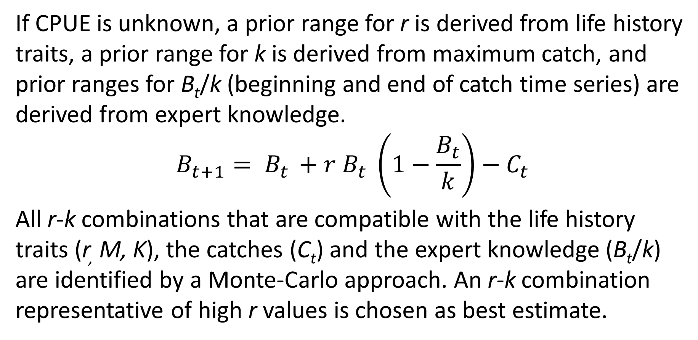
The CMSY Method in a Nutshell
If CPUE is unknown, a prior range for r is derived from life history traits, a prior range for k is derived from maximum catch, and prior ranges for B_{t}/k (beginning and end of catch time series) are derived from expert knowledge.
$$B_{t+1}= B_{t }+r B_{t} \left(1−\frac{B_{t}}{k}\right)−C_{t}$$
All r-k combinations that are compatible with the life history traits (r, M, K), the catches (C_{t}) and the expert knowledge (B_{t}/k) are identified by a Monte-Carlo approach. An r-k combination representative of high r values is chosen as best estimate.

Slide 13
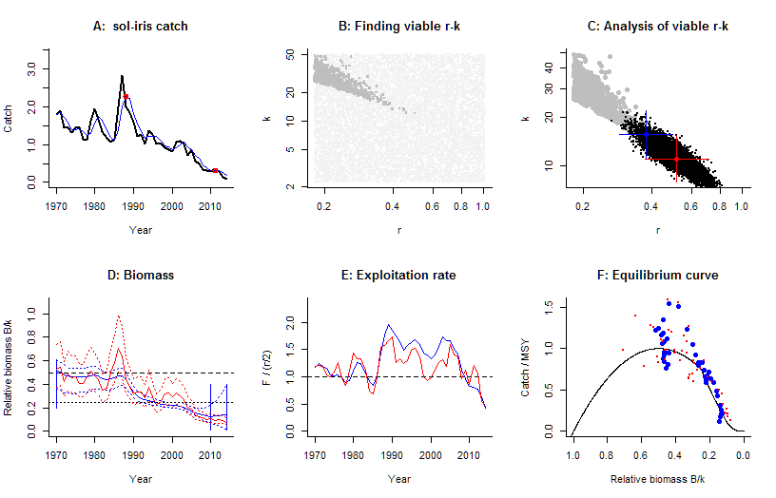
Sole in the Irish Sea:
Graphic Results of
CMSY/ BSM
analysis for use by
stock assessment
working group

Slide 14
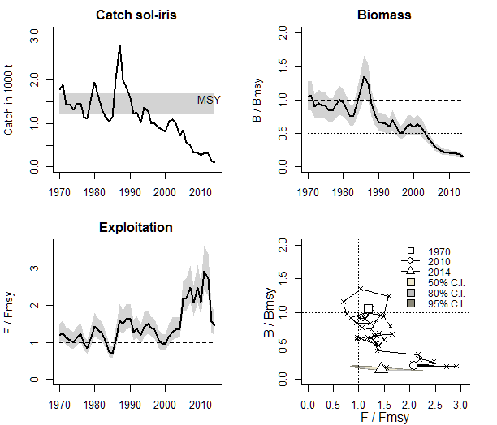
Sole in the Irish Sea:
Graphical results of
CMSY / BSM analysis
for use by management

Slide 15

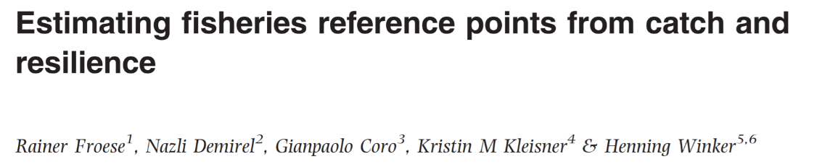
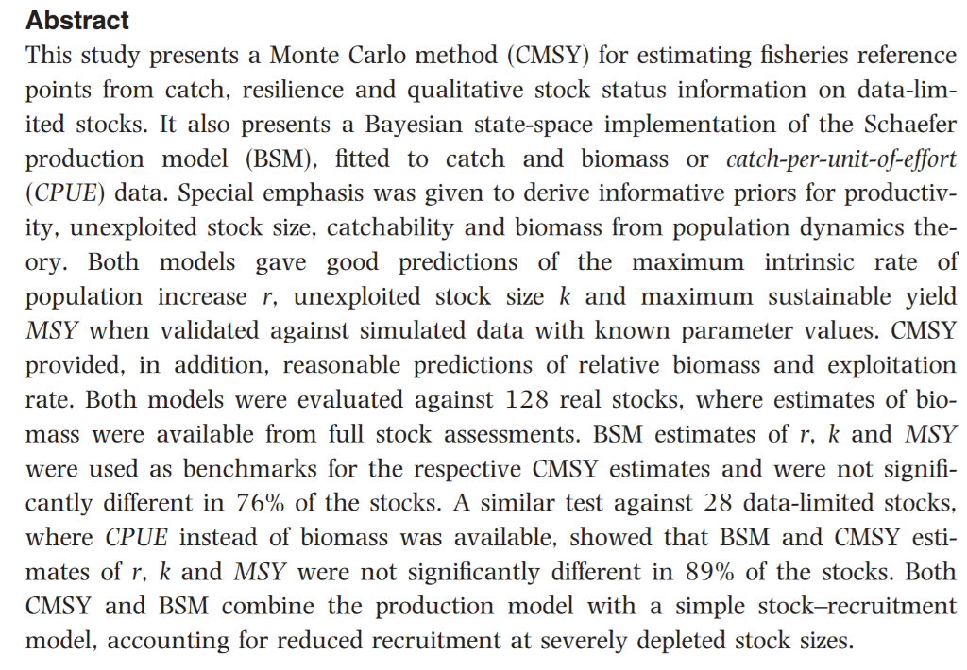
Download from:
www.fishbase.de/rfroese/

Slide 16
Proof of Concept: Application to 400 Stocks
Froese, R., Garilao, C., Winker, H.,
Coro, G., Demirel, N., Tsikliras, A.,
Dimarchopoulou, D., Scarcella, G.,
Sampang-Reyes, A. 2016.
Exploitation and status of European
stocks. World Wide Web electronic
publication,
http://oceanrep.geomar.de/34476/

Slide 17
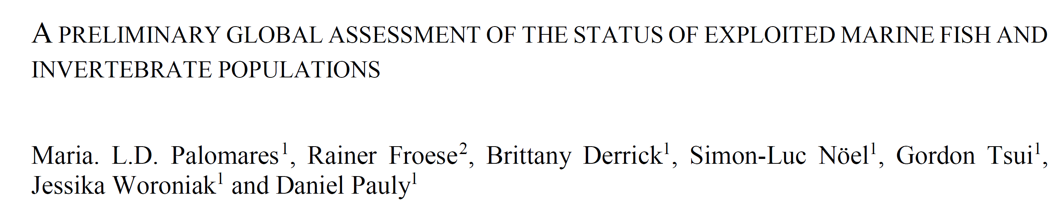
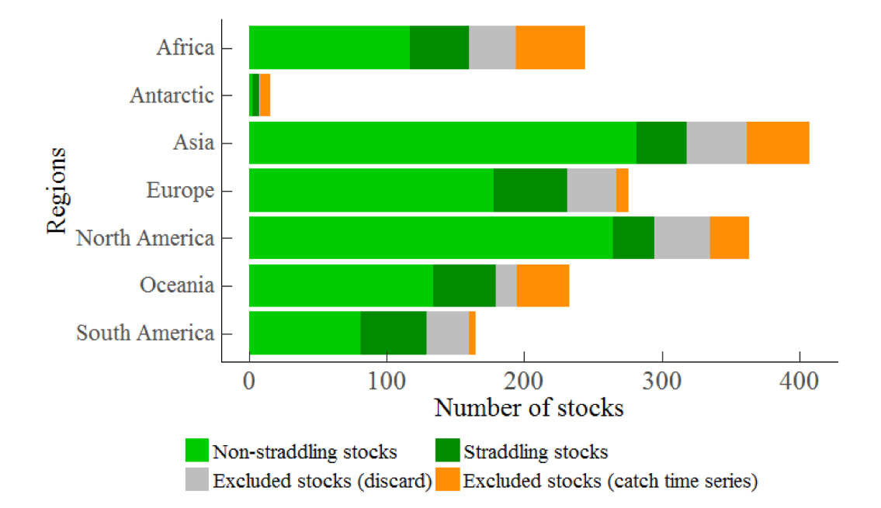
An assessment of the status of 1320 fish and invertebrate populations (or ‘stocks’) of 484 species exploited by
fisheries in 232 Marine Ecoregions (MEs) overlapping with the Exclusive Economic Zones (EEZs) of 218 countries
and their overseas territories was performed using the CMSY method applied to annual catches (1950-2014)
reconstructed by the Sea Around Us.

Slide 18
Checking Out Stock Assessments in Asia
Go to www.SeaAroundUs.org
Select “Tools & Data”
Select “Search Type: ME”
Click on a Marine Ecoregion of interest,
e.g. Eastern Philippines
Scroll down to Stock Assessments and select a stock,
e.g. Katsuwonis pelamis
https://s3-us-west-2.amazonaws.com/cmsy/Kats_pel_WesternPacificOcean2018-06-15-2052.RnW.pdf

Slide 19
Questions for CMSY?
Thank You

