Slide 1
Brain Size in Fish and FishBase
Rainer Froese
GEOMAR Helmholtz Centre for Ocean Research
UNAM, 16 October 2017

Slide 2
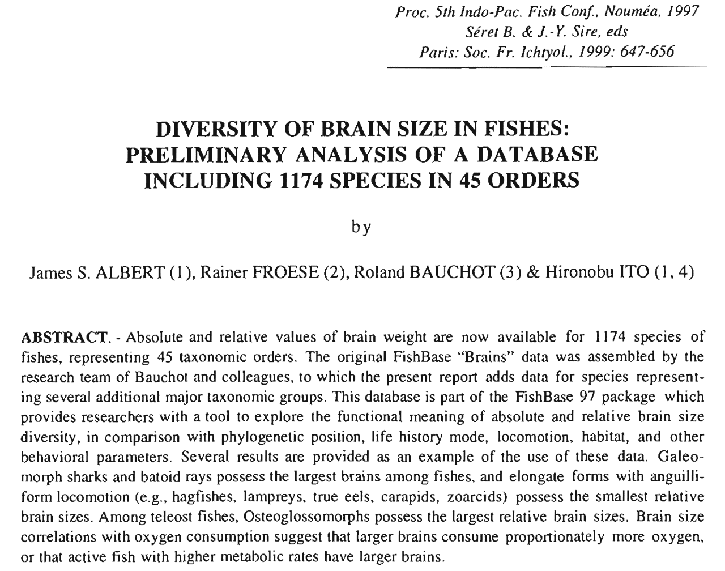
Aavailable from
www.fishbase.de/rfroese/

Slide 3
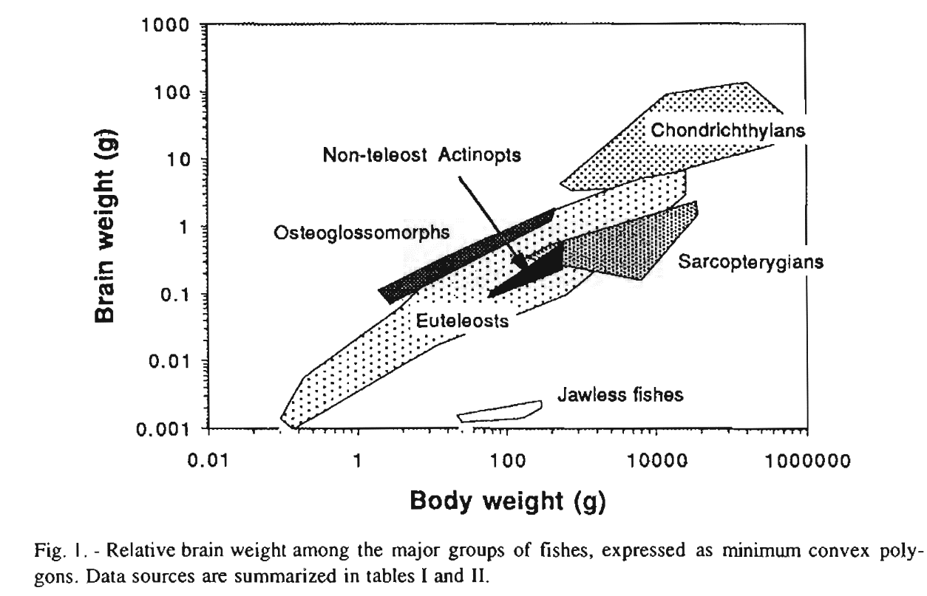
Wide Variety of Brain Size in Fish
Much of the diversity is explained by phylogenetic relationships: species in the same Genus, Family, Order or Class will have similar relative brain sizes

Slide 4
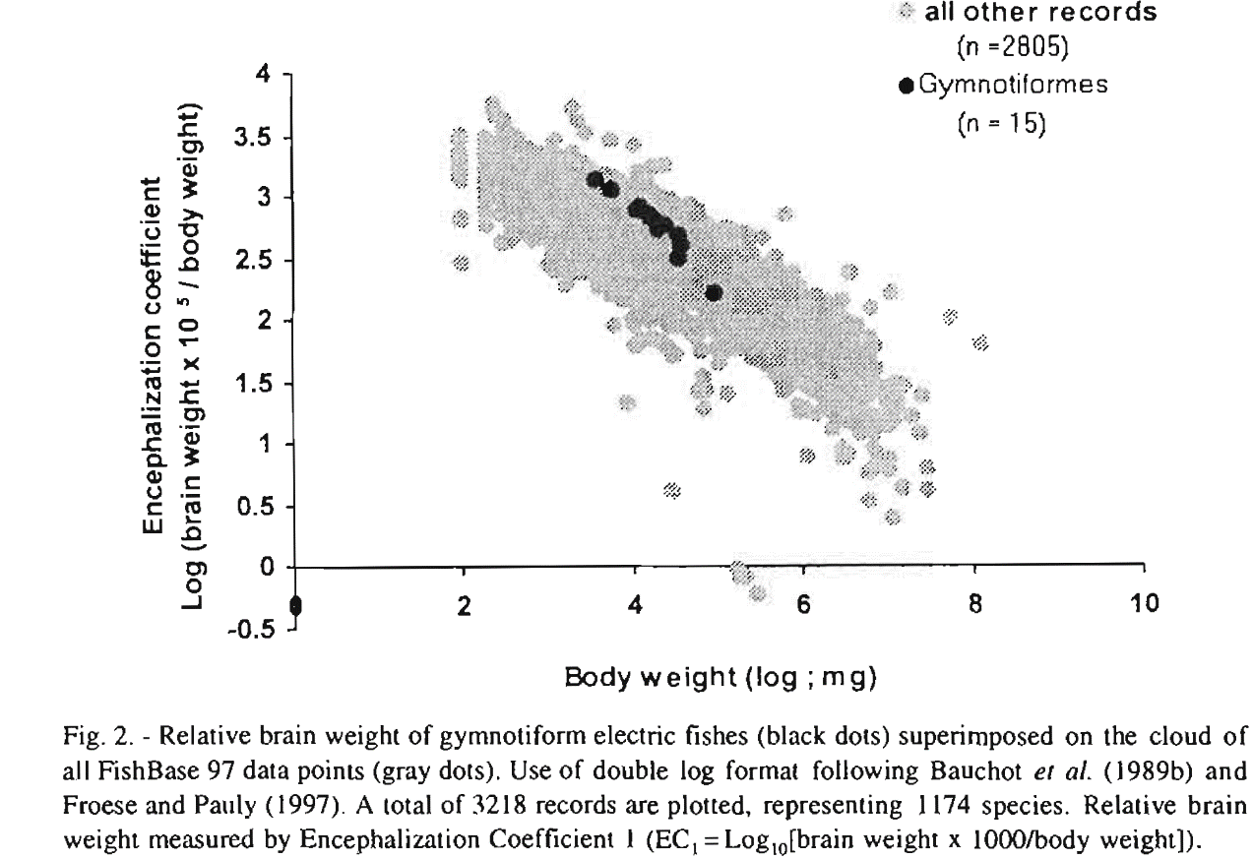
Species with special cognitive
abilities tend to have larger brains,
here: electro-sensing bony fish

Slide 5
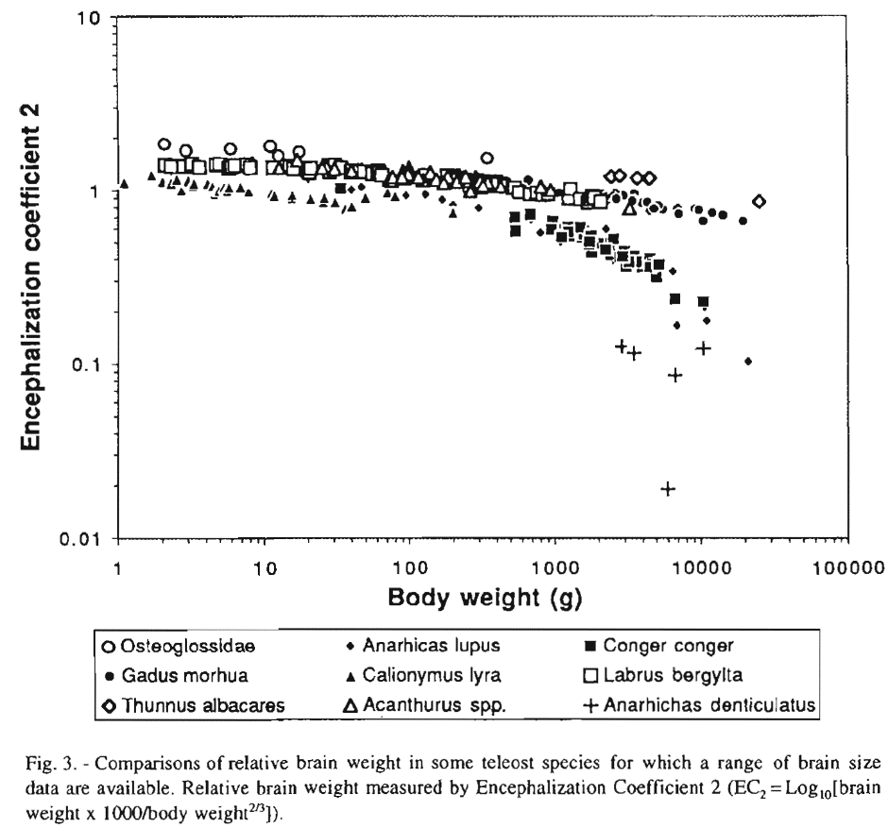
There are errors in the data
Brain growth slows before maximum size is reached

Slide 6
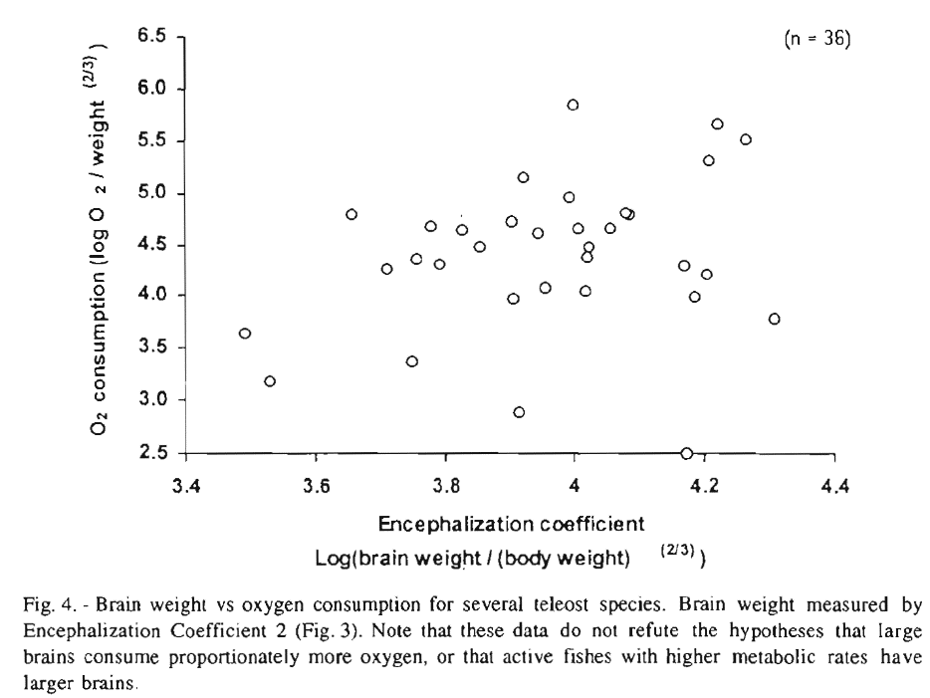
Brains are the most oxygen-demanding organ
More active fish tend to have higher oxygen
consumption and larger brains
Also, airbreathing fish such as the Arapaima
tend to have larger brains, presumably because providing the required oxgen-supply is less costly.

Slide 7
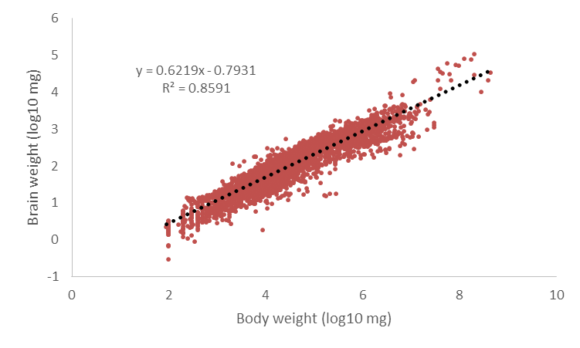
Across-Species Scaling is about 2/3
For between species comparsions,
scaling of brain weight with body
weight is traditionally assumed
as 2/3 or 0.67, i.e., about same
as surface area and a bit less than
blood flow and metabolism, which
are typically scaling with ¾ of
body weight.
RF_Brains_1.xlsx

Slide 8
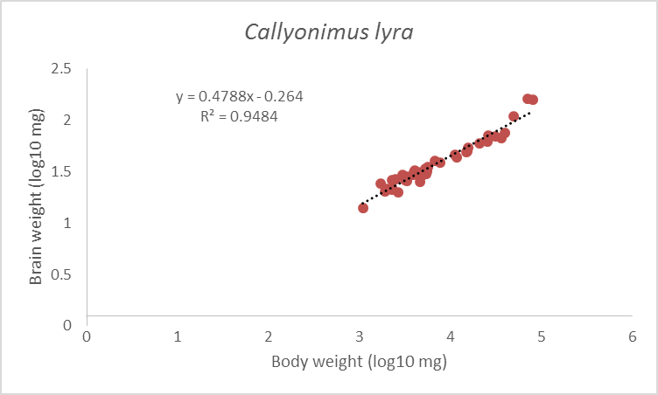
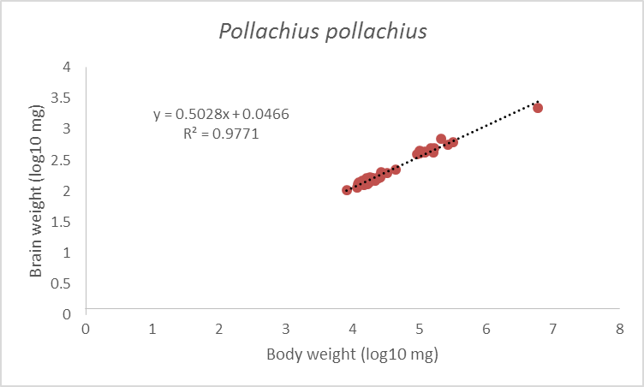
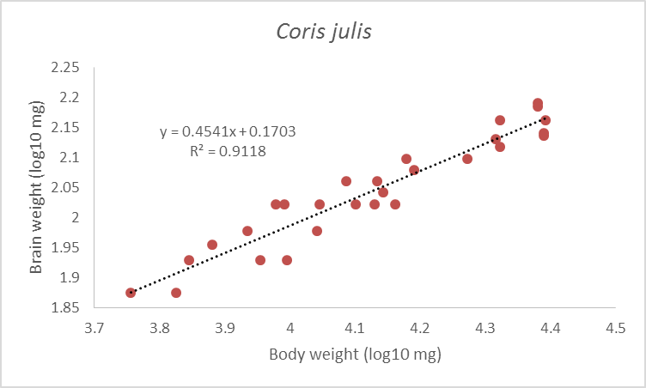
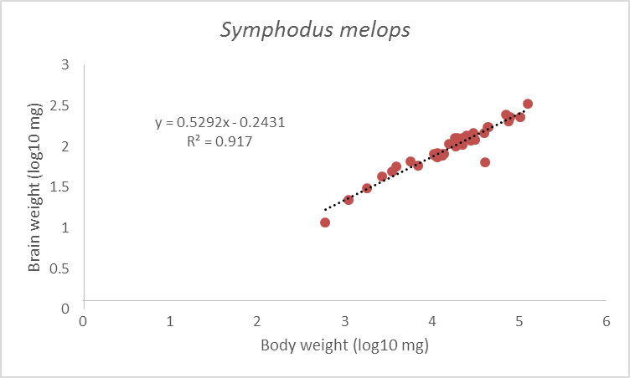
Within-Species Scaling is typically around 0.5

Slide 9
Conclusions
Brain size is correlated with phylogeny, life history traits, life style, and special cognitive abilities
Brains grow slower than the rest of the body
Within-species brain growth is slower than across species
When compairing brain size, phylogeny, life history traits, life style, and special cognitive abilities have to be accounted for
If slopes of brain growth can be standardized to the same scaling, then the intercept can be tested for significant difference
Larger numbers of individuals reduce uncertainies

