Slide 1
Data-Limited Stock Assessment Using CPUE only: AMSY
Rainer Froese, GEOMAR
23 April 2019, Kiel, Germany

Slide 2
Available Data in Data-Poor Fisheries
Length-frequencies from the commercial fishery
Use LBB (compare Linf with data in FishBase/SealifeBase)
Catch
Use CMSY (use expert interviews or better LBB for B/B₀ priors)
Catch-per-unit-of-effort (CPUE)
Use CMSY/BSM if CPUE and catch data are available
Use AMSY if catch is unreliable or if true stock boundaries are unknown (use expert interviews or better LBB for B/B₀ prior anywhere in the time series)

Slide 3
Acceptable Data
kg per hour
kg per day
Specimens per 100 hooks per day
catch per fuel used
time series of acoustic survey
any arbitrary index
Only the trend must be correct (min 10 years)

Slide 4
Why would there be Only CPUE?
Catch data are often unkown or aggregated (e.g. small pelagics) or unreliable
CPUE may be available from research data or from a reliable fisher’s log-book

Slide 5
The AMSY Method in a Nutshell
If only CPUE is known, a prior range for r is derived from FishBase, a single prior range for B/k = CPUE/kq (anywhere in the time series) is derived from expert knowledge or better from LBB. The lower end of the range must be larger than max CPUE.
$${CPUE}_{t+1}= {CPUE}_{t }+r {CPUE}_{t} \left(1−\frac{{CPUE}_{t}}{k_{q}}\right)−C_{q t}$$
All r-k_{q} combinations that are compatible with the CPUE in the sense that they result in time series of plausible (never negative, never much too high) predicted catches are identified by a Monte-Carlo approach.

Slide 6
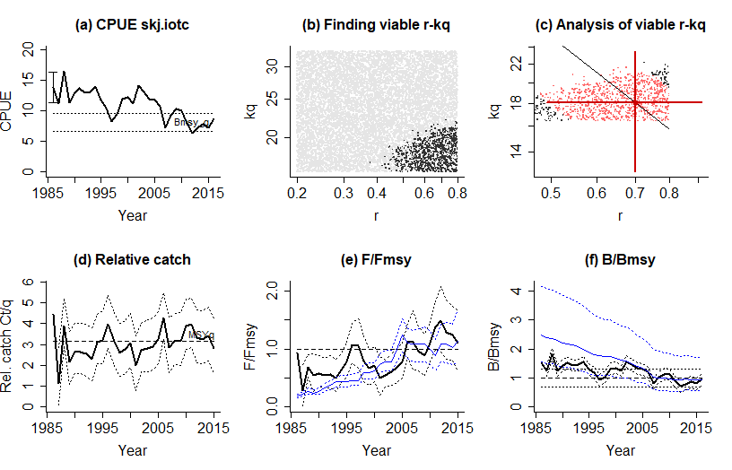
AMSY assessment of Skipjack tuna in the Indian Ocean
Notes:
(a) The bold curve shows the time series of CPUE. The dotted horizontal lines indicate the range where Bmsy could be. The error bar in 1985 indicates the expert opinion on relative stock size, here 70-100% of unexploited biomass. (b) The grey dots indicate all r-k pairs that were tested; the black dots indicate the ‘viable’ pairs. (c) The disgonal black line indicates all r-k pairs that result in the same, median MSYq estimate. The black dots are the viable pairs, overlaid with red if they fall within the 95% confidence limits of MSYq. The red cross indicates the most probable r-kq pair, with indication of confidence limits. (d) The bold curve shows the predicted catches resulting from the median r-kq pair combined with CPUE. The dotted curves indicate the 95% confidence limits. The dashed line is MSYq. (e) The bold curve shows predicted exploitation F/Fmsy, the dotted curves are 95% confidence limits. The blue curves result from the independent full assessment, for comparison. (f) The bold blck curve indicates relative stock size B/Bmsy, with (dotted) 95% confidence limits. The dashed line indicates B=Bmsy, with confidence limits. The blue curves stem from the independent full assessment, for comparison.

Slide 7
AMSY Analysis, Wed Mar 06 14:38:05 2019
------------------------------------------------------------
Stock skj.iotc , Katsuwonus pelamis , Indian Ocean skipjack tuna
CPUE data for years 1986 - 2016 , CPUE range 6.42 - 16.4 , smooth = FALSE
Prior for r = Medium , NA - NA
Used prior range for r = 0.2 - 0.8
Prior for 1986 stock status = More than half , 0.7 - 1
Used 1986 prior B/B0 range = 0.7 - 1 , prior B/Bmsy = 1.4 - 2
Used prior range for kq = 16.4 - 32.8 [ original range = 13.4 - 19.1 ]
Assessment Fmsy = 0.37
Assessment F/Fmsy = 1.14 , 0.78 - 1.7 ( 2015 )
Assessment proxy Bmsy = 1117971
Assessment proxy B/Bmsy = 0.946 , 0.57 - 1.7 ( 2016 )
Source: NA
Comment: Standardized CPUE from EU Purse Seine Index

Slide 8
Monte Carlo filtering of r-kq space with 10000 points and 30 error patterns
Viable r-kq pairs = 3621
Results:
selected r-kq pairs = 3442
median kq = 18.1 , 12.6 - 23.5
median MSYq = 3.16 , 2.22 - 3.89
r (4 MSYq/kq) = 0.7 , 0.49 - 0.91
Fmsy (r/2) = 0.35 , 0.245 - 0.455
F/Fmsy = 1.1 , 0.626 - 1.65 ( 2015 )
B/Bmsy = 0.958 , 0.758 - 1.16 ( 2016 )

Slide 9
Consider “effort creep” in commercial CPUE
Fisher tend to follow the stock and can maintain high catches even if the overall stock is declining
Because of increasing experience of fishers or better gears or better equipment, the catch per effort tends to increase
CMSY and AMSY allow to correct for effort increase
2% per year has been found to be a reasonable average in many fisheries (Pauly and Palomares, submitted)

Slide 10
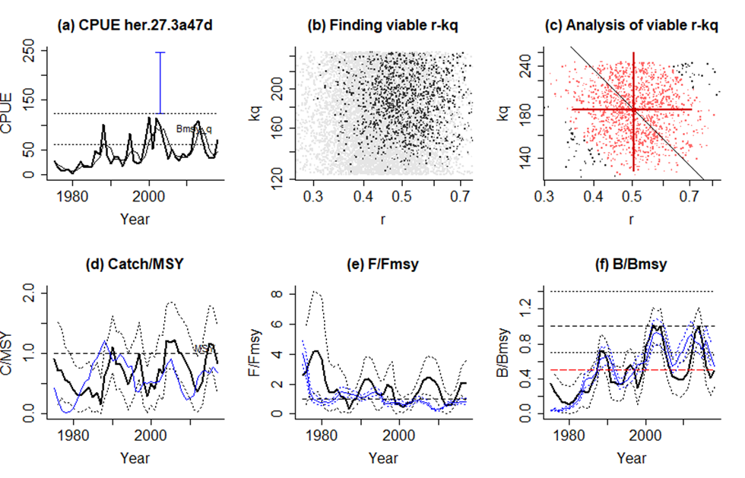

Slide 11
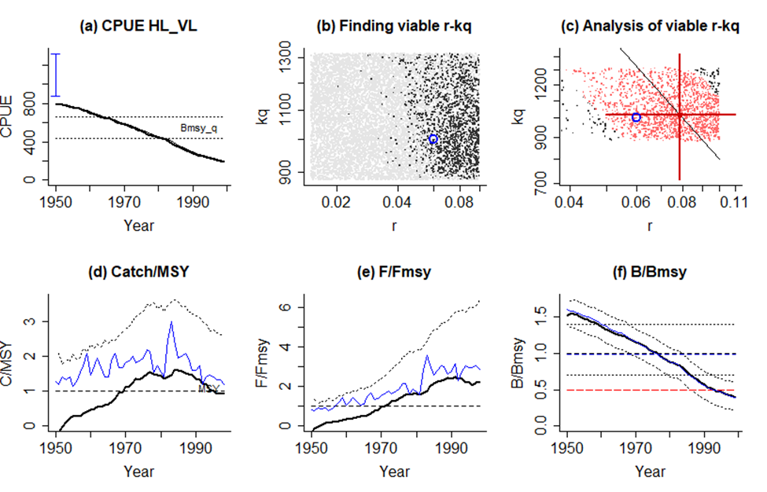
Bad Fits (1)

Slide 12
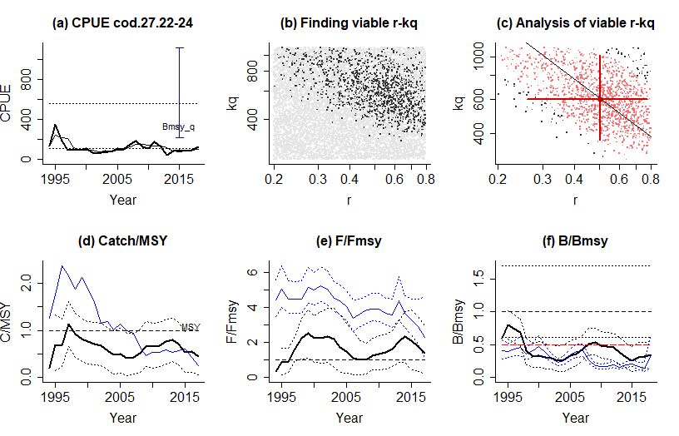
Bad Fits (2)

Slide 13
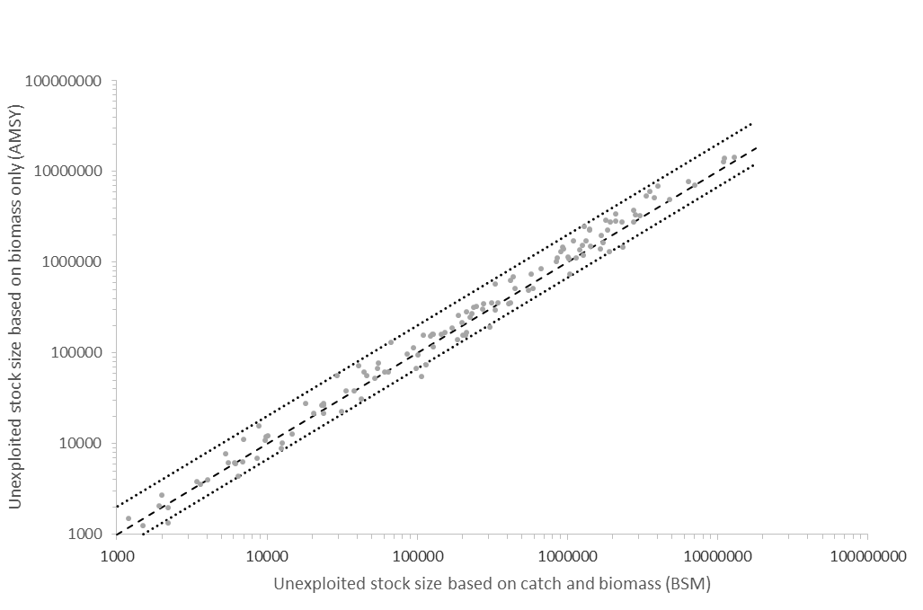
Comparison with full Schaefer

Slide 14
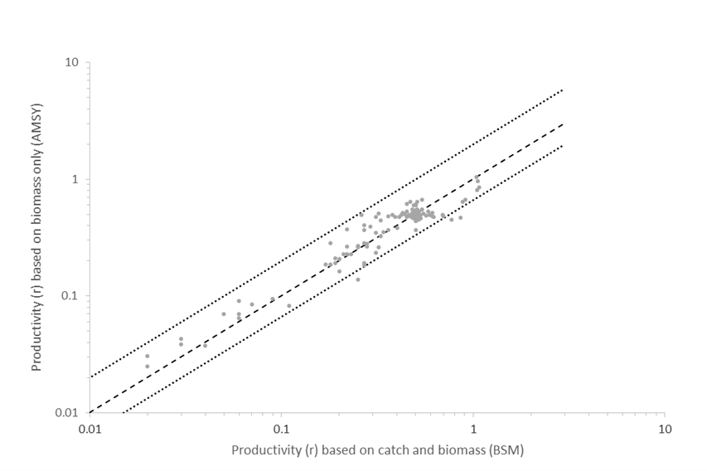

Slide 15
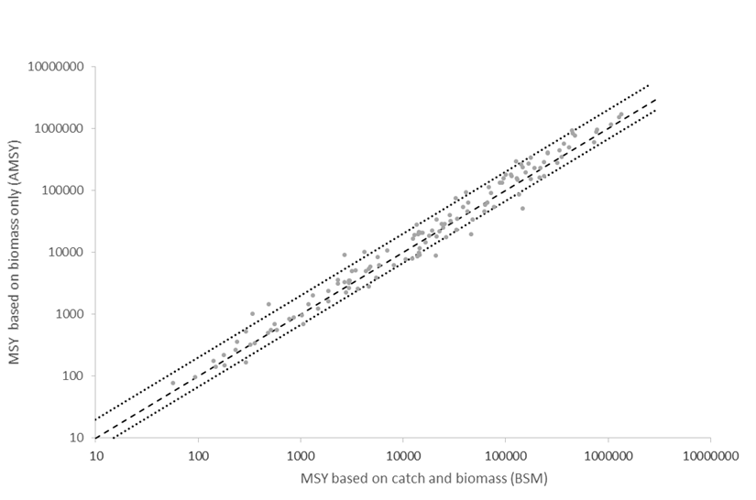

Slide 16
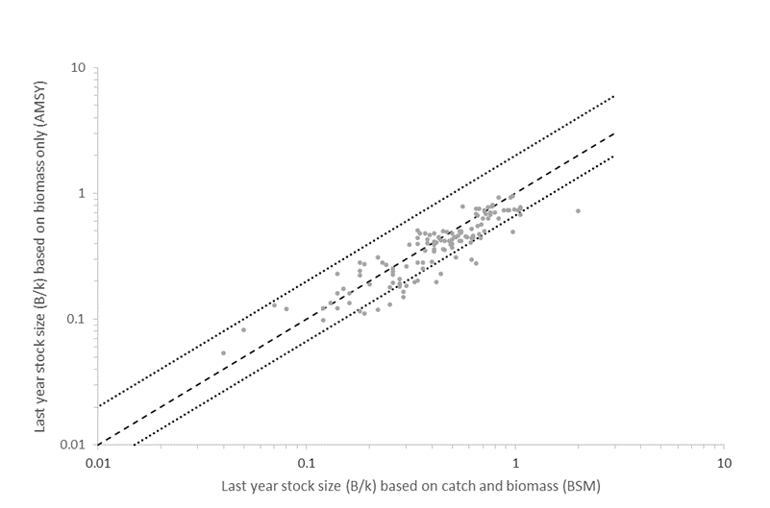

Slide 17
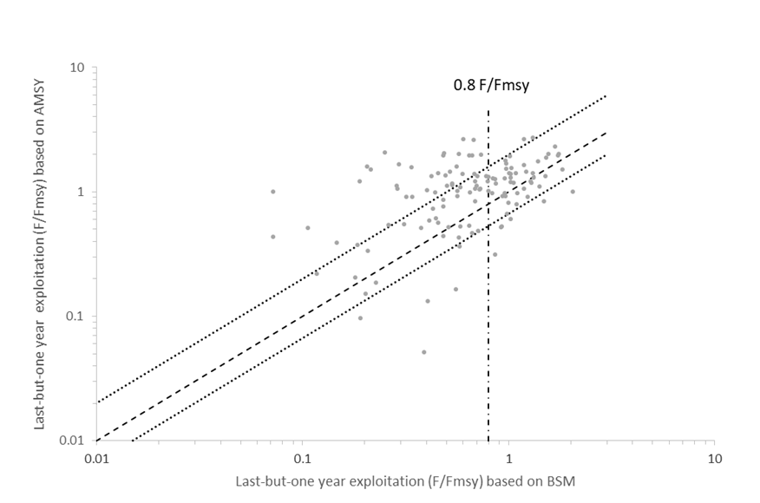

Slide 18
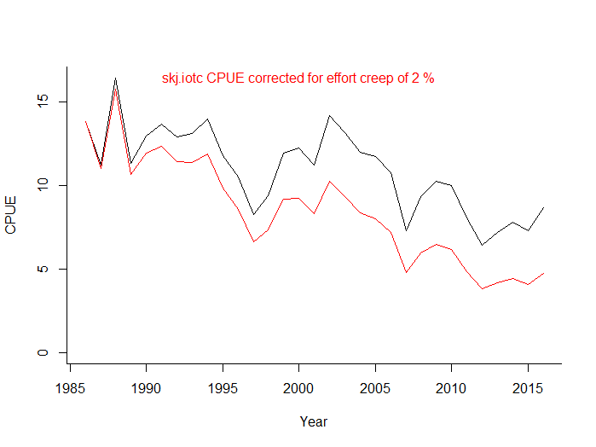
Effort creep correction for Skipjack

Slide 19
Questions for AMSY? Thank You
Rainer Froese, GEOMAR
07 March 2019, NFRDI & Q-Quatics, Quezon City, Philippines

