Slide 1
Overfishing the Unknowns: How Science Can Help Managing Data-poor Fish Stocks
Rainer Froese
HOSST-TOSST Seminar 07 April 2016
GEOMAR, Kiel, Germany

Slide 2
The Challenge
Globally, about ¾ of exploited fish stocks are “data-poor”, i.e., stock status is unknown
This is also true for developed areas, such as Europe or North America
Combining catch data with general knowledge and heavy computing can provide reasonable proxies for stock assessment and fisheries management

Slide 3
Background: Some Fisheries Terms
MSY is the maximum sustainable yield (catch) that a fish stock can provide
Biomass (B) is the weight of the fish in the water
B_{msy} is the smallest biomass that can still produce MSY
F is the fishing mortality rate, the fraction of biomass killed by fishing
F_{msy} is the F that will eventually result in B_{msy} and MSY

Slide 4
Background: Some Population Dynamics Terms
r is the maximum intrinsic rate of population increase at small population sizes
k is the maximum population size or carrying capacity, where population growth is zero
Absolute population growth in numbers or biomass (Y = surplus production) is highest at about ½ k and about ½ r
MSY is obtained at B_{msy} = ½ k with fishing mortality F_{msy} = ½ r

Slide 5
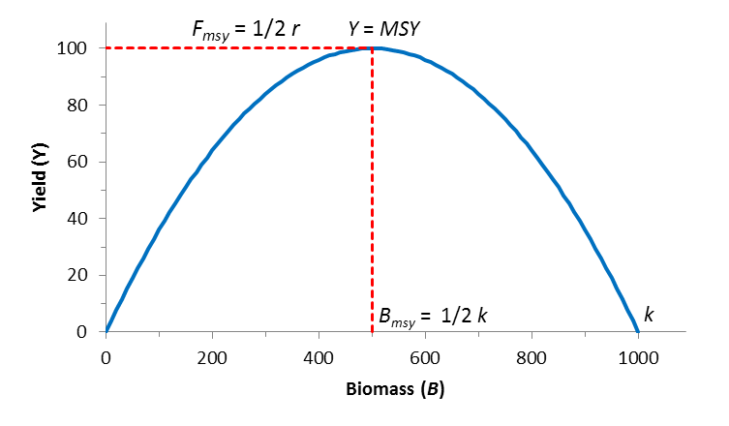
Relation between Biomass and Yield

Slide 6
Data-rich Stock Assessments
In data-rich stock assessments, commercial catches, abundance estimates from surveys, and data on size and numbers by age group are combined to estimate biomass (B) and fishing mortality (F).
With additional estimates of natural mortality and the relation between biomass of parents and recruitment, the references points B_{msy} and F_{msy} are derived.

Slide 7
New Approach to Data-poor Stock Assessments
In data-poor stock assessments, all that is known are the landings, qualitative impressions about the status of the fishery, and some life history traits (max size, max age, fecundity, growth rates) of the species
A Monte Carlo approach is used to find the combination of stock size k and productivity r that is compatible with the available information

Slide 9
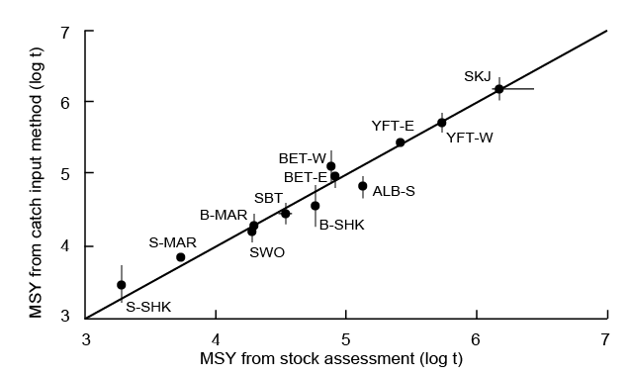
Comparing MSY estimates with those from full stock assessments
Pacific tuna and sharks, from Schiller and Pauly, in prep.
Notes:
Pacific tuna and shark stocks whose MSY was estimates using complex and data-hungry stock assessments (X-axis) and using the catch-MSY methods (from FishBase); from Schiller and Pauly (in prep.)

Slide 10
From Catch-MSY to CMSY
The Catch-MSY method of Martell & Froese (2013) provides robust estimates of MSY
The method has been developed further (called CMSY) and now provides in addition estimates of F_{msy}, B_{msy}, current biomass and current exploitation rate (Froese et al., submitted)

Slide 11
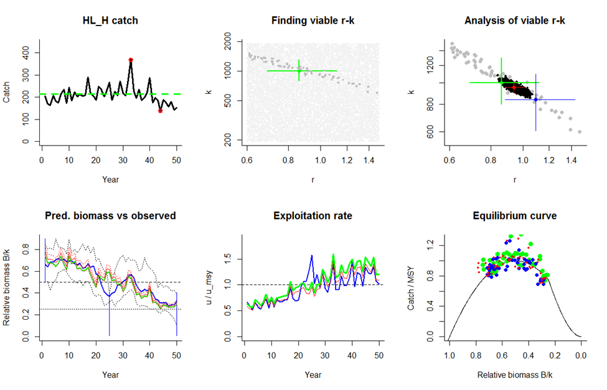
CMSY Simulation testing
Simulated high to low biomass, for a species with high resilience. Green = simulated,
red = BSM full assessment, blue = CMSY assessment.

Slide 12
CMSY Evaluation
Evaluation testing against full assessment data for Arctic cod.
Red = BSM full assessment, blue = CMSY assessment

Slide 13
CMSY Summary
Requires: catch or landings, resilience (e.g. from FishBase), broad stock status (good or bad)
Predicts: MSY, B_{msy}, F_{msy}, current biomass & exploitation.
Performance: results compare well with those from traditional, data-hungry stock assessments

Slide 14
CMSY Outlook
In an upcoming workshop, CMSY and BSM will be applied to all European stocks, including the Mediterranean and the Black Sea
For many stocks, this will be the first assessment in an MSY framework
It will be the first comprehensive assessment of biomass, stock status and exploitation level for all commercial stocks in European waters

