Slide 1
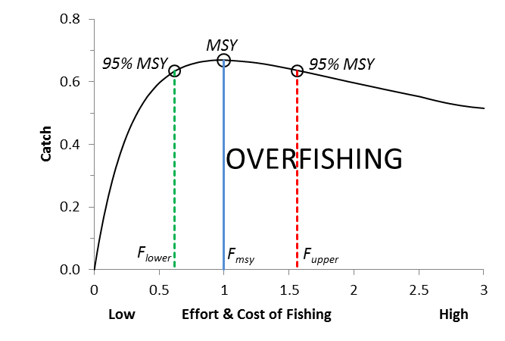
Relation between fishing effort or cost of fishing and predicted long-term catches.
Note that 95% of the theoretical maximum catch can be obtained with substantially
lower effort and cost (F_{lower}) and thus with substantially higher profits for the fishers.

