Slide 1
Estimating the intrinsic rate (r_{max}) of population increase from life history correlates
Rainer Froese GEOMAR
41st CIESM Congress
Audimax, University of Kiel
12 September 2016, Kiel, Germany

Slide 2
Question
If you were granted the wish
to know one number
for every species on Earth,
what number would you pick?

Slide 3
Answer
For every population, there is one number that summarizes maximum size, longevity, maturity, mortality, somatic growth, and reproductive success:
r_{max}
The maximum intrinsic rate of population increase

Slide 4
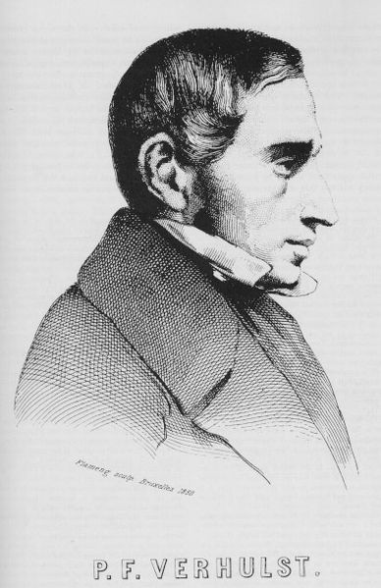
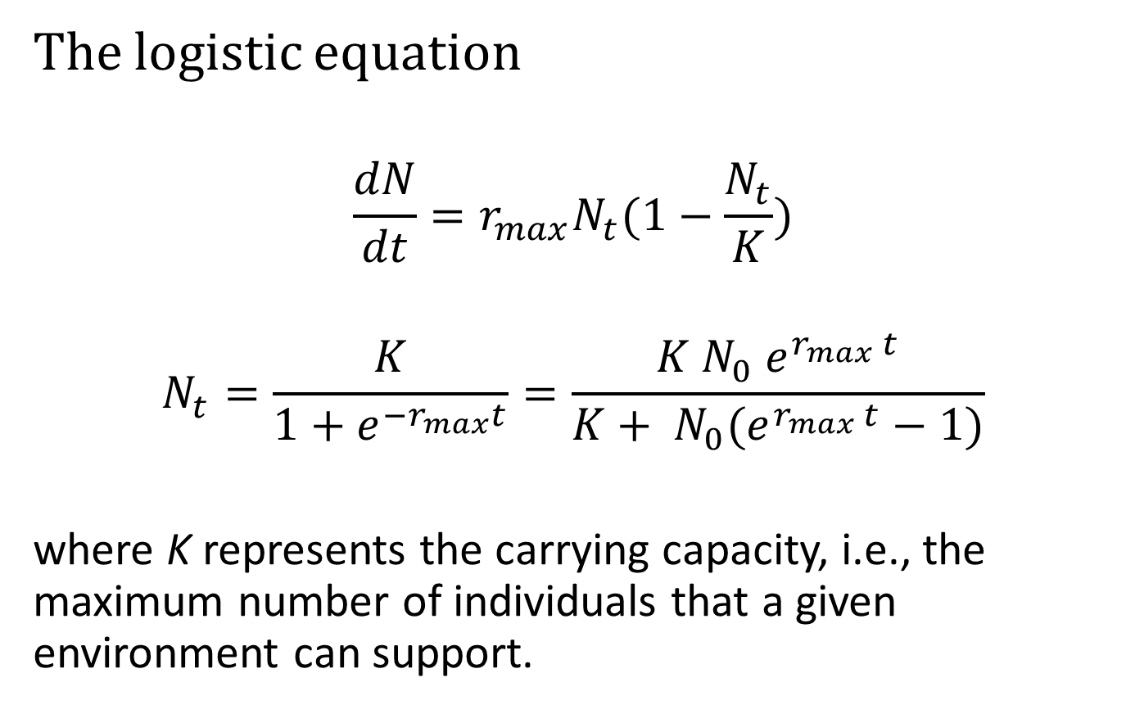
Pierre François Verhulst
(1804 – 1849, Belgian Mathematician)
(1844)

Slide 5
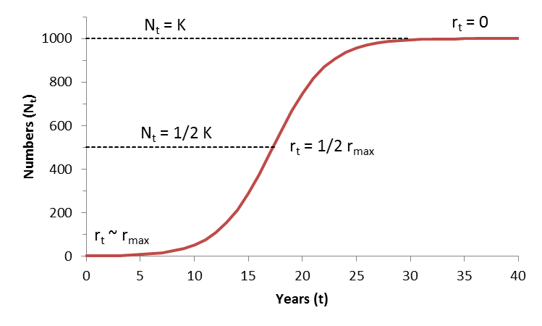
Logistic Curve Properties
BioDivPopGrowthMSY.xls

Slide 6
Importance to Conservation
How fast populations can recover from a depleted state is determined by r_{max}
Doubling time = log(2) / r_{max} ̴ 0.7 / r_{max}
r_{max} = 0.7 → 1 year
r_{max} = 0.07 → 10 years

Slide 7
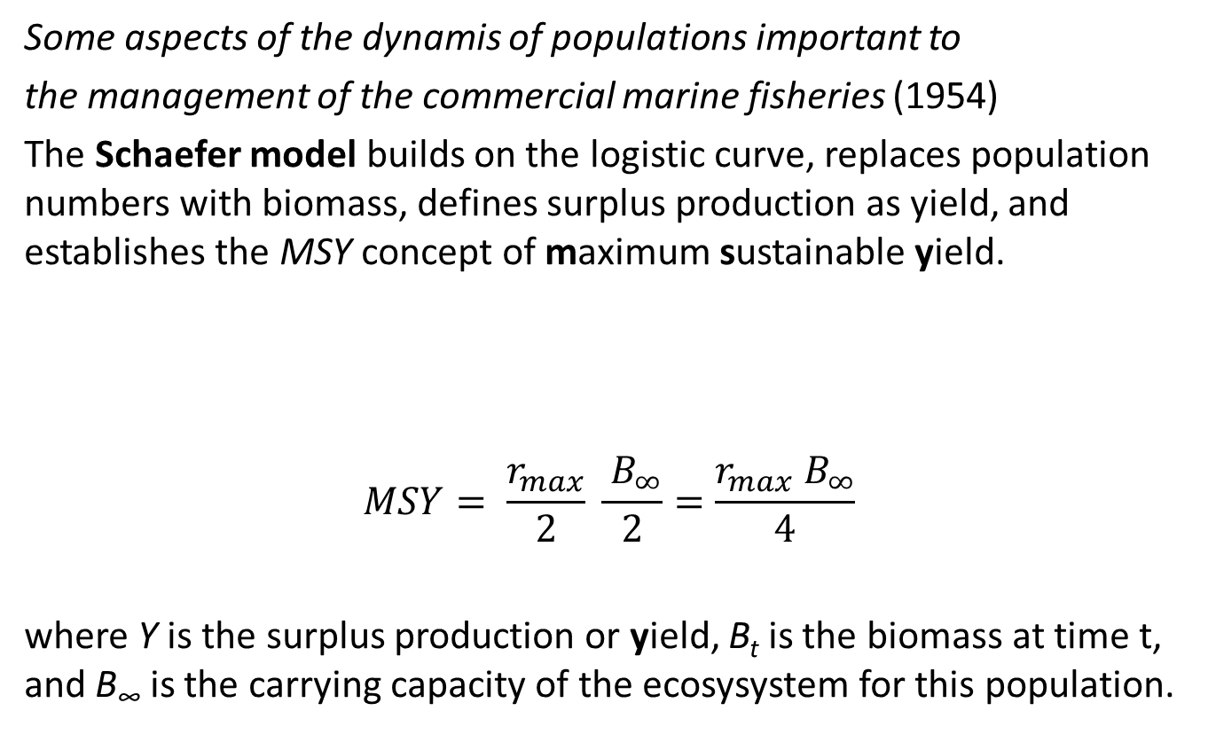
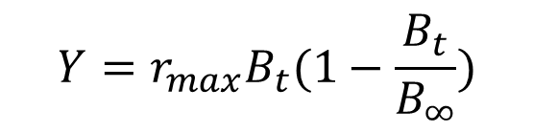
Milner Baily Schaefer
(1912 – 1970, US Fisheries Scientist)

Slide 8
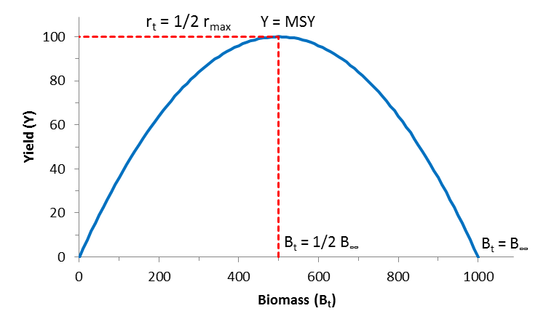
The Schaefer Model
BioDivPopGrowthMSY.xls

Slide 9
Life History Correlates of r_{max}
r_{max} = 2 F_{msy} (Schaefer 1954)
r_{max} ̴ 2 M because M ̴ F_{msy} (Gulland 1971)
r_{max} ̴ 3 k because K ̴ 2/3 M (Jensen 1996)
r_{max} ̴ 9/t_{max} because t_{max} ̴ 3/k (Taylor 1958)
r_{max} ̴ 3.3/t_{gen} because t_{gen} ̴ 1/k (Roff 1984)
r_{max} = f(Fecundity < 1000) (Musick 1999)
These relations were used to predict r_{max} in FishBase for currently close to 1000 species:

Slide 10
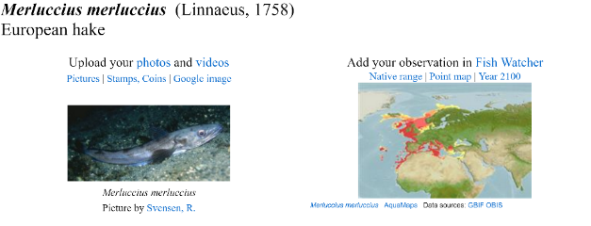

Currently only on www.fishbase.ca

Slide 11
Thank You

