Slide 1
Many Ways to Estimate B_{msy}
Rainer Froese, GEOMAR
Presentation at the Workshop on
Challenges and Opportunities of
Fish Stock Recovery Targets
13 October 2014, Brussels, Belgium

Slide 2
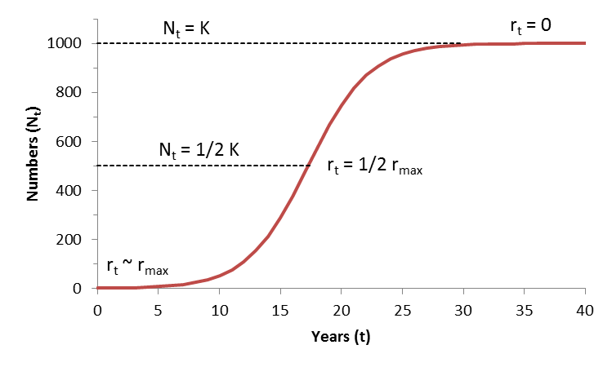
Verhulst (1844) Model of Population Growth
BioDivPopGrowthMSY.xls

Slide 3
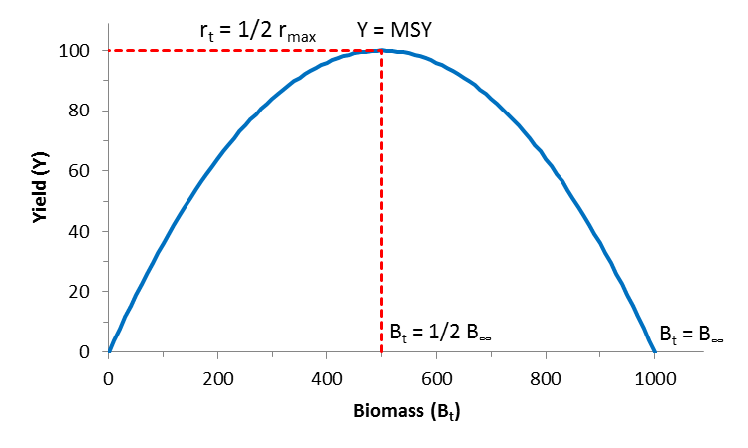
The Schaefer Model (1954)
F_{msy} = ½ r_{max}
B_{msy} = ½ K
BioDivPopGrowthMSY.xls

Slide 4
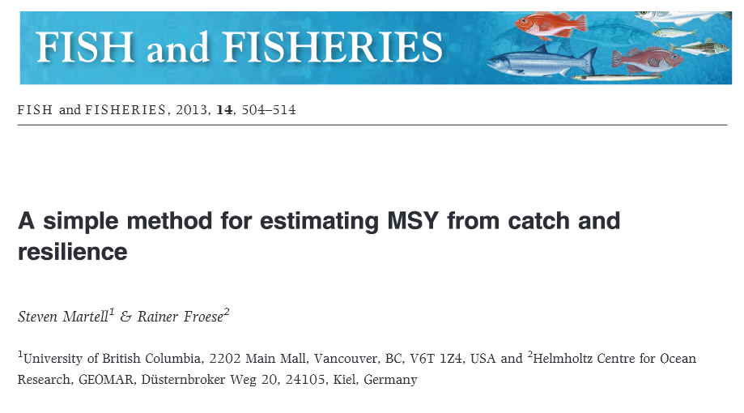
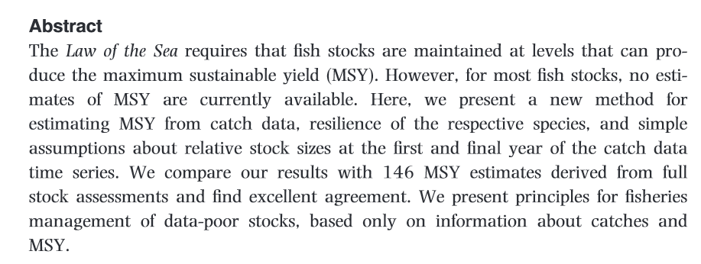
Available from the Workshop Drop Box

Slide 5
From Catch-MSY to CMSY
Catch-MSY gave robust estimates of MSY, but biased estimates of r (too low) and K (too high).
CMSY overcomes the bias and gives reasonable estimates of F_{msy} and B_{msy}
Catch-MSY could not reliably predict biomass
CMSY gives reasonable estimates of biomass
Simulation testing and evaluation of CMSY done, submission planned for December

Slide 6
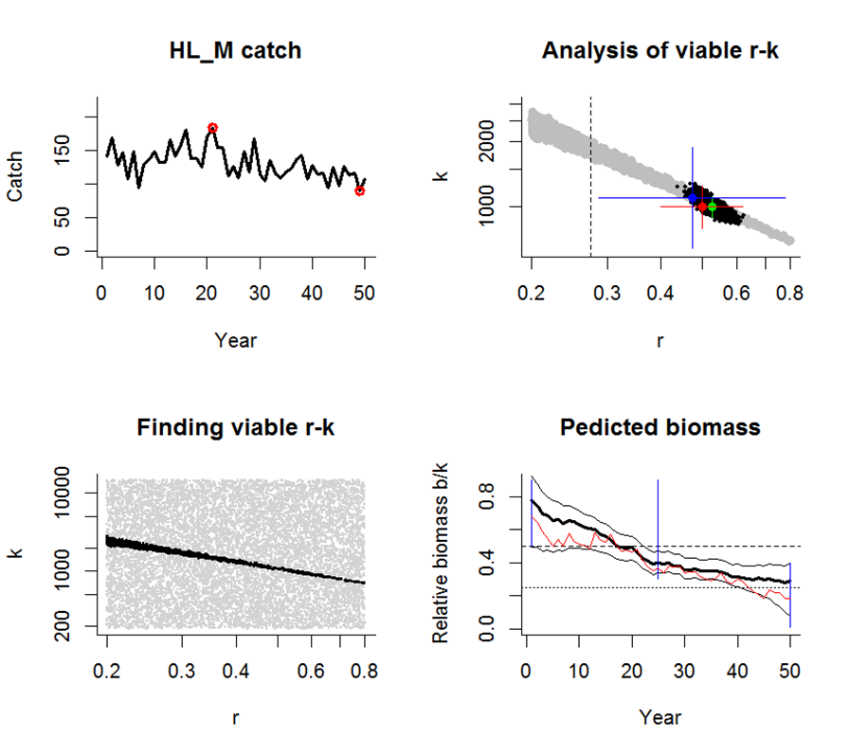
CMSY Simulation testing I
Simulated high to low biomass, for a species with medium resilience

Slide 7
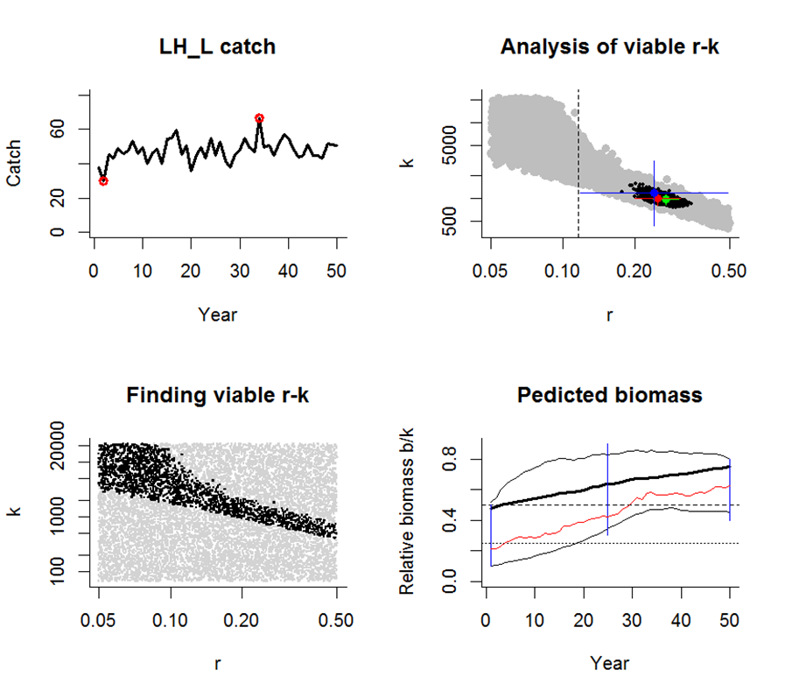
CMSY Simulation testing II
Simulated low to high biomass, for a species with low resilience

Slide 8
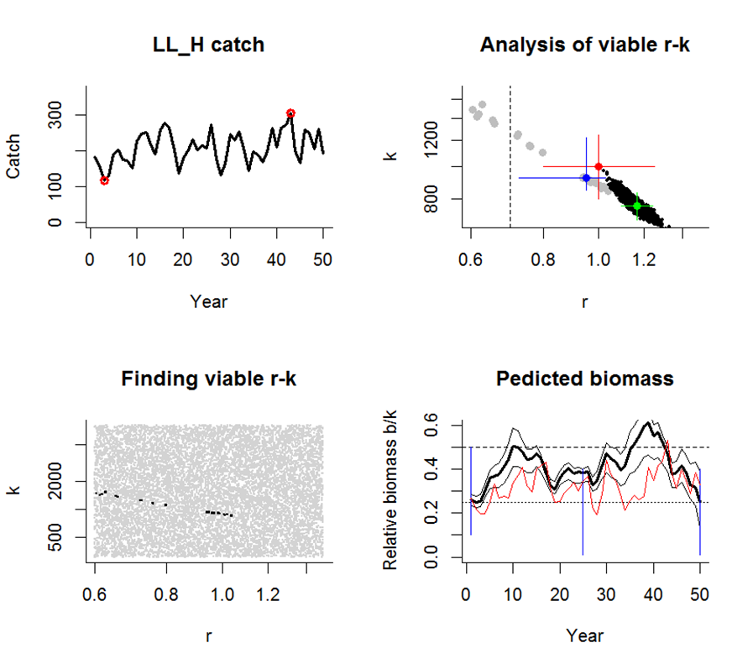
CMSY Simulation testing III
Simulated constant low biomass, for a species with high resilience

Slide 9
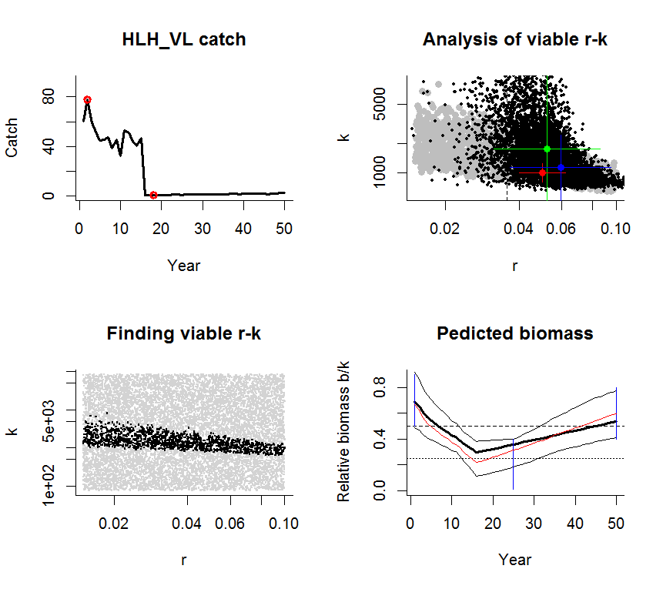
CMSY Simulation testing IV
Simulated high-low-high biomass, for a species with very low resilience

Slide 10
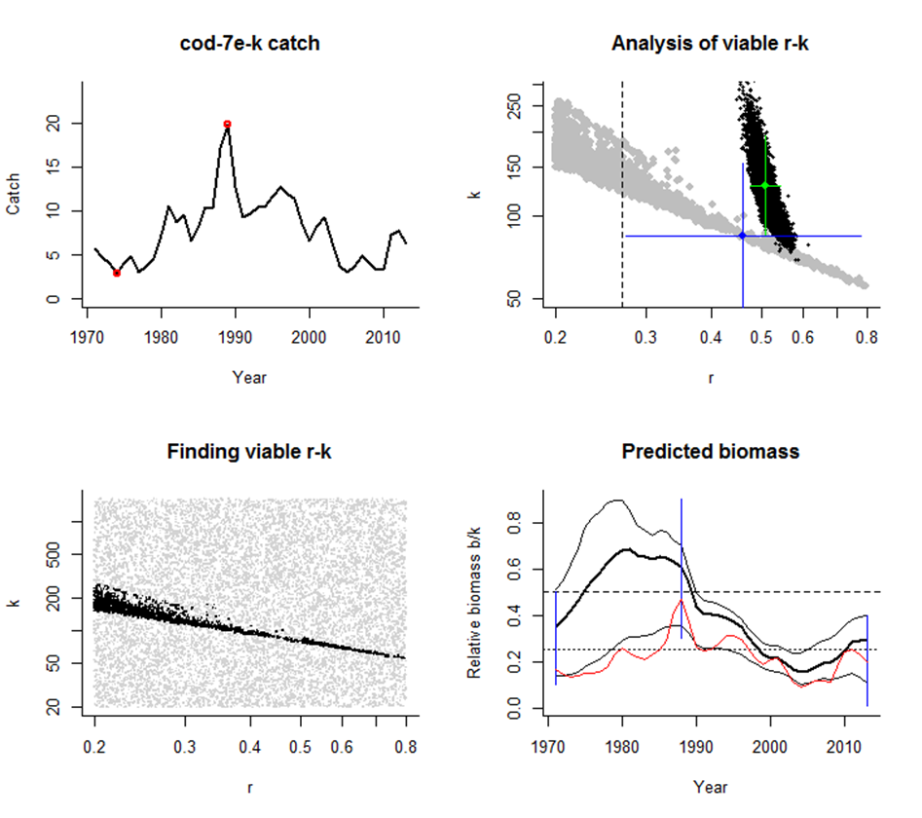
CMSY Evaluation I
Evaluation testing against full assessment data for Celtic Sea cod

Slide 11
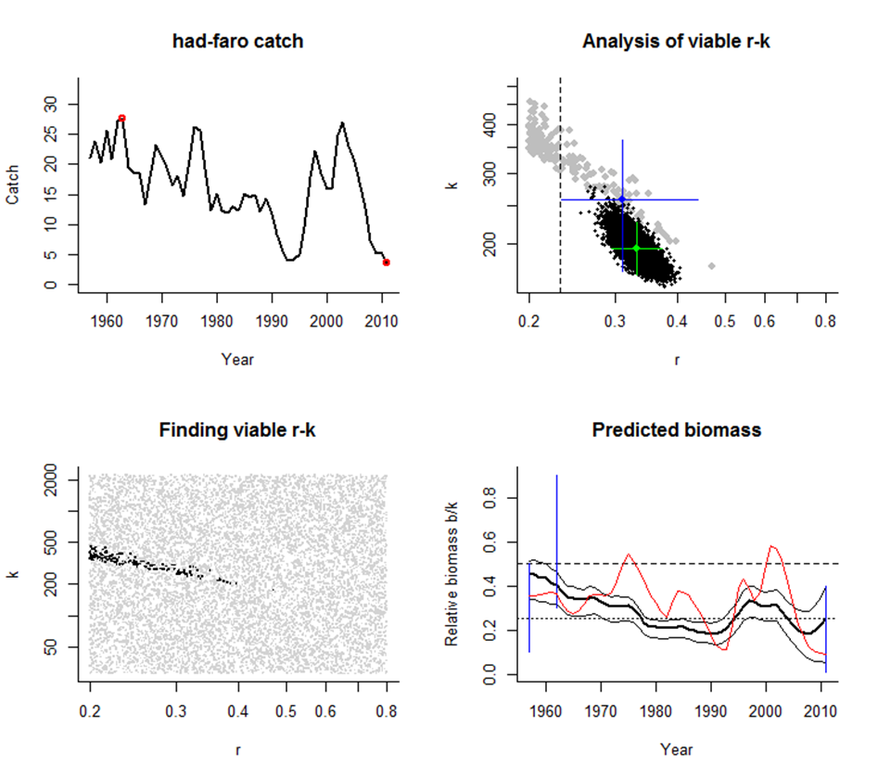
CMSY Evaluation II
Evaluation testing against full assessment data for Faroe Haddock

Slide 12
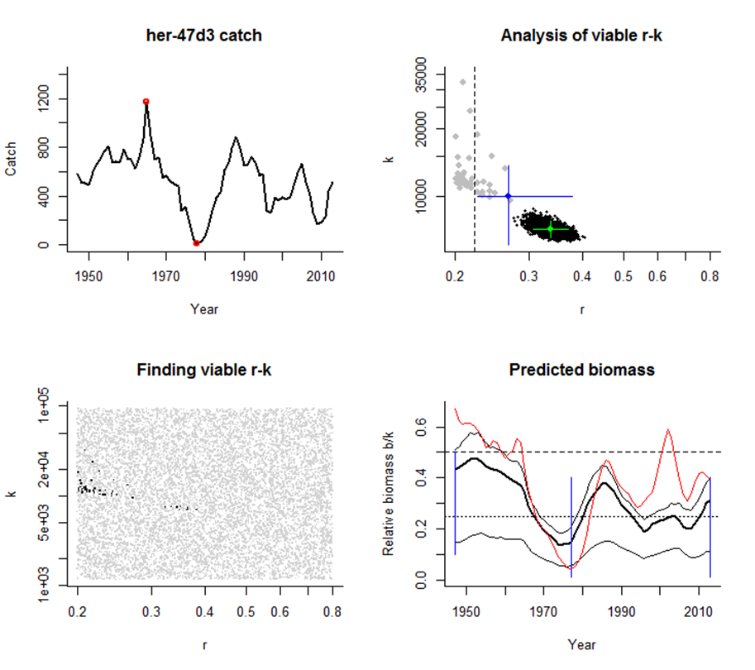
CMSY Evaluation III
Evaluation testing against full assessment data for North Sea herring

Slide 13
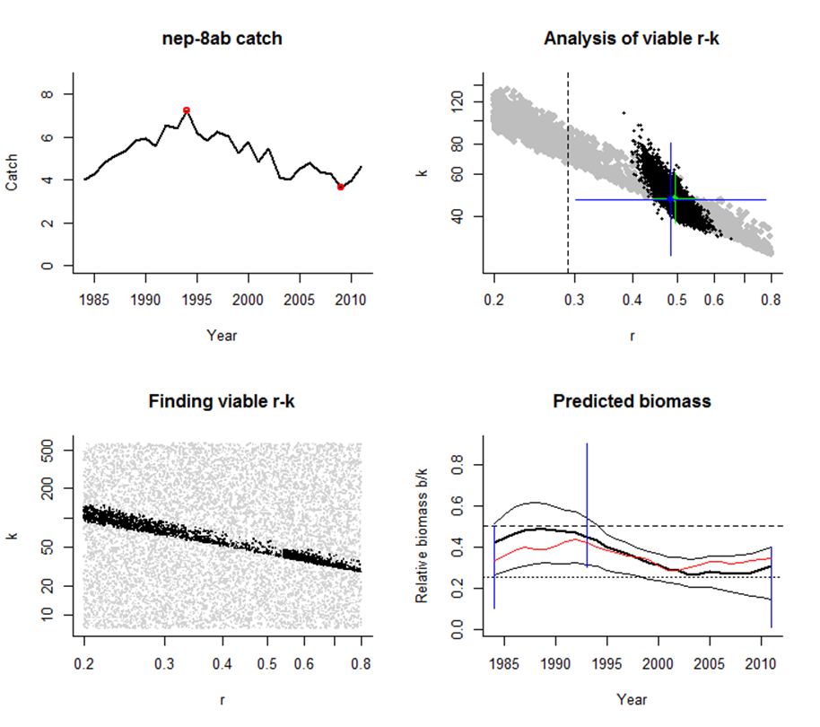
CMSY Evaluation I
Evaluation testing against full assessment data for Norway lobster in the Bay of Biscay

Slide 14
Results So Far
CMSY is still a work in progress. Results so far for 24 simulated scenarios and 100+ fully assessed stocks are very promising. The results for the simulated stocks are available in the drop box as CMSYvsSim7.docx. If you have more fully assessed stocks for us to test, please let me know.

Slide 15
Using Stock-Recruitment Data to Estimate B_{msy}
Froese et al. in press

Slide 16
Using 2*B_{pa} as Proxy for B_{msy}
ICES gives B_{pa} for all fully assessed stocks.
B_{pa} marks the stock size below which recruitment may be compromised
This is usually expected at 0.2 B₀ (Beddington & Cooke 1983)
B_{msy} is expected between 0.37 B₀ (Fox 1975) and 0.5 B₀ (Schaefer 1954)
2 * B_{pa} = 0.4 B₀ is therefore a not-too-ambitious proxy for B_{msy}

Slide 17
Using 2 * MSY Btrigger as Proxy for B_{msy}
ICES defines MSY Btrigger as “A level of SSB below which the stock is outside the range of values associated with SSBmsy.”
ICES proposes MSY Btrigger, which has the lowest probability of being Bmsy, as a proxy for the highest probability of being Bmsy
ICES stock assessment groups are using B_{pa} as proxy for MSY Btrigger
2 * MSY Btrigger is therefore another not-too-ambitious proxy for B_{msy}

Slide 18
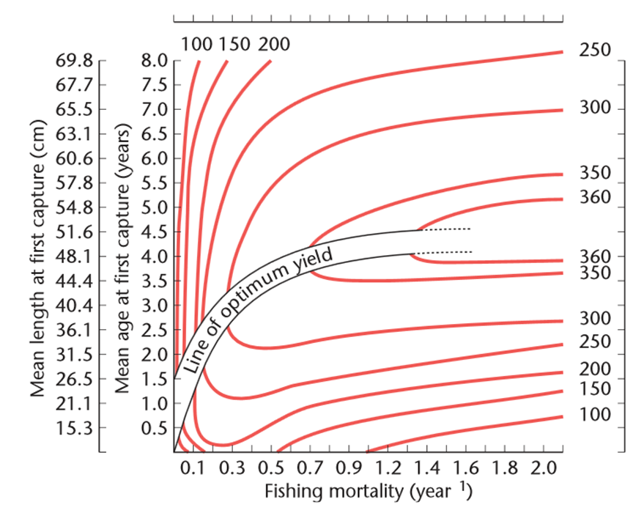
Using Yield-per-Recruit Analysis
Yield per recruit as a function of F and Lc (Beverton & Holt 1957).

Slide 19
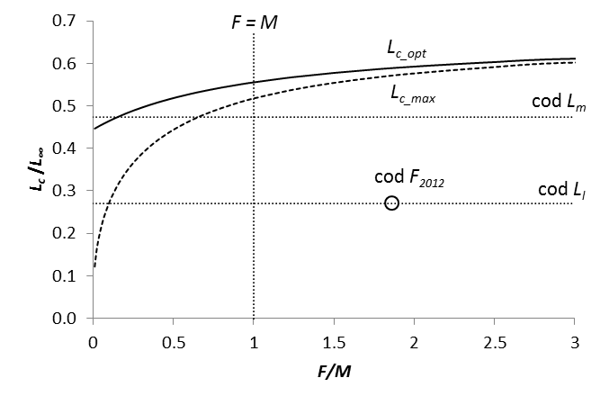
Using Yield-per-Recruit Analysis
For every F, there is a corresponding length-at-first-capture (L_{c}) that maximizes catch (dashed
L_{c_max} curve) or that maximizes catch and increases biomass (solid L_{c_opt} curve, Froese et al.,
in prep.)

Slide 20
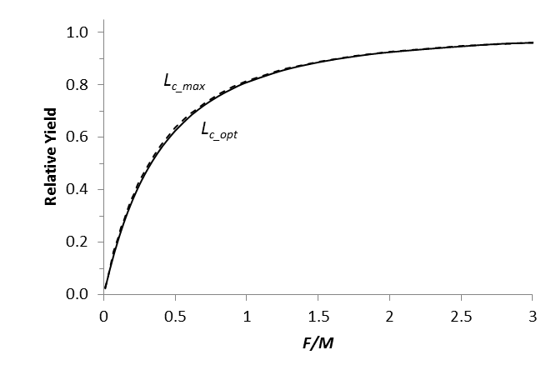
Using Yield-per-Recruit Analysis
For a given F, starting fishing at Lc_opt gives the same yield as starting fishing at Lc_max

Slide 21
Using Yield-per-Recruit Analysis
In the area of reasonable fishing, yield lines are nearly parallel to the length-at-first-capture axis.

Slide 22
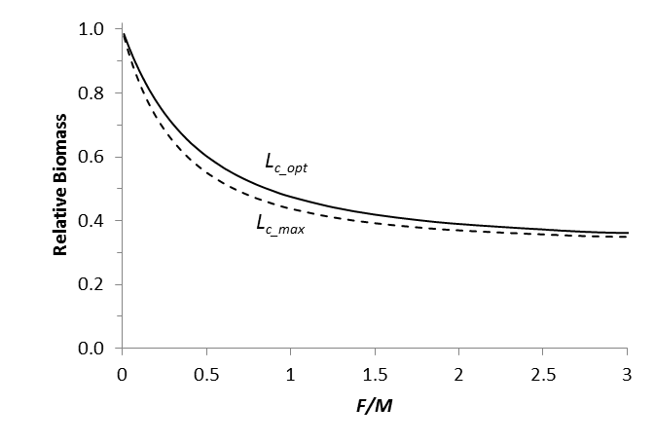
Using Yield-per-Recruit Analysis
For a given F, starting fishing at L_{c_opt} gives higher biomass than starting at L_{c_max}

Slide 23
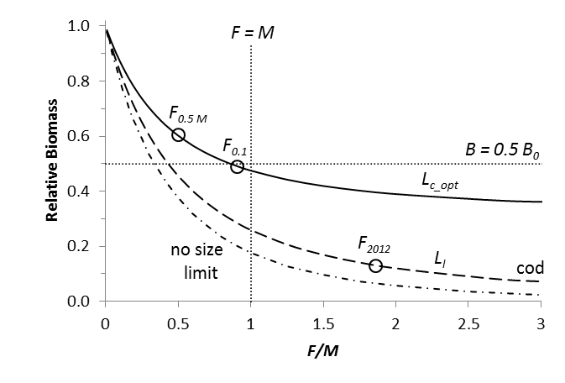
Using Yield-per-Recruit Analysis

Slide 24
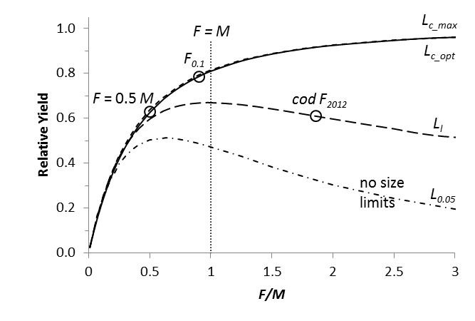
Using Yield-per-Recruit Analysis

Slide 25
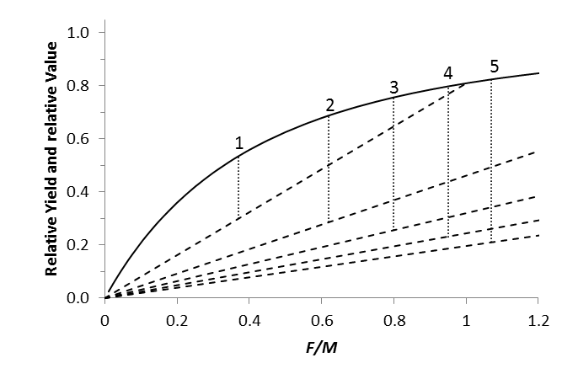
Follow the Money…

Slide 26
Thank You

